Slide 1
Skills for Care Update
Helen Jackson helen.Jackson@skillsforcare.org.uk

Slide 2
Adult Social Care Workforce Data Set
(ASC WDS)
Notes:
I would be interested if you are happy to share in the chat if you have heard of ASC WDS, if you have an account and any barriers to you using it?

Slide 3
The Adult Social Care Workforce Data Set
ASC-WDS is a free data collection service, commissioned and funded by the Department of Health and Social Care. It is the leading source of intelligence for the adult social care workforce. It helps you to manage your team and provides crucial information to decision makers.
Notes:
The Adult Social Care Workforce Data Set (ASC-WDS) is a data collection service, commissioned and funded by the Department of Health and Social Care. It is the leading source of intelligence for the adult social care workforce.
We know that the adult social care sector is complex and fragmented and made up of thousands of different care providers. And, we know that understanding the workforce is so important for planning and decision making across the sector- and that’s what we’re trying to do with ASC-WDS- to build that understanding.

Slide 4


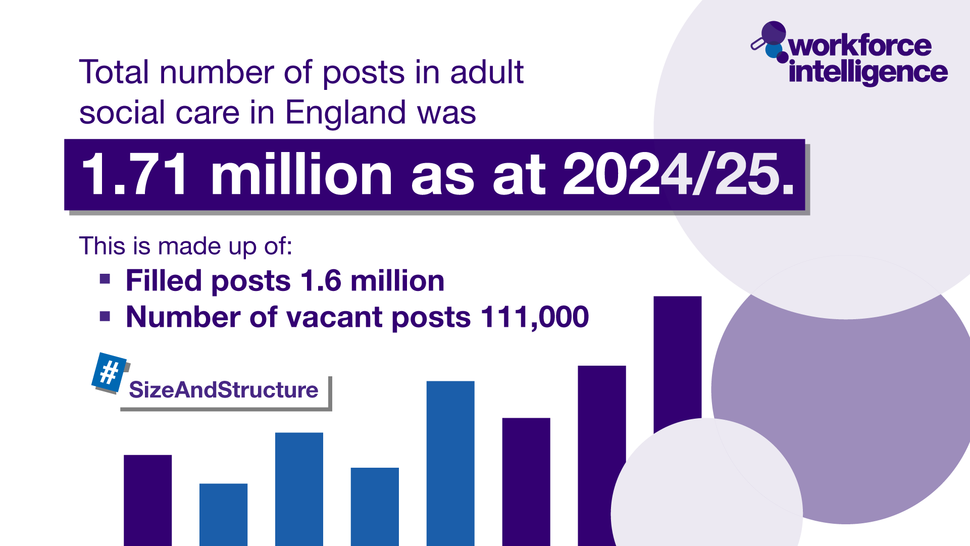

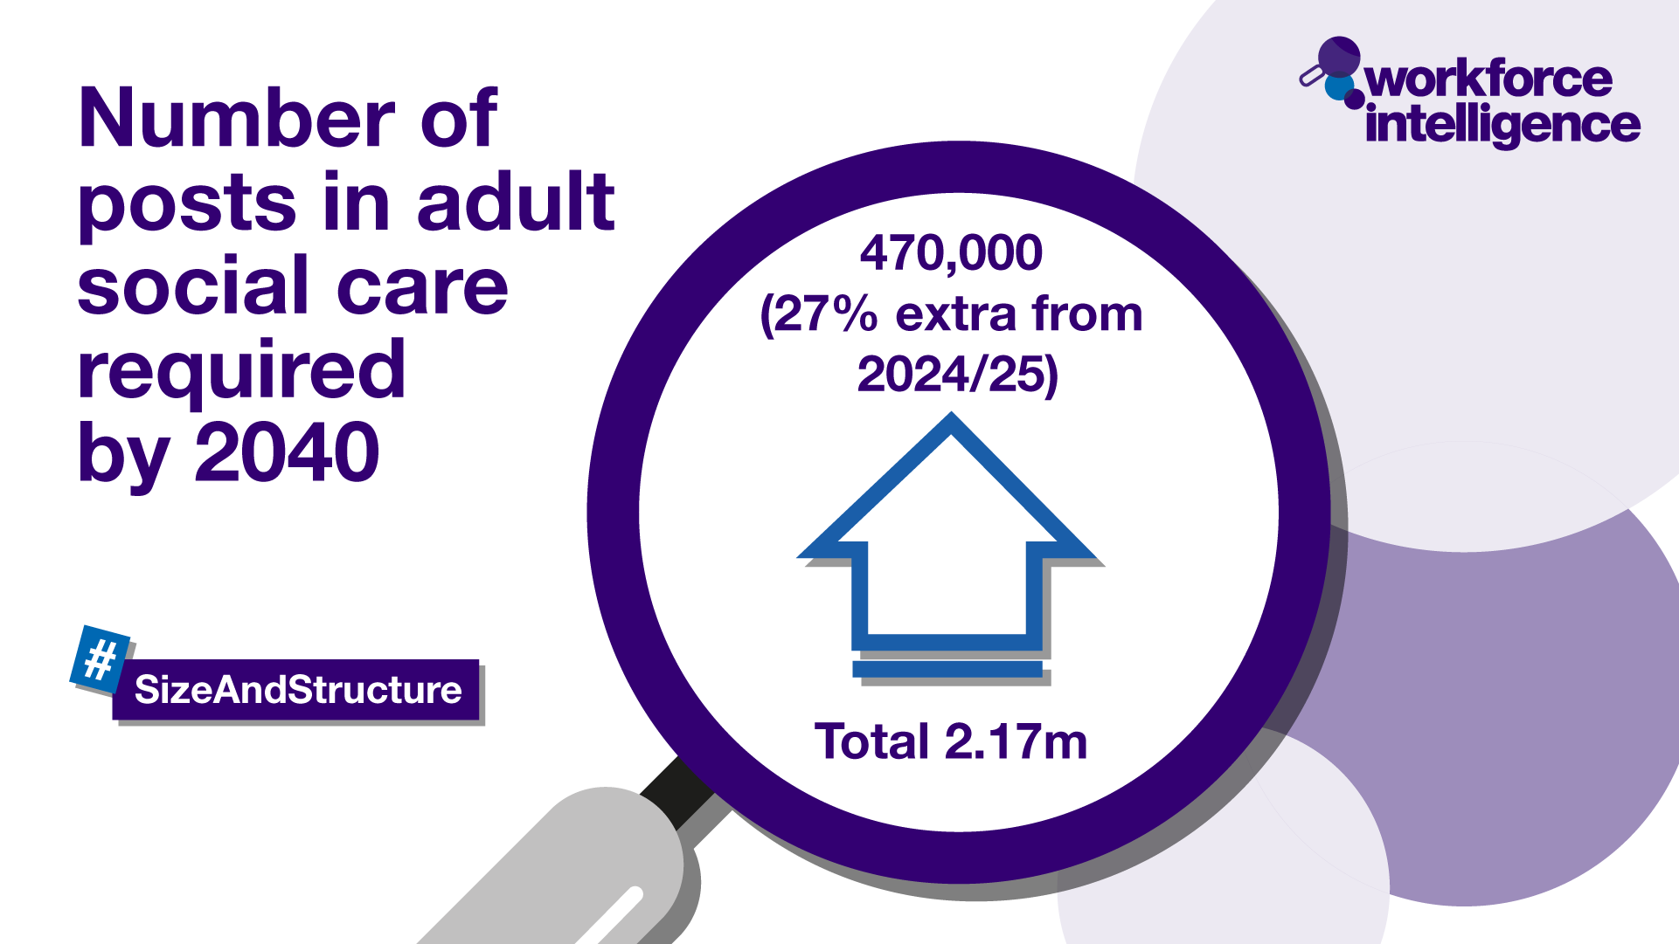










The Adult Social Care Workforce Data Set
Our crucial intelligence is used by:
Who we are regulated by:
Notes:
ASC-WDS means that all care providers can make their voice heard. Around 21,000 providers already have an account and are providing us with crucial information.
The information is used by decision makers such as government, the Department of Health and Social Care, the Care Quality Commission, ICSs and local authorities.
The data from those providers tells us…
There are one point seven one million posts in ASC
That one point four seven million people work in ASC in England, 29,000 posts in ASC in Norfolk
It tells us that ASC vacancy rate nationally is 7%.This has fallen since previous years but still remains 3 x higher than the wider economic average
It tells us that 26% of the workforce in Suffolk are aged 55 and over so in the next 10 years could be looking to reduce hours or retire
It also tells us that we’ll need 470,000 more jobs by 2040 to keep up with an aging population
So by contributing to ASC-WDS, you can help us build a detailed picture of the sector and highlight the areas that most need support.

Slide 5



Benefits to your business
Funding for training your staff
Safe and free storage of staff records
Manage training records
Benchmark your workplace
Access the ASC-WDS Benefits Bundle
Share data with CQC & LA ready for inspection
Notes:
We understand that time is precious in the sector so it is important to take a moment to reflect on the benefits to having an ASC-WDS account? Well…
Input your service information to help decision makers understand the sector
You can gain access to funding for training your staff
The system provides safe and free storage of staff records
It can help you to manage your training records
You can benchmark your workplace against other providers in your area, for metrics like pay, turnover rates or staff sickness.

Slide 6
Register for an account
Is your service CQC registered? ​
If yes - find your workplace using your CQC location ID or postcode ​
If no – find your workplace using your postcode​
Main service ​
Employer type​
Number of staff​
User account details: your name, job title, email address and contact number ​
User name, password and security question.​
Submit your registration
Notes:
If you do not already have an account getting set up is really easy, you’ll just need to answer a few questions, then your registration goes to the support team to be approved. ​
​
Is your service CQC registered? Yes/no options. Doesn't matter if you are or not, you can still create an account.​
​
Find your workplace using your CQC location ID or the postcode for your workplace. ​
​
We’ll ask you what the main service you provide is. ​
​
What is your employer type? Local authority, Private sector, Voluntary, charity, not for profit, other​
​
How many members of staff does your workplace have? The number should include all staff (care-providing and none care-providing, those on permanent or temporary contracts, pool, bank and agency workers). You can enter an estimate at this stage and update once your registration is confirmed. ​
​
We’ll ask for your user account details: your name, job title, email address and contact number ​
​
You will then set your user name, password and security question. ​
​
Submit your registration which gets checked and validated by our support team. ​
​
They’ll notify you by email when you can log in to your account.

Slide 7
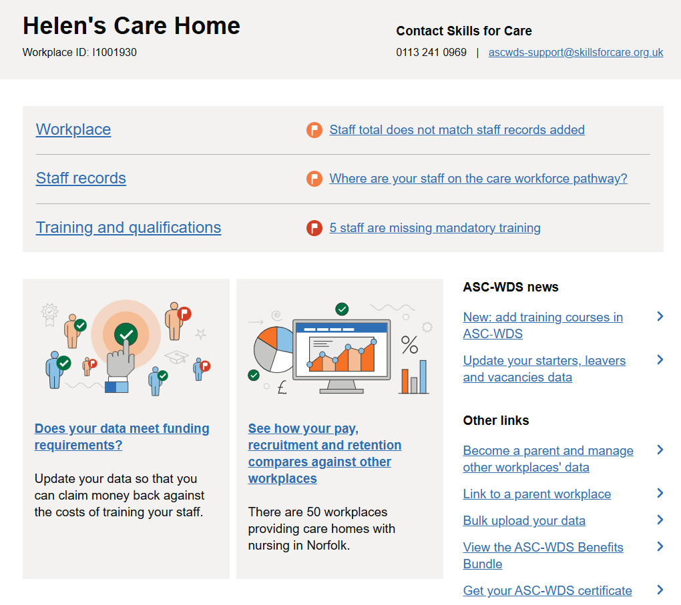
Notes:
Once an account is created you can log in and start to add details about your
Workplace
Staff records
These are mandatory sections which need to be completed if you wish to access funds for staff training and qualifications through LDSS
There is also an additional section for training and qualifications but this is not mandatory to be completed for providers to be eligible to claim LDSS
On the bottom left there is a link to follow called ‘does your data meet funding requirement’

Slide 8
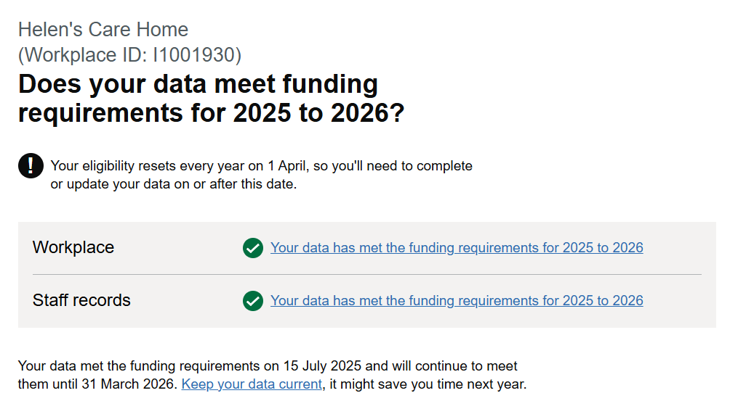
Notes:
If you click on the does my data meet funding requirements for 2025-2026
It shows on the green tick that my data has meet funding eligibility, if it had not there was would a flag there and it would detail exactly what needs to be completed or updated to meet funding eligibility
If we now move on to look at the workplace and staff records tabs which are the 2 mandatory sections which need to be completed to be eligable to claim LDSS

Slide 9
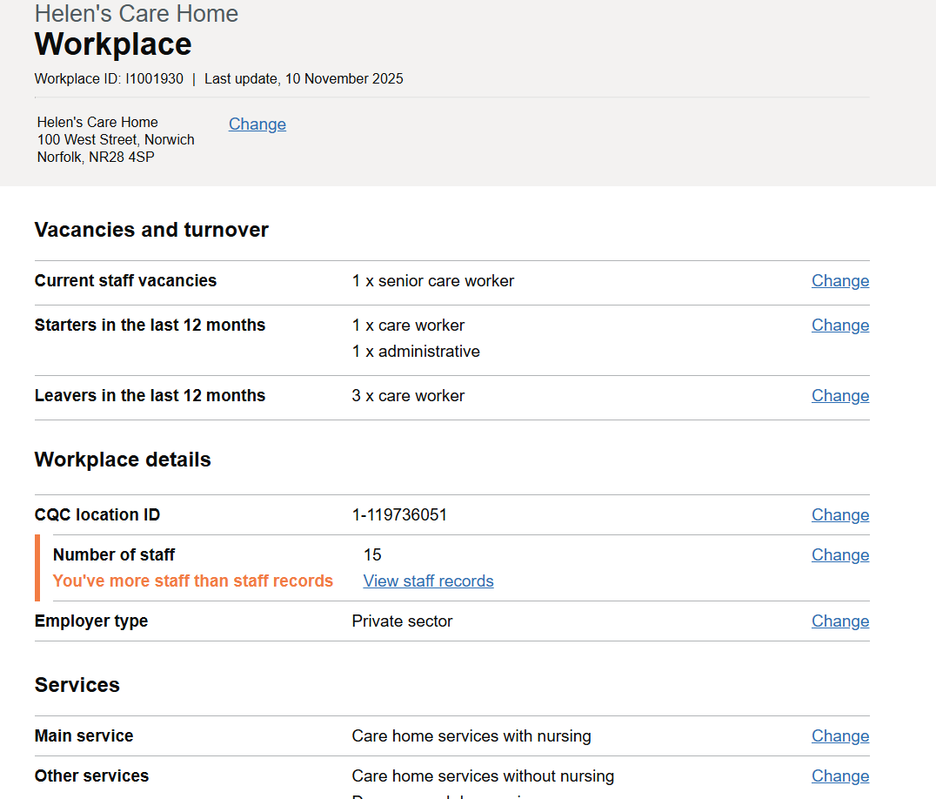
Notes:
The workplace section will ask you information about your workplace including
Current vacancies
Leavers in the last 12 months
Main service offered
Service capacity
Service user need
If you carry out delegated healthcare and which activities
There are 12 mandatory questions that’s it.

Slide 10
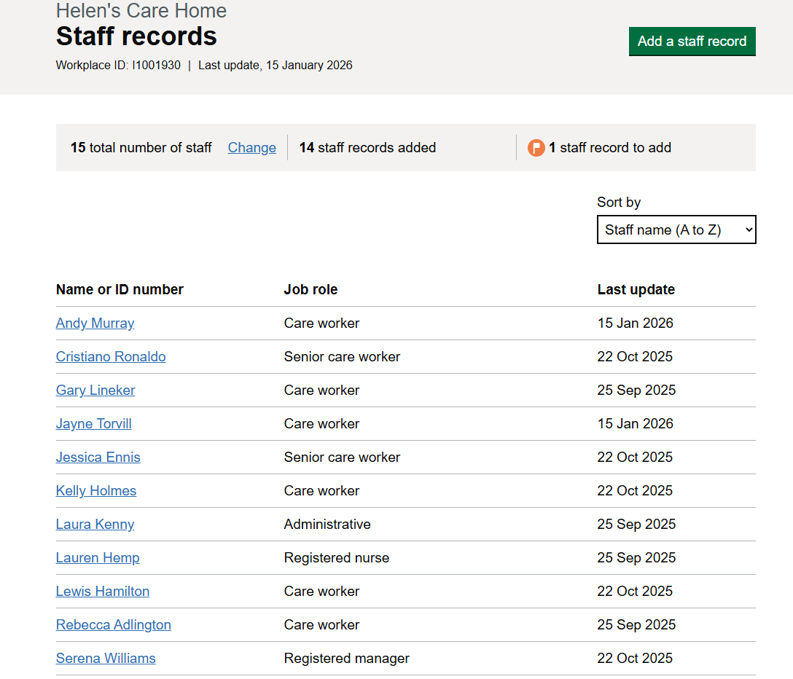
Notes:
Staff records will ask you for details for each staff member
It asks 21 questions about each staff member, many of these being questions which you will likely know such as permanent or temporary contract, rate of pay, job role, contracted hours, gender, nationally and qualifications held.
You do not have to have added all of your staff members immediately to be eligible to claim LDSS but you do have to have added details for the staff members you wish to claim funding for training through LDSS
So if I had a care assistant who wanted to complete their level 3 to work towards a team leader role I would prioritise adding their details.
If I had an activity coordinator who wanted to complete further training on activity provision in social care I would prioritise adding their details.

Slide 11
Learning and Development Support Scheme (LDSS)
Notes:
Again I would be interested to know via the chat if any of you have accessed funding through LDSS and if not what have been your barriers, we do report directly back to the department of health and social care so your insight into how we can support the system to meet your needs is vital

Slide 12
What is the Adult Social Care Learning and Development Support Scheme (LDSS)?
Launched in September 2024 by the Department of Health and Social Care, the LDSS supports the non-regulated care workforce to complete courses and qualifications by providing a financial contribution to the costs of training.
Why is this funding available?
Ensuring the availability of relevant upskilling opportunities for care staff is an essential part of our work to support the professionalisation of the care workforce. By completing courses and qualifications, care workers can gain recognition for their existing expertise, as well as developing new skills and specialisms.
Who can benefit?
The non-regulated care workforce can undertake courses and qualifications supported by funding from DHSC. An upskilled workforce can bring recruitment and retention benefits to employers, while improving the quality of care.
Notes:
Completion of ASC WDS is linked to the Adult Social Care Learning and Development Support Scheme.
Launched in September 2024 by the Department of Health and Social Care, the LDSS supports the non-regulated care workforce to complete courses and qualifications by providing a financial contribution to the costs of training. LDSS is 12 million pound fund to support access to quality assured training courses for the adult social care.
This is not an endless fund and it is important for providers to look at their workforce plan early in the financial year including what training needs their staff team have and apply for funding as soon after 1st April to ensure claims are successful, if claims are left later in the financial year towards February and March then funds could no longer be available.
This funding is provided by DHSC to fund relevant upskilling opportunities for care staff, this is an essential part of our work to support the professionalisation of the care workforce. By completing courses and qualifications, care workers can gain recognition for their existing expertise, as well as developing new skills and specialisms.

Slide 13
Who can access the funding?
LDSS funding can only be used towards courses and qualifications undertaken by eligible staff, who must be non-regulated members of the care workforce in England.
This includes care staff, deputy and Care Quality Commission-registered managers, and agency staff
Those without British citizenship are eligible as long as they have a UK national insurance number and are legally employed in England.
Funding must be claimed by an employer of eligible staff. The employer (including local authorities) must meet the following criteria:
provide an adult social care service
directly employ care staff in England
have an up-to-date account on the Adult Social Care Workforce Data Set (ASC-WDS)
There is no requirement for care providing organisations to be CQC registered to claim from this fund.
Notes:
Who can access LDSS funding?
LDSS funding can only be used towards courses and qualifications undertaken by eligible staff, who must be non-regulated members of the care workforce in England. This means staff who are not registered nurses, social workers or OTs. A registered nurse, social worker to OT who is working as a registered manager can claim funds through their role as a registered manager.
Those without British citizenship are eligible as long as they have a UK national insurance number and are legally employed in England.
So to confirm to be eligible staff have to non regulated and work legally in ASC in England.
Funding must be claimed by an employer of eligible staff. The employer must meet 3 criteria:
provide an adult social care service
directly employ care staff in England
have an up-to-date account on the Adult Social Care Workforce Data Set (ASC-WDS)
There is no requirement for care providing organisations to be CQC registered to claim from this fund.

Slide 14
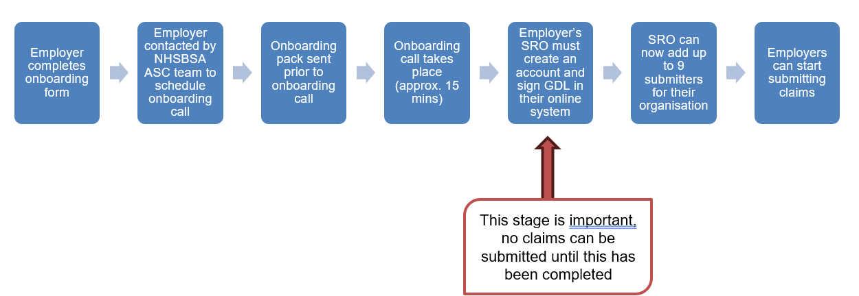
LDSS application system
Claims for reimbursement are being made through a digital online claims service.
Notes:
Skills for Care support and manage the ASC WDS. LDSS funds are managed by NHS BSA, business service authority.
Claims for reimbursement are being made through a NHS BSA digital online claims service
The provider completes an onboarding form and arranges an onboarding call, which takes about 15 minutes then they can create an account and start submitting claims
It is important to note an organization must have identified a Senior Responsible Officer (SRO) who will signed the grant determination letter (GDL) in the application process before any claims can be submitted. Once this has been completed, they can then add up to nine submitters to their organisation’s account.
Funding for a training course is provided on submission evidence, evidence required is detailed on the submission form but can include the invoice or certificate
Funding for a training course can be provided on completion of the course with submission of evidence.
Funding for a qualification can be provided on completion or providers can claim 60% when the course is started and then the remaining 40% on completion and receipt of a certificate.

Slide 15
Eligible training
Eligible training courses and qualifications - GOV.UK
Leadership modules
Digital leadership
Mental health first aid
Dementia care
Palliative care
Awareness and prevention of falls
Oral care for health and social care
Activity provision in social care
OMMT Tier 1 and Tier 2
Notes:
Providers have told us that it is important to have training offered that is quality assured, this means that it is reviewed to ensure that it offers best practice to the sector.
You do need to use one of the quality assured training providers to ensure you are eligible to claim the funding, if you follow the attached link this will take you to a list of courses available and which providers are quality assured.
Courses which are available include
Leadership and management including level 5 diplomas
Digital leadership
Understanding working in mental health
Mental health first aid
Positive behavioural support
Level 3 award in education and training to support delivery of in house training
Level 2 adult social care certificate
Understanding principles and practice of assessment – useful for team leaders
Level 4 award in understanding internal quality assurance assessment, processes and practice – this is useful for succession planning and developing aspiring managers
Level 2 and 3 qualifications in subjects such as dementia and end of life, understanding diabetes care and management, safe handling of medications, awareness and prevention of falls , understanding nutrition and health, oral care for health and social care, stroke awareness, activity provision in social care
These could be utilised to to support development of champions within your service to help an environment where learning and improving standards of care are embedded in everyday practice and culture.
There was additional funds added to LDSS for the current financial year to support with OMMT tier 1 and 2

Slide 16
The Care Workforce Pathway
Notes:
Again I would be interested if you are happy to add to the chat, who has heard of CWP and if any one has started implementation of CW in your organisation

Slide 17
Defining the Pathway
A flexible, universal career structure for Adult Social Care
Clearly defined role categories
Role specific knowledge, skills and behaviours
Universal role values
Example role personas
Role specific learning opportunities
Focused tools and resources
The Pathway is a career structure which applies to practical care settings and includes roles employed in Adult Social Care or those directly provided by Local Authorities.
It covers those who deliver, coordinate, and manage care, and also recognises the vital support of ancillary staff who help make care possible.
The Pathway is not ‘mandatory’, but it’s strategically important, because transforming adult social care starts with investing in the people who deliver it.

Slide 18

What the Pathway aims to do
The Pathway is a universal career structure for the adult social care sector, which aims to:
Professionalise non-regulated adult social care roles
Improve recruitment and retention of the adult social care workforce
Enhance the quality and standards of care provided through a skilled, confident and competent workforce
Promote adult social care as a viable and rewarding long-term career option
Sets clear expectations for training, development and competence
Supports workforce planning for now, and the future

Slide 19
The Pathway’s values
“Values are often talked about but can feel spongy and intangible. They can also be taken for granted, appearing straightforward and noncontroversial.
The reality is more complex, at their heart they are based on beliefs about what we think is right or wrong.
For people who draw on care and support, receiving their support from workers who have the right skills, knowledge and training is important, but if they don’t hold the right values, people are unlikely to experience good person-centred care and support.
Values translate into behaviour, and that’s what people experience in their care and support, day to day. This is why they are so important.”
Kind, compassionate and empathetic
See the whole person
Honest, trustworthy and reliable
Flexible, open and learning
Respect
Proud and positive
Courageous and principled
Values-and-the-workforce-TLAP-report.pdf
Notes:
Ther care workforce pathway has been developed with a range of stakeholders across ASC including a range of providers, the NHS and LA
Lets a take a more detailed look at the pathway starting with the universal pathway values

Slide 20
Role categories
Published Roles
New to Care | Care / Support Worker | Personal Assistant | Enhanced Care Worker | Supervisor / Leader | Practice Leader | Deputy Manager | Registered Manager
Roles currently in development
Nominated Individual | Care/Digital Technologist | Activities Co-Ordinator
Quality Assurance | Learning and Development | Corporate middle / senior managers
Corporate admin roles | Ancillary roles
Notes:
These are the current published roles and roles currently in development.
The term role categories has been used to allow the sector to use the pathway flexibly as we understand different organisations will have different role names for roles with similar key duties

Slide 21
Currently published role categories
New to Care | Care/Support Worker | Personal Assistant | Enhanced Care Worker | Supervisor/ Leader | Practice Leader | Deputy Manager | Registered Manager
Entry point for individuals with no prior experience in social care. | Provides direct care and support to individuals | Provides support and is directly employed by the person being supported or their representative. | Delivers more complex care, including delegated healthcare tasks. | Leads a team and supports care delivery. | Leads on specialist practice and supports others to improve. | Supports the Registered Manager in running the service. | Leads the service and ensures regulatory and legal compliance.
Key duties: Focused on learning and induction Shadowing and basic support tasks No independent responsibilities Ideal for probation or onboarding phase | Key duties: Personal care (washing, dressing, toileting) Assistance with eating and mobility Supporting access to activities and community Promoting independence and wellbeing May require clinical oversight depending on duties | Key duties: One-to-one, person-directed support across daily living, social, employment and health-related tasks Flexible, personalised care based on individual preferences and routines No formal leadership responsibilities; Works independently under the direction of the person drawing on care | Key duties: Condition-specific or specialist support Delegated healthcare tasks from professionals (e.g. Nurses, OTs) Requires additional, auditable training Requires ongoing competency assessments No leadership responsibilities | Key duties: Supervises care staff Supports staff development May manage rotas or shift planning Acts as a point of escalation Explores career progression into practice or management | Key duties: Develops and maintains a specialism Coaches and mentors others Leads on best practice in a specific area Stays up to date with sector developments Drives quality improvement in practice | Key duties: People management and staff development Supports decision-making and service delivery Acts as manager in the registered managers absence Helps ensure regulatory compliance May be preparing for a registered manager role | Key duties: Strategic and operational leadership Ensures safe, person-centred care Staff training, recognition, and support Regulatory compliance and inspections Makes informed decisions about service delivery

Slide 22
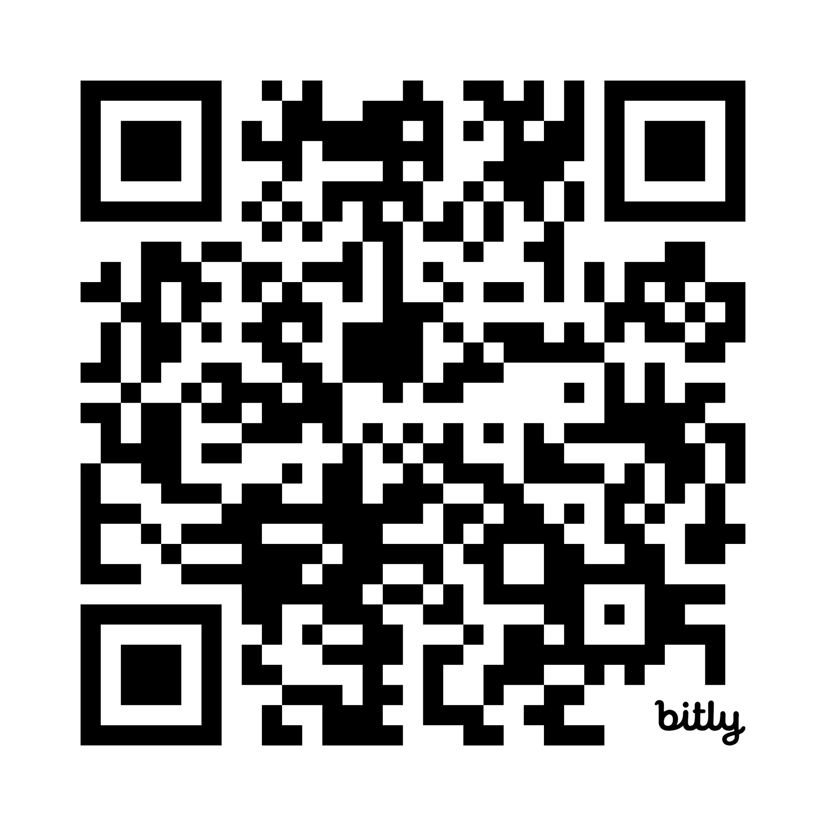
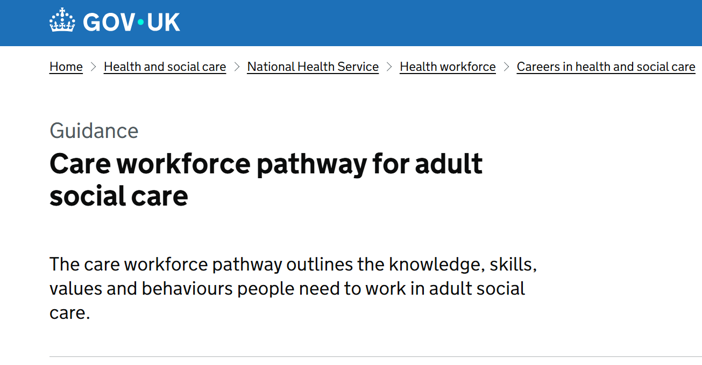
Find out more about the Care Workforce Pathway
Notes:
If you wanted to look at further dteail about those role categories information and be found using the QR which will take yoy to Gov.co.uk. Here there is further detail on the role categories and what the knowledge, skills and behaviours are for each role category as well as those universal values.

Slide 23
Benefits of the Pathway
Adult Social Care Staff
Improved motivation, capability and confidence. Improved sense of feeling valued. Improved perception of being viewed as a respected and skilled professional. Improved sense of career ownership and self-directed learning and development. Improved knowledge of opportunities to move and progress within the sector.
Adult Social Care Employers
Improved supervision and support. Improved recruitment and retention. Strengthening of positive workplace culture. Reduced recruitment costs. Reduced duplication and waste in workforce development spending. Improved succession planning. Improved competency.
Notes:
If the audience are Workers:
Having recognised qualifications and certifications aligned to their role not only increases their own competencies, but also credibility in their field of practice; boosts confidence in their abilities
Positive driver for financial and social mobility via career progression (in theory more upskilling and competency development equates to more pay)
Supports career mapping into clinical roles – how to go from a support worker to OT.
It gives the opportunity to enhance their skills and expertise, giving a route into practice specialisms
For long established workforce, the CWP knowledge and skills outline can support new areas of learning and development
For the profession:
By having knowledge and skills quality standards, along with values, a professional social care workforce supports building public trust and reputation. Training and development standards/baseline requirements, ensure standardisation of competancy and skills, which ensures better quality of care outcomes, sand safeguarding from unethical practice
Standardisation and best practice across the sector will lead to more consistent and higher quality of care, and where there is a focus on CPD, innovation and he adoption of new techniques and knowledge will take place (growth mindset)

Slide 24
Benefits of the Pathway
Our sector
Positive changes in the right individuals entering and staying within the sector. Improved diversity of talent and experience throughout the sector. Improved capacity within the sector to meet existing and future demand. Strengthening of the sector through unity. Improving the sector’s ability to influence national policy and system changes. Improving digital training and integration.
Those drawing upon care and support
Improved quality, consistency and experience of those drawing upon care and support. Improved representation ie those drawing upon care and support see themselves in the professionals who care for them. Improved safety and wellbeing.
Notes:
If the audience are service users:
Having a baseline for what quality care and support looks like, the behaviours and values, supported by formal learning & development, enhances safeguarding practice; protecting service users and others from abuse and neglect. E.g. lack of training around person centred cared can lead to discriminatory and/or abusive practice
Staff are better able to recognise early signs of abuse and neglect (they know what good quality care looks like and what bad care would then be), including self-neglect and can positive support service users to keep safe
Staff who know how to communicate with those who have special needs in an accessible way, enable service users to easily tell them when something is wrong
Competent staff are aware of and can apply pertinent legislation such as the Mental Capacity Act 2005; making sure decisions and made in that service users' best interests, being an advocate (formal or informally) for the service user
A competent workforce will take a proactive approach towards harm prevention
If the audience are employers:
Improved compliance from the workforce on policies, regulatory and any legislative requirements
Positive contribution to CQC expected standards and practice – this supports inspection outcomes
Increased quality and competency = reduced risk, reduced incidents = reduced costs (e.g. insurance)
Become an 'employer of choice', attracting talent and developing a talent pool
Trust and confidence from funders and customers
Better positioned re commissioning/tenders
Organisation fit for the future – complex care needs are growing, the need for specialisms are growing, eg. Dementia care

Slide 25
Explore the Pathway
What | Why | How
Get to know the Pathway to understand how it can support your organisation. | The Pathway can seem big at first and using it could lead to changes in your organisation. That’s why it’s important to start by thinking about what you want to achieve and how the Pathway can help. Once you’re clear on your goals, you can take it step by step, making changes at a pace that works for you, and your team. | Check out each of the role categories in the Pathway. They can all be found on the GOV.UK website and each contain knowledge, skills, behaviours and values.
Learn from other organisations who have been using the Pathway already. | Learning from others who are already using the Pathway can help you to: Build confidence by showing that change is possible and has worked in similar settings. Save time and resources by adopting proven ways of working instead of starting from scratch. Spark ideas and innovation by exploring different approaches and perspectives. Strengthen buy-in from teams by sharing real-world success stories that feel relatable and achievable. | Visit the Skills for Care website to find case studies and a podcast.

Slide 26
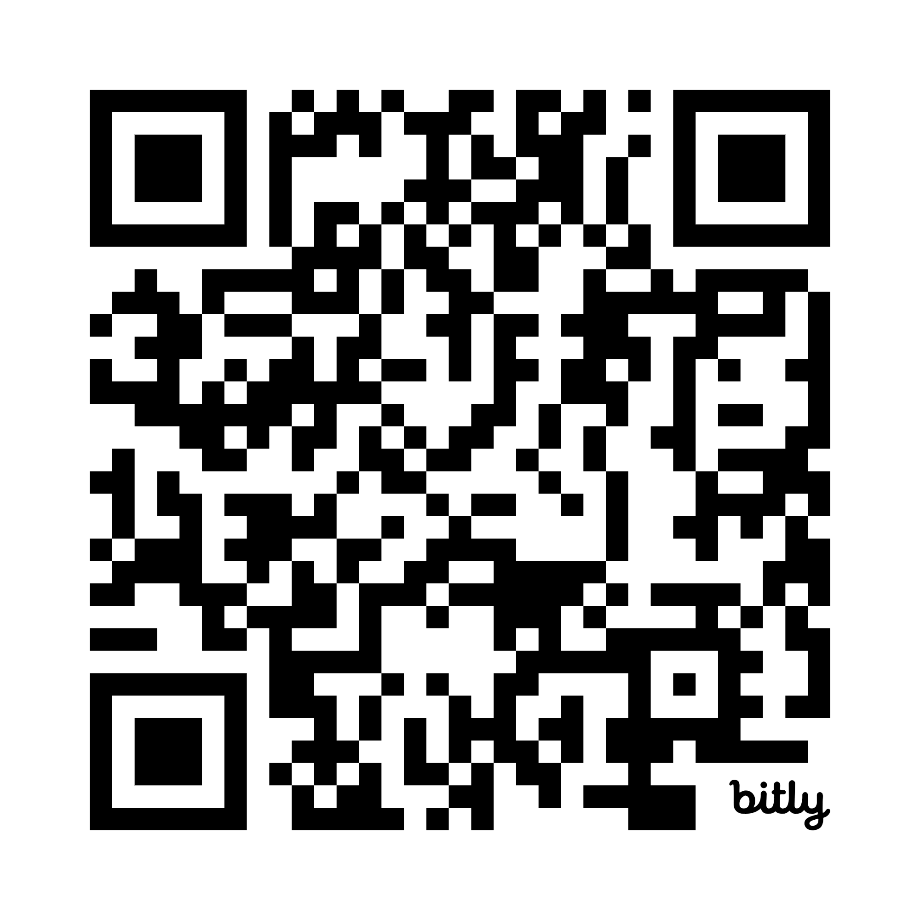

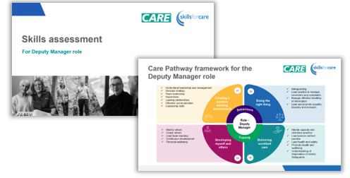
Care Workforce Pathway Resources

Slide 27
Any questions or thoughts

