Slide 1
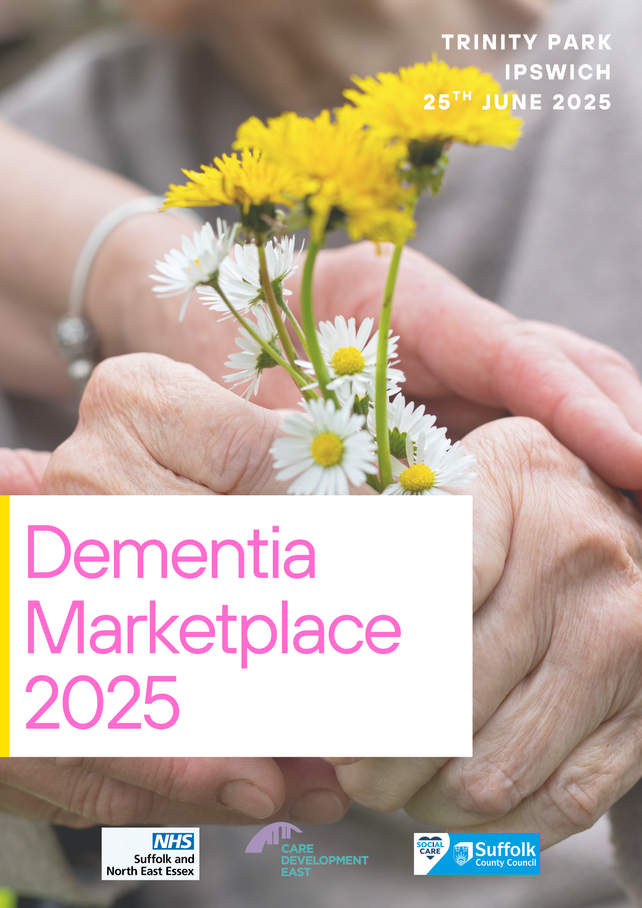
WELCOME

Slide 2
Dementia Marketplace 2025
What support is there in Suffolk for people with dementia and their carers?

Slide 3
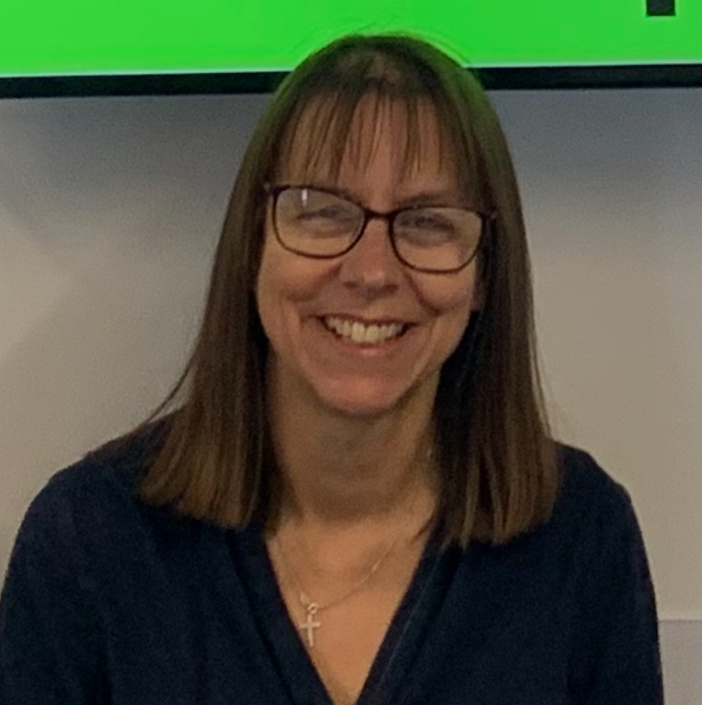
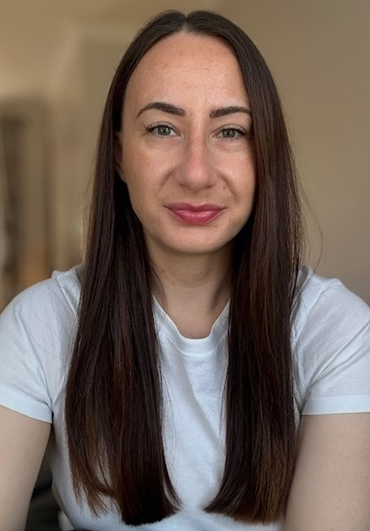
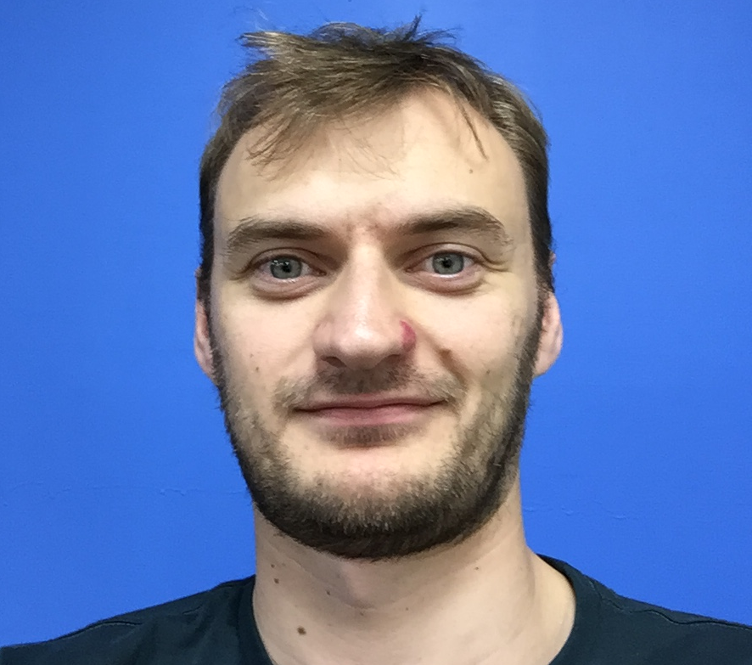
Presenters
Shaftesbury Suffolk Memory and Dementia Support Service (Ipswich, East and West Suffolk)
Jo Marshall
Alzheimer’s Society – Norfolk and Waveney Dementia Support Service
Hana Richardson
Suffolk Family Carers
Demi Smith
Adult Social Care -Supported Self Assessments
Ben Ankers

Slide 4
Shaftesbury Suffolk Memory and Dementia Support Service (Ipswich, East and West Suffolk) Jo Marshall

Slide 5
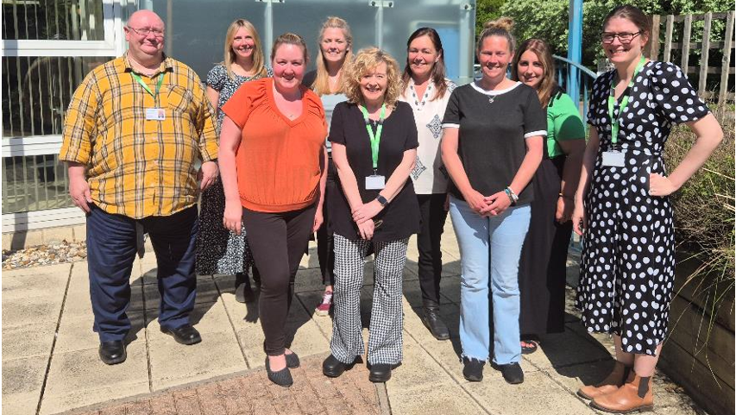
Shaftesbury Suffolk Memory and Dementia Support
We are here for
People who have memory concerns
People who are living with dementia at any stage .
Carers and Families
Across Suffolk ( accept Waveney)
Notes:
Funded by Suffolk NHS and Suffolk country council to deliver a community support service across suffolk

Slide 6
What our service offers - Information, guidance and support
Someone to guide you
Trained dementia advisors – telephone or in person
Single point of contact via our free 7 day a week helpline
Be taken seriously - treating you as an individual
Individualised Assessment and personalised response and plan of support - includes carer assessments
Continuity of care
No re-referral needed - if needs change you can call us
Working together
We work together with you and link up with the memory clinics, GPs, local hospitals – voluntary sector organisations – local communities
Notes:
Info, guidance and support – to enable you to live as independently and as well as possible
Someone to guide you – navigate the system – understand your situation
The service offers a single point of contact via our local helpline or website for information and support so that you only have to tell your story once, no matter which stage you are at, whether worried about your memory, awaiting a memory assessment or following a diagnosis we treat each person as an individual.
We will listen – empathy – holistic individual assessment and personalise response
Continuity – no need to retell your story – pick up where we left off
Our approach is working together – to try to ensure we are linking up – we use a systmone

Slide 7
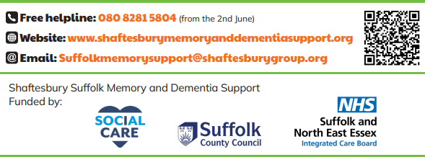
Shaftesbury Suffolk Memory and Dementia Support
Call our free helpline open 7 days a week
0808 281 5804

Slide 8
Alzheimer’s Society – Norfolk and Waveney Dementia Support Service Hana Richardson

Slide 9
Dementia Support Service Norfolk and Waveney
The Service aims to provide localised specialist support to people affected by dementia living in Norfolk & Waveney. The service includes:
​
Bespoke, individualised clinical and non-clinical specialist dementia support.
Practical and emotional support for people living with dementia, their families, carers and loved ones. ​
Support pre-assessment, after diagnosis and through to end of life.
A local helpline
Community Development and volunteering opportunities

Slide 10
The Cycle of Support
Ensuring people get the right support at the right time the service has three core components;
Telephone Dementia Advisers
Single Point of Access
Information, Advice, Support and Signposting
Community Dementia Advisers
Bespoke, Specialist, Non-clinical Support
Community Admiral Nurses
Bespoke, Specialist, Complex Clinical Support
Local Communities & Volunteering Officer
Growing our reach and raising awareness within local communities

Slide 11
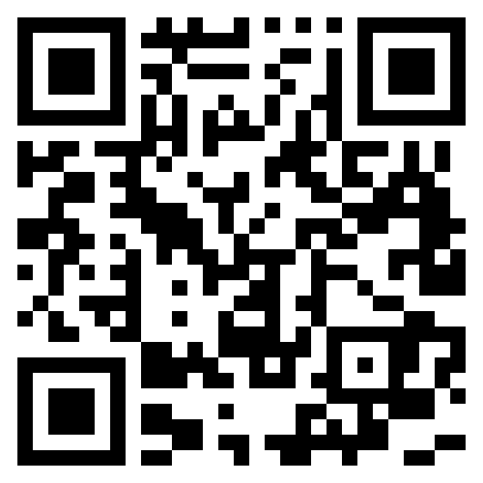
How to refer or contact us
Telephone our local team: 01603 763556
Email us at: norfolk@alzheimers.org.uk
Make a referral online
To access a range of support, printed information, advice and guidance visit our website; www.alzheimers.org.uk
"I received the highest level of support in terms of compassionate advice and education. I cannot praise this service enough."

Slide 12
Suffolk Family Carers Demi Smith

Slide 14
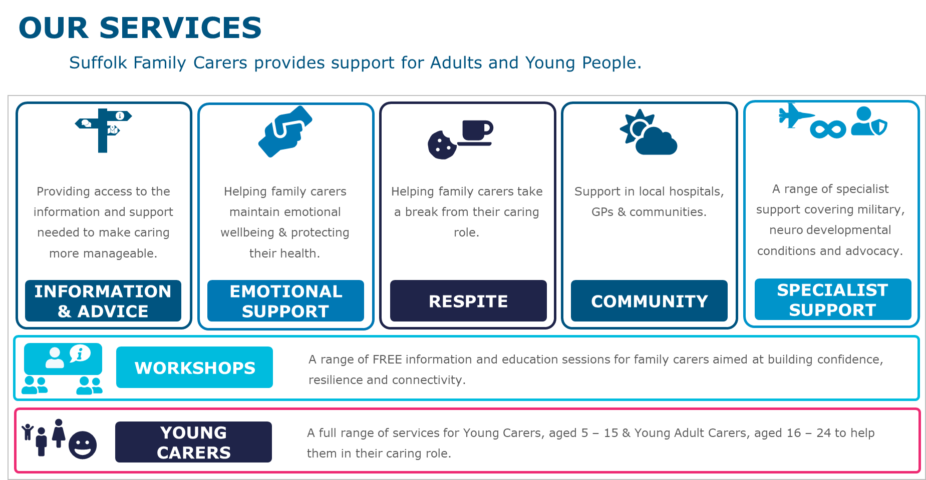

Slide 15
Adult Social Care Supported Self Assessments Ben Ankers

Slide 16
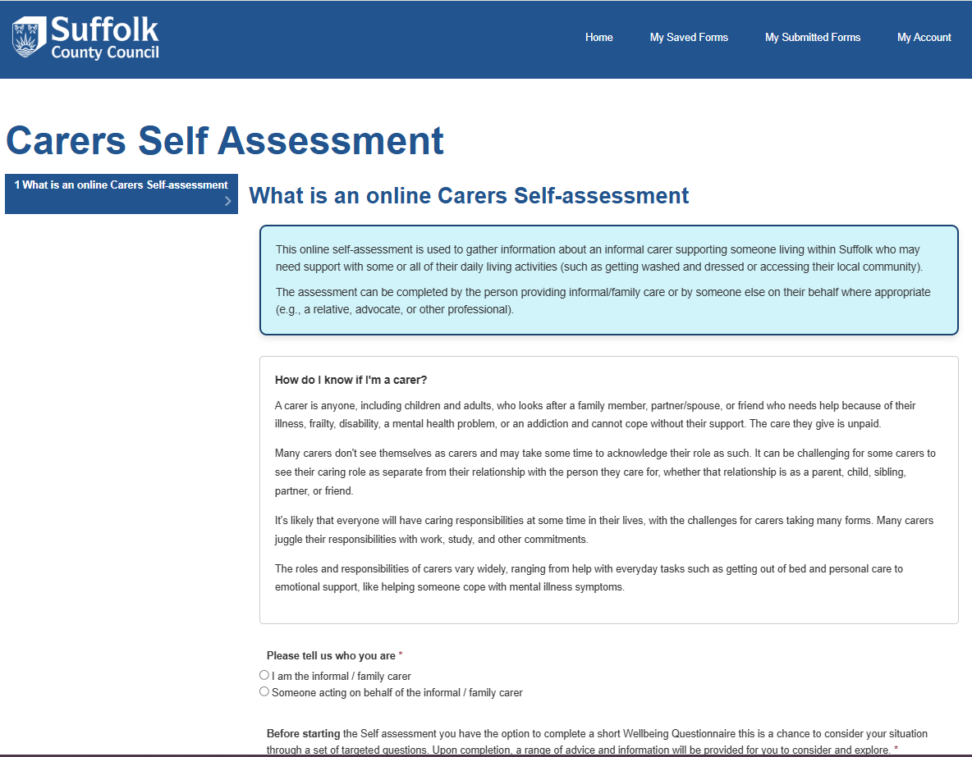
Adult Social Care - Supported Self Assessments
The portal was codesigned with carers, as an option for Carers that have the ability to access online resources themselves or with a someone acting on their behalf.
The form asks all the questions a worker would discuss during an assessment allowing the Carer to feel like they aren't being rushed and for the worker to focus on the concerns identified by the Carer.
As its online Carers can start, save and return to the form at a time that suites them and their cared for person.

Slide 17
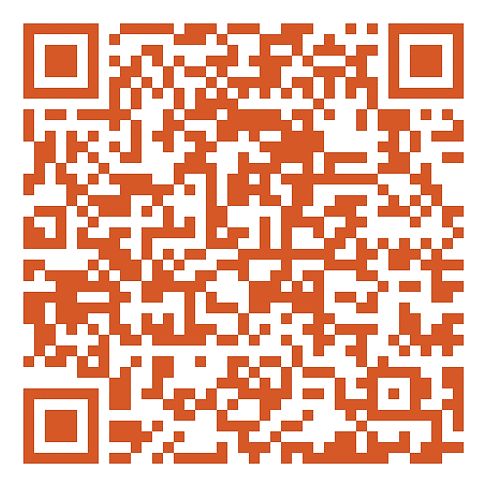
Access the portal today
The portal is for non-urgent needs, in the event of urgent needs please contact Customer first on:
0800 917 11099

Slide 18
Presenters
We invite you to Ask us any questions
Shaftesbury Suffolk Memory and Dementia Support Service (Ipswich, East and West Suffolk)
Jo Marshall
Alzheimer’s Society – Norfolk and Waveney Dementia Support Service
Hana Richardson
Suffolk Family Carers
Demi Smith
Adult Social Care -Supported Self Assessments
Ben Ankers

Slide 20
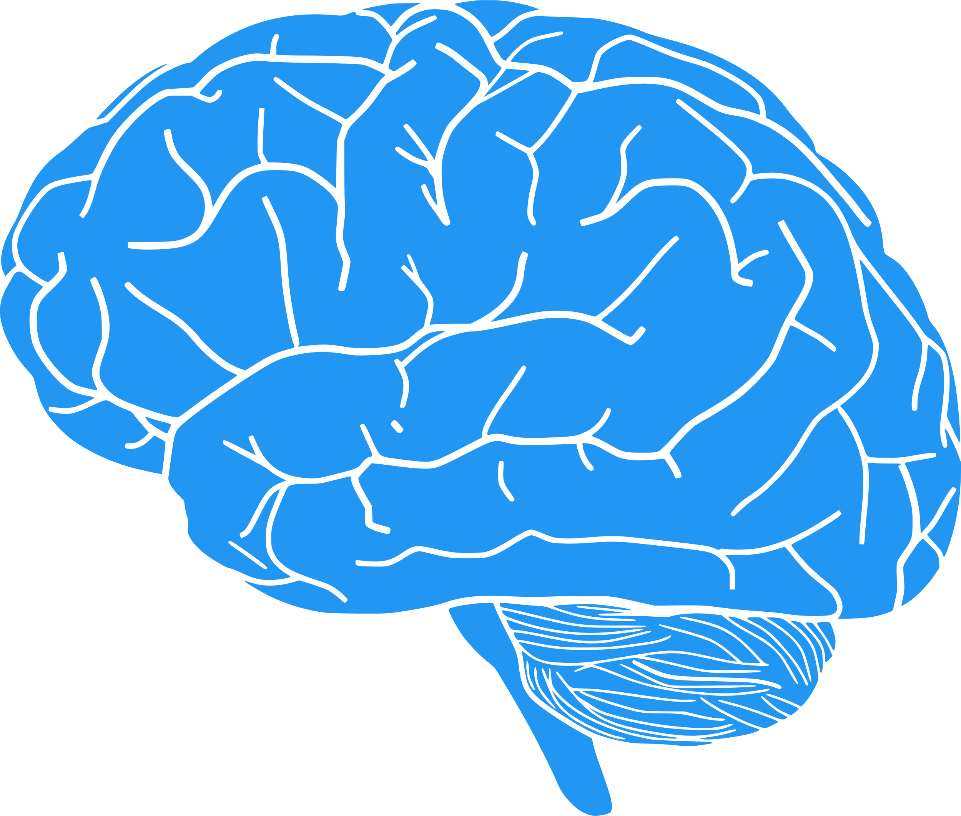
Melanie D’ardis
Operations Manager Older Adult Community Services
Norfolk and Suffolk NHS Foundation Trust
June 25th 2025

Slide 21
Brain Health: Everybody’s business
Welcome!
Introduction
Why brain health matters to everyone
Important for those living with dementia

Slide 22
Heart and Brain Health Connection
What is good for your heart is also good for your brain
Healthy blood flow supports brain function
Shared risk factors: high blood pressure, diabetes, smoking, high cholesterol.

Slide 23
14 Modifiable Risk Factors!
(Lancet Commission (2022, 2024))
Early life:
Poor educational attainment

Slide 24
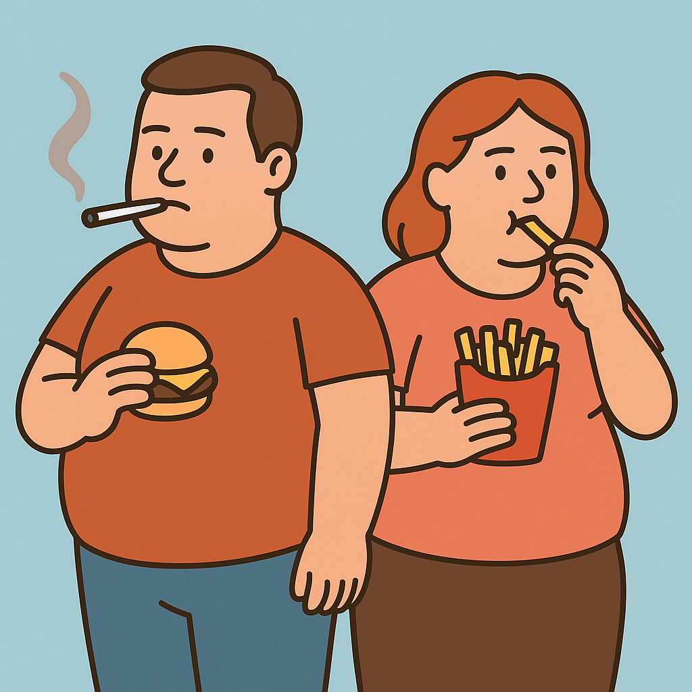
14 Modifiable Risk Factors, con…
Midlife: (Risks to Heart Health) –
unmanaged hypertension
high cholesterol
Obesity
Inactivity
Diabetes
Smoking
excess alcohol
depression…

Slide 25
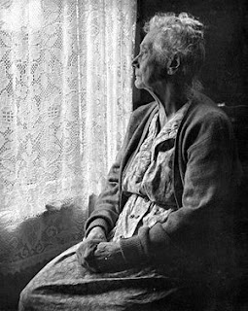
14 Modifiable Risk Factors, con…
Later life:
Social isolation
Untreated visual loss
Hearing impairment
This Photo by Unknown Author is licensed under CC BY-NC-ND

Slide 26
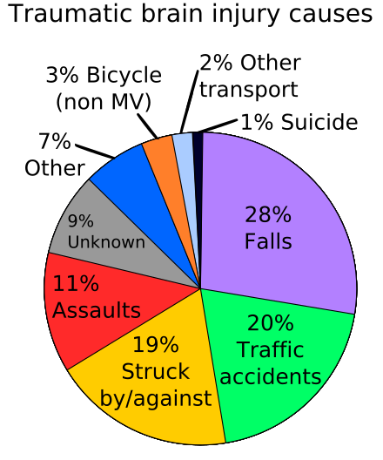
Additional risks to Brain Health:
- Traumatic Brain Injury - Air Pollution
This Photo by Unknown Author is licensed under CC BY

Slide 27
Why Do These Risks Matter?
Each factor increases risk of developing dementia
Multiple factors = higher risk
Addressing them can reduce risk of developing dementia by up to 45%

Slide 28
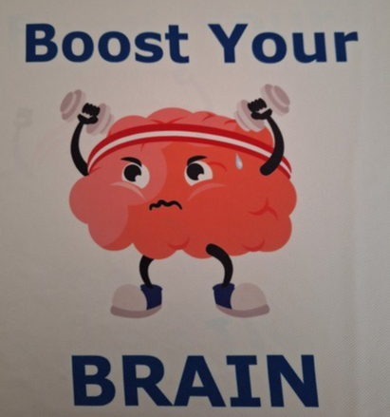
Healthy Habits to Boost your Brain:
Stay active – physically and mentally
Eat a balanced diet (e.g., Mediterranean)
Stay socially connected
Manage hearing and vision
Avoid smoking and excess alcohol
Take medication as prescribed
Annual health checks

Slide 29
“I am already living with Dementia…”
To support brain health while living with dementia, consider these key strategies:
Stay engaged socially.
Social activities can boost confidence, mental well-being.
**Maintain a healthy diet**:
Fruits, vegetables & lean proteins
**Exercise regularly**:
Walking, tai chi, or dancing
**Manage health conditions**:
Controlling blood pressure, diabetes,
cholesterol levels can reduce the impact of dementia.
**Engage in cognitive activities**:
Puzzles, reading, or learning new skills
.
**Adopt coping strategies**:
Reminders, support groups, positivity, can improve daily living.

Slide 30
Examples of Local Support Services
(Contact details are included on handout)
Shaftsbury Suffolk Memory and Dementia Support
Community Memory Assessment Service
Dementia Intensive Support Team
Suffolk Family Carers
Headway Suffolk
And where you can find additional information:
InfoLink
Dementia services - NHS Suffolk and North East Essex ICB

Slide 31
Further Reading and References:
Livingston, G., Huntley, J., Sommerlad, A., et al. (2022). Dementia prevention, intervention, and care: 2022 report of the Lancet Commission. The Lancet, 400(10345), pp.1234-1256. DOI: 10.1016/S0140-6736(22)01234-5.
Livingston, G., Huntley, J., Liu, K.Y., et al. (2024). Dementia prevention, intervention, and care: 2024 report of the Lancet standing commission. The Lancet, 404(10452), pp.572-628. DOI: 10.1016/S0140-6736(24)01296-0.
Harvard Medical School (2025). Heart-brain health: The two-way connection. Harvard Medicine Magazine, 98(2), pp.34-41. Available at: https://magazine.hms.harvard.edu/articles/heart-brain-health-two-way-street [Accessed 18 June 2025]
Lifestyle, Behavior, and Cognitive Training Intervention Research | National Institute on Aging
Brain-Health-consensus-statement_291121.pdf
NIH: Lifestyle and Cognitive Training
Addressing 14 health and lifestyle factors could prevent nearly half of global dementia cases - Alzheimer's Research UK
Lancet infographic - TL_Dementia_Risk_Factors_2024 - v3
The Lancet Commission Report on Dementia Prevention, Intervention, and Care: 14 Modifiable Risk Factors — Dementia Services Development Centre

Slide 32
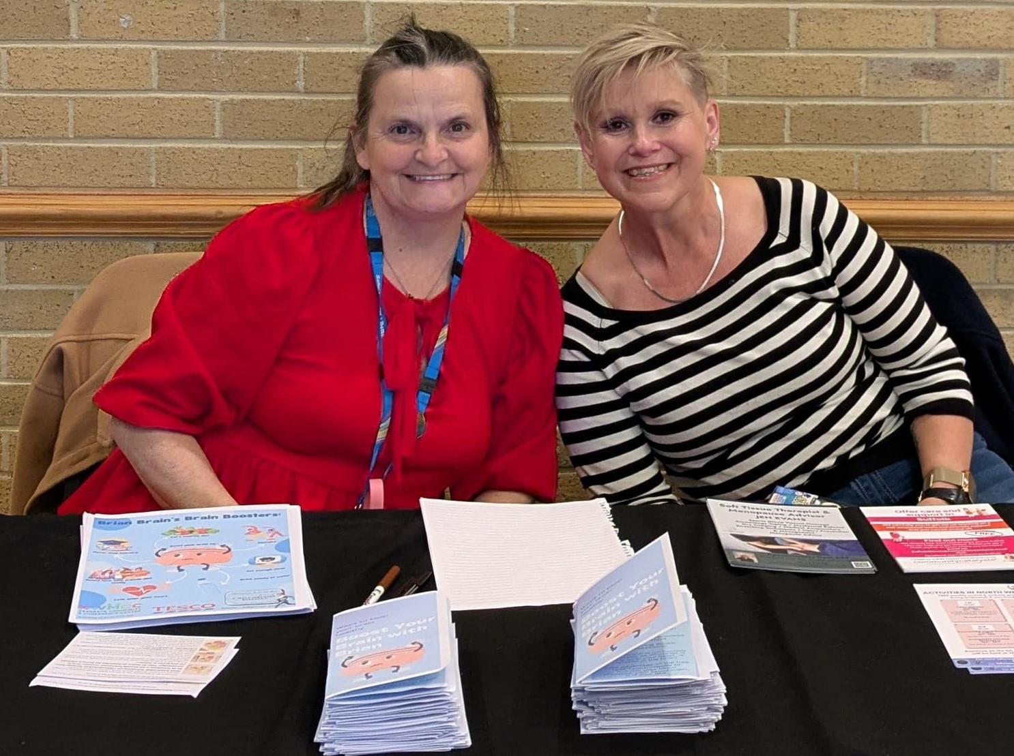
Any Questions?
Thank you for attending!
Please take a handout
Please complete the feedback form
Mandy and me at a recent Brain
Health Promotion event.

Slide 33
Dementia Marketplace 2025
The importance of contingency planning

Slide 34
Demi Smith Project Manager
Suffolk Family Carers

Slide 35
Contingency Planning
Through Suffolk County Council you can access a Family Carers Emergency Plan. A Family Carers Emergency Plan sets out what will happen to the person being cared for in the case of an emergency.
Once the plan has been received by Suffolk Adult Social Care you, the family carer will be issued with a key fob and card which should be kept on you at all times. This will have a telephone number on which is used to activate the plan if an emergency affecting the ability to carrying out any caring responsibilities occurs.
Suffolk Family Carers and other TPO’s can assist you to complete a Family Carers Emergency Plan. It is also accessible to complete online.

Slide 36
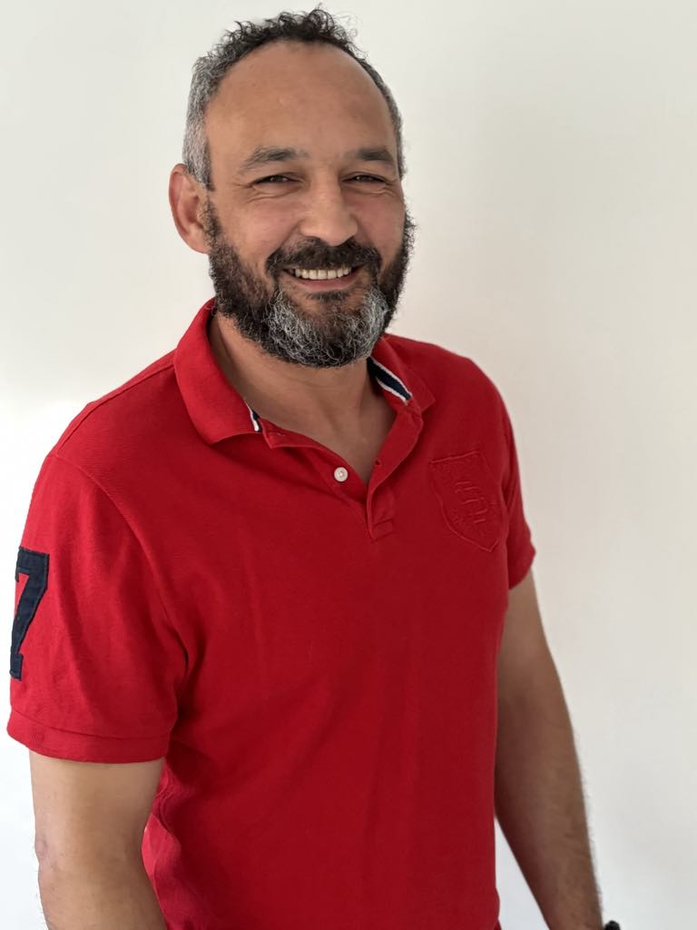
Suffolk Safeguarding Partnership
Will Wright
Professional Adviser - Adult

Slide 37
https://www.youtube.com/watch?v=7a0trR5tkEQ&embeds_referring_euri=https%3A%2F%2Fwww.suffolksp.org.uk%2F&source_ve_path=OTY3MTQ
Dementia — Suffolk Safeguarding Partnership

Slide 38
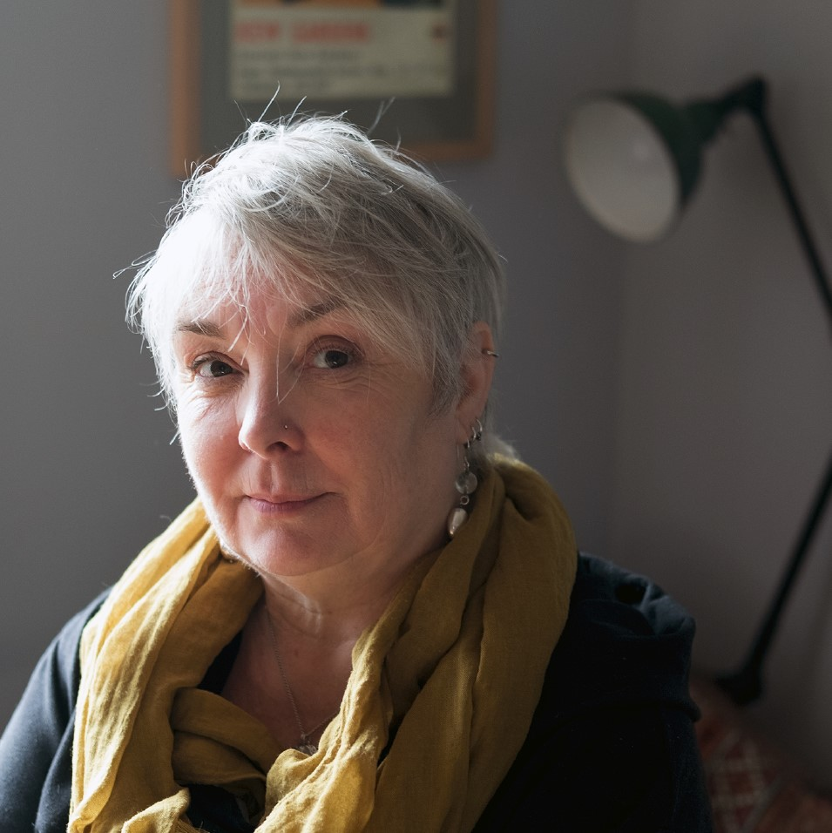
Financial management and social care
Claire Tolliday – Head of Financial Inclusion and Advice Service, SCC

Slide 39
Third party access to financial decision making
Informal permission such as third party access to bank accounts – only lasts whilst you are able to withdraw permission
DWP appointeeship – covers welfare benefits only and DWP need to be satisfied that you need support to manage benefit claims
Enduring power of attorney – had to be made before October 2007 and needs to be registered when you are no longer able to make financial/property decisions
Lasting power of attorney – made by you (not your relatives/carers) when you are able to understand and agree to giving powers to your Attorney(s)
Court of Protection Deputyship – Court appoints Deputy(s) to look after your affairs if no LPOA/limited LPOA in place before you are no longer able to make decisions

Slide 40
Impact of not having legally appointed person in place before you are no longer able to grant permission
No access to your assets – including ordinary banking & income like occupational pensions
No access to DWP benefits
Not able to complete social care financial assessments, new benefit claims, conversations with utility providers etc.
No one able to make decisions about use of assets, tenancy issues, buying/selling property etc.
May put care arrangements at risk, and accrue debts
Court of Protection Deputyship can be lengthy process, expensive and burdensome for Deputy

Slide 41
Demi Smith
Will Wright
Claire Tolliday

Slide 42
Compassionate Communications…. let’s reduce the arguments
Nicola Bradford
Dementia Practitioner & Trainer
LimeSkills/Daisy Days
Chair of Trustees – Ipswich Dementia Action Alliance
Suffolk Dementia Marketplace – June 2025

Slide 43
In this session….
Understanding different perspectives of dementia
The SPECAL Approach, from The Contented Dementia Trust
The 3 Golden Rules

Slide 44
What’s your perspective of dementia?
How would you describe dementia to someone?
The overwhelming majority use language which is negative and fearful – supported by the way the media use headlines or shape documentaries
Yet, it is a fact that dementia is a disease of the brain – and more often than not people offer sympathy and support to people who are ill, so why is dementia different to any other illness??

Slide 45
Dementia is a disease of the brain….. But the human brain is unique to each individual, so each person will it experience it differently
Notes:
…..
One common factor of dementia is that the disease will progress and that there is no cure – therefore the disease is a terminal health condition. It is currently the number one cause of death in the UK.
But unlike other terminal diseases such as cancers, the general level of understanding of dementia is low, so its not talked about, people are fearful of seeking a diagnosis and the world becomes a very small place for families when a member is diagnosed with dementia and friends and family scatter as they just don’t know what to say or do….
So how can we help people to develop a greater understanding of the disease – not necessarily from a medical perspective as the brain is such a complex organ, but from the perspective of one human being relating to another?

Slide 46
Dementia is complex
As dementia affects a person’s brain, the organ that controls all of our bodily functions, it can also affect the very essence of who we are, what we know, our values, thoughts and behaviours
But there are over 100 different types of dementia, and it is possible to have different types together, called mixed dementia.
Most common type is Alzheimer's Disease, followed by vascular dementia, then Lewy body dementia and frontotemporal dementia.

Slide 47
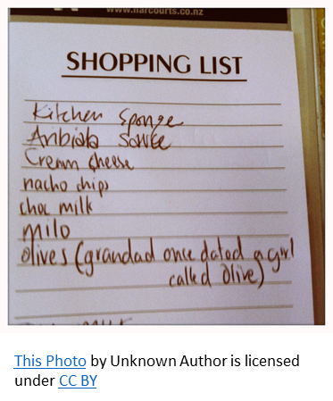
Symptoms of dementia
Dementia can impact any aspect of daily living
Common association with short term memory loss, but also;
sequencing
visual perception

Slide 49
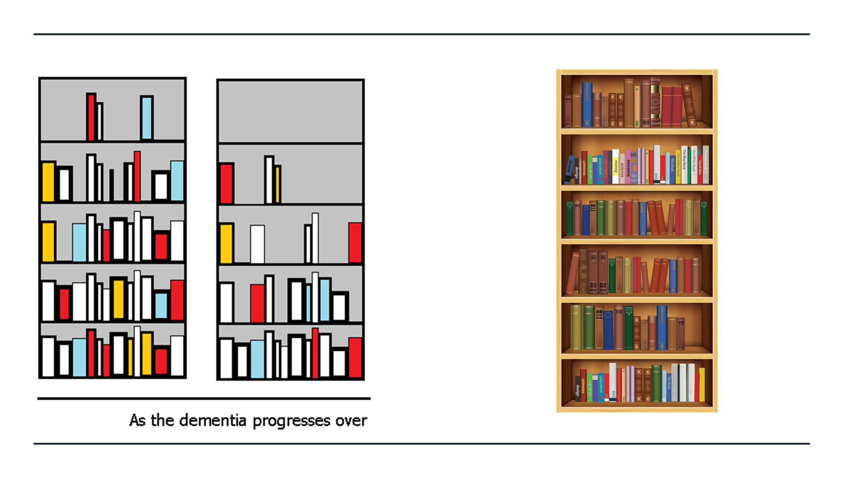

Slide 52
3 Golden rules to improve communication
Avoid asking any direct questions that requires the person with dementia to search their memory for factual information that may not have been stored.
Their desperate search for missing facts will only increase their perception of their own disability, causing them unnecessary distress. It is surprising how much information you can gather from a person with dementia without asking direct questions

Slide 56
Thank you for attending this session
For further info and training sessions – nicola@limeskills.co.uk
Contented Dementia is available to loan via Suffolk Libraries
Or purchase via Amazon
www.contenteddementiatrust.org

Slide 57
Thank you for listening! The full presentation from today will be available to view on the Care Development East website after the event
www.caredevelopmenteast.co.uk

