Slide 1

WELCOME
12:15 -12:45pm Networking
Leaders In Care
1st October, Bungay

Slide 2

Gemma Bloomfield
CEO,
Care Development East

Slide 3
Skills for Care Update – Helen Jackson

Slide 4
Skills for Care provider update
helen.jackson@skillsforcare.org.uk
Notes:
Thank you for inviting me here today to provide a Skills for Care update,
I would like to introduce myself , my name is Helen Jackson and I am your Skills for Care locality manager for Norfolk and Suffolk

Slide 5
A Workforce Strategy
for Adult Social Care in
England
Workforce Strategy for Adult Social Care in England
Notes:
I wanted to start by talking about the Workforce strategy for adult social care, which was launched just over 1 year ago..
For the first time ever, the adult social care sector came together, led by Skills for Care, to develop the Workforce Strategy it needed to recognize the contribution of social care
Social care needed to ensure we have enough of the right people with the right skills to provide the best possible care and support for the people who draw on it, the strategy aims to address the long term challenges with recruitment and retention.
Development of the strategy was collaborative with members who were system leaders representing voices across social care, it could not have been developed without the expertise, time and commitment of many stakeholders.

Slide 6

What are the 3 strategy themes three strategy themes?
Attract and retain
Includes
Action on pay, terms and conditions
10-year attraction plan
International recruitment plan
People Promise
Champions
Wellbeing and equality, diversity and inclusion
Train
Includes
Ensuring and funding high-quality training
Expanding skills through the Care Workforce Pathway
Delegated healthcare
Overhauling apprenticeships
Transform
Includes
Legislative mandate and central body for workforce planning
Digital skills
New roles
Coastal and rural communities
Investigating registration
Notes:
The strategy set sour 56 recommendations.
There are recommnedations that could be owned and acted upon by the whole sector and recommendations which be adopted by a new government
Attract and retain – action on pay, terms and conditions. International recruitment plan, wellbeing and equality, diversity and inclusivity
Train – ensure access to funding for high quality training, expand skills through CWP, DHA. This has included Formalising and expanding the care cert training with L2 adult social care cert
Transformation – digital skills and costal and rural communities, the National care forum is piloting care technologist role
Small but mighty for registered professional already seen launch of preceptorship support package
The workforce strategy is a 15 year vision buts its success will rely on continued energy, commitment and collective action

Slide 7
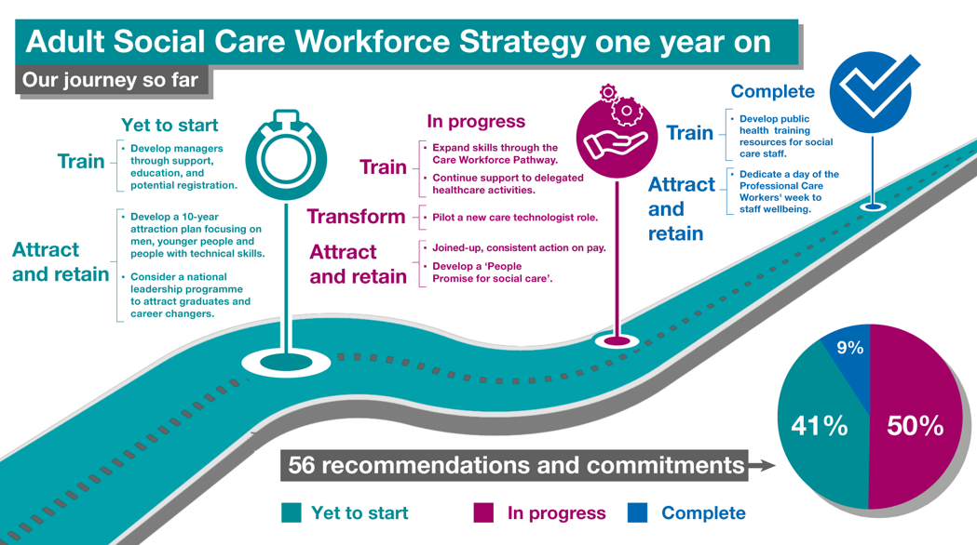
Notes:
It is great to see that half of the recommendations of the strategy have already been completed or are in progress

Slide 8
Care Workforce Pathway
The Care Workforce Pathway
Notes:
The care workforce pathway is a framework for employers regardless of size or services, The framework sets out roles within social care with details of the behaviors, knowledge skills and learning required to succeed in those roles.

Slide 9


Care Workforce Pathway
Role categories and resources to help you use the pathway
Role categories in development for 25/26
Role categories
They describe
Supporting resources
New to Care
Care or Support Worker
Enhanced Care Worker
Personal Assistant
Supervisor or Leader
Practice Leader
Deputy Manager
Registered Manager
Universal values
Behaviours
Knowledge and skills
Learning and development
Guide to adopting the pathway
Templates and checklists for how to approach implementation
Job mapping template
Skills self-assessments
Careers conversations toolkit
Development plan template
Nominated Individual
Activities Coordinator
Care/Digital Technologist
*Corporate middle/senior managers
*Quality assurance roles
*ASC learning and development roles
*these roles will contain a lower level of detail than the full role categories
Find out more about the Care Workforce Pathway.
Notes:
The framework sets out roles within social care with details of the behaviors, knowledge skills and learning required to succeed in those roles.
The roles include;
There is current engagement to develop further roles which include Personal Assistant role

Slide 10






Adoption areas | a summary overview
Paperwork and People (Light) | Processes (Medium) | Systems and Structures (Full)
Speak with the workforce about why the organisation is introducing the Pathway, what it is aiming to achieve and why it’s important for them, those who draw upon care and support and the sector. | Map Pathway values and behaviours into recruitment activities (eg job adverts and interview questions). | Identify gaps and emerging (or future) needs in the organisation’s structure and consider introducing new roles / changing existing roles based on Pathway role categories.
Map specific job(s) in the organisation to align with the Pathway categories (organisations do not have to map all roles, not all may fit and there are more roles in development which will be published in 2026). | Update supervision processes using the Pathway’s career development resources and embed career conversations throughout the organisation. | Update systems, HR approaches and relevant other organisational policies to reflect the Pathway and any changes made from its adoption and use.
Update job descriptions to incorporate the values, behaviours, knowledge and skills in the Pathway. | Further develop the organisation’s learning and development approach/content based on a review of the training areas within the Pathway. | Create or further embed an organisational culture of continuous learning and development, and regular and consistent recognition for individuals who demonstrate the Pathway’s behaviours and values.
Notes:
When I am talking about the care workforce pathway what does that mean for you and your services.
The Care Workforce Pathway has been designed with flexibility in mind, recognising that employers are starting from different places, are different sizes and have different levels of capacity available.
We have already had providers engage with the first year early adopters and current pathway pioneers
There are resources online to support provides to explore the care workforce pathway for their teams and service.
There are three levels of adoption:
light – which focuses on paperwork and people, this might include provider sharing Role categories with staff and completing Basic use of self-assessment/planning tools
medium – which looks more at processes, this might include - Role mapping completed, using in training plans, Career development plans in use, Some supervision aligned to the Pathway
full, which incorporates systems and structures. This would include Pathway fully integrated into recruitment, induction, supervision, and appraisal - Workforce strategy aligned to role categories, Regular evaluation and updates, Leadership development linked to succession plannin
These are not fixed stages, but a stepped approach that allows organisations to gradually build their use of the pathway over time
There is no right or wrong way to adopt the Care Workforce Pathway. From making changes to your job descriptions to restructuring, there are many great examples of how the pathway has helped organisations in different ways.

Slide 11




Benefits of Pathway adoption
Staff | Employers
Improved motivation, capability and confidence. Improved sense of feeling valued. Improved perception of being viewed as a respected and skilled professional. Improved sense of career ownership and self-directed learning and development. Improved ability to transition into clinical roles. Improved knowledge of opportunities to move and progress within the sector. Improved ease of ability to move effectively throughout the sector. | Improved supervision and support. Improved recruitment. Improved morale and retention. Strengthening of positive workplace culture. Reduced recruitment costs. Reduced duplication and waste in workforce development spending. Improved succession planning. Improved competency. Improved compliance. Improved care outcomes. Evidence of workforce planning approaches and impact that can be showcased to CQC.
Notes:
This slide brings highlights realised and anticipated benefits of the pathway.
At an individual level staff feeling more motivated, confident, and valued, with a stronger sense of professional identity and ownership over their development.
Organisationally, we’re seeing improved recruitment and retention, while also reducing costs and strengthening compliance and care outcomes.

Slide 12
Adult Social Care Workforce Data Set ( ASC WDS)

Slide 13
The Adult Social Care Workforce Data Set
ASC-WDS is a free data collection service, commissioned and funded by the Department of Health and Social Care. It is the leading source of intelligence for the adult social care workforce. It helps you to manage your team and provides crucial information to decision makers.
Notes:
The Adult Social Care Workforce Data Set (ASC-WDS) is a data collection service, commissioned and funded by the Department of Health and Social Care. It is the leading source of intelligence for the adult social care workforce.
We know that the adult social care sector is complex and fragmented and made up of thousands of different care providers. And, we know that understanding the workforce is so important for planning and decision making across the sector- and that’s what we’re trying to do with ASC-WDS- to build that understanding.
It provides crucial information to key decision makers such as Government, DHSC, CQC and local authorities. It helps them plan, monitor and fund the sector

Slide 14


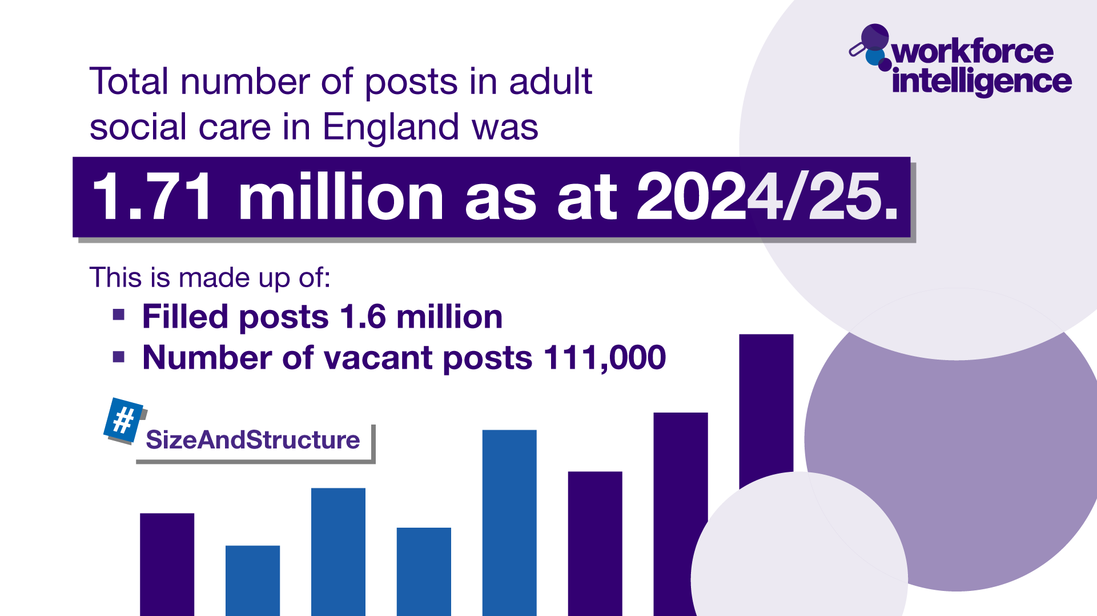

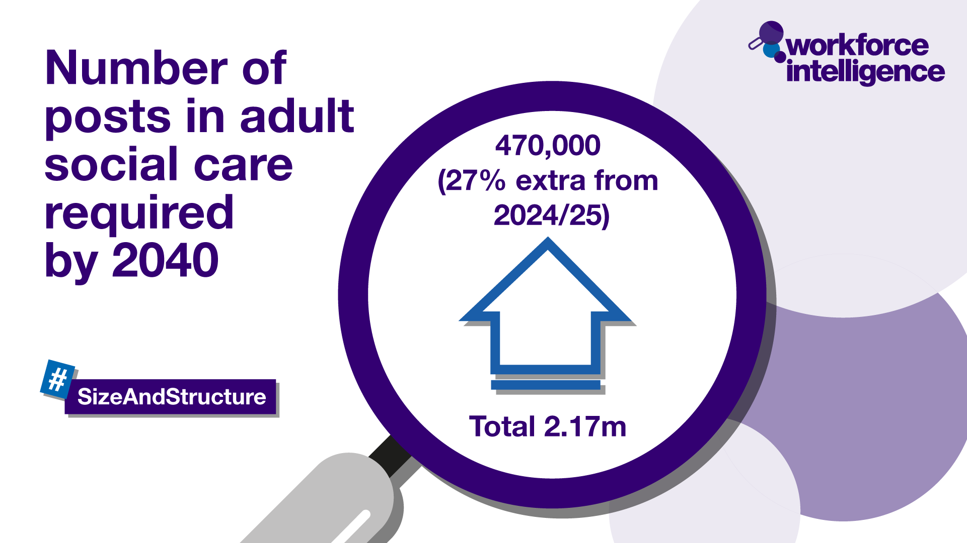










The Adult Social Care Workforce Data Set
Our crucial intelligence is used by:
Who we are regulated by:
Notes:
ASC-WDS means that all care providers can make their voice heard. Around 21,000 providers already have an account and are providing us with crucial information
The data from those providers tells us…
There are one point seven one million posts in ASC
That one point four seven million people work in ASC in England
In 2024/2025 the ASC vacancy rate was 7%. Returning to levels seen prior to COVID-19
It also tells us that we’ll need 470,000 more jobs by 2040 to keep up with an aging population
The data we collect is the leading source of intelligence for the adult social care workforce. It provides crucial information to decision makers such as government, the Department of Health and Social Care, the Care Quality Commission, ICSs and local authorities. We are regulated now by the Office for Statistical Regulation as a leading source of workforce intellgience data.
So by contributing to ASC-WDS, you can help us build a detailed picture of the sector and highlight the areas that most need support.

Slide 15



Benefits to your business
Funding for training your staff
Safe and free storage of staff records
Manage training records
Benchmark your workplace
Access the ASC-WDS Benefits Bundle
Share data with CQC & LA ready for inspection
Notes:
So what are the benefits to having an ASC-WDS account? Well…
You can gain access to funding for training your staff
The system provides safe and free storage of staff records and can help you to manage your training records.
You can benchmark your workplace against other providers in your area, for metrics like pay, turnover rates or staff sickness.

Slide 16
Claiming funding for training
The Learning and Development Support Scheme
Eligible ASC qualifications and courses
Started in September 2024 and runs until by 31 March 2026
Claims from NHSBSA
Must have an updated ASC-WDS account to claim the funding
Easy to check your data meets requirements using the checker tool inside ASC-WDS
Adult Social Care Workforce Data Set requirements
Notes:
In 2025/26 ASC-WDS is linked to the Adult Social Care Learning and Development Support Scheme. The webpages linked provide more information about what can be claimed and the process to do so. The key point is that you must have an up to date ASC-WDS account to claim from the funds, and that these funding sources have saved care providers thousands of pounds.
Training available through quality assured training providers includes
Leadership and management
Digital leadership
Mental health first aid
Positive behavioural support
Level 2 and 3 qualifications in subjects such as dementia and end fo life

Slide 17
Strategy to see social care as a placement of choice for all student nurses and nursing associates

Slide 18
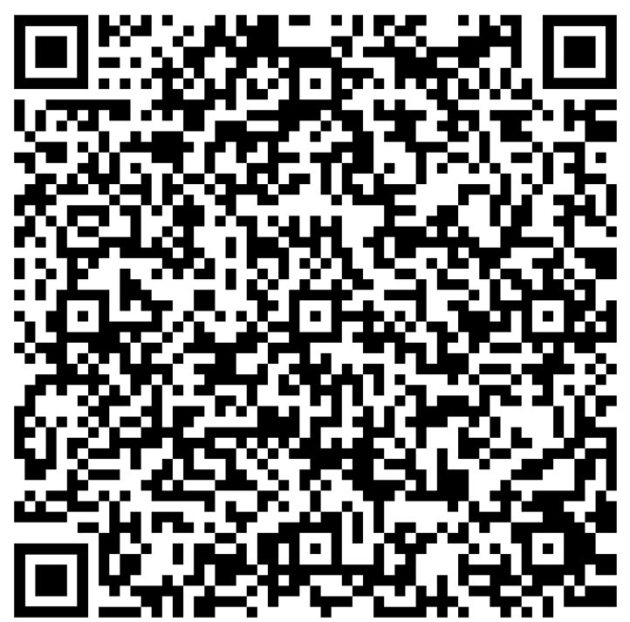
Placement strategy
Funded by DHSC and developed in partnership with the Council of Deans of Health
Articulates the importance of social care in nursing education including practice learning placements.
Makes recommendations for stakeholders under four strategic objectives:
The opportunities social care has to offer
Facilitating access to these opportunities
Maintain and grow the quality of social care practice placements
Increase students' awareness of social care and encourage them to consider it as a career
Download the strategy
Notes:
The strategy articulates the importance of social care in nursing education including practice learning placements and it makes recommendations for stakeholders under four strategic objectives.
The first objective is - The opportunities social care has to offer – The strategy engages students as well as health and education systems to recognise social care as a rewarding environment to work in with a rich landscape of opportunities for learning and development.
The second objective is - Facilitating access to these opportunities –The strategy brings a focus on the value of social care placements and works to develop closer partnership working with universities and collages to support access to placements and routes into adult social care.
The third objective is - Maintain and grow the quality of social care practice placements - Raising the profile of social care and the nursing workforce through the strategy will continue to grow practice placement capacity and with collaborative approaches ensure the quality of the practice placement is maintained.
The final objective is - Increase students awareness of social care and encourage them to consider it as a career – the strategy brings focus to the role of social care nursing and supports students insight into the range of career pathways for nurses. It also highlights the role of education which is inclusive of social care nursing and the benefit of investing in career pathways leading to adult social care. By giving student nurses and nursing associates practice learning experiences in adult social care, they gain first-hand insight into the challenges and rewards of supporting people as close to their own home and as independently as possible.
This strategy implementation isn’t to say that everyone will end up wanting to work in social care, but our future workforce needs to understand how to work across the whole system.
Social Care providers, universities and collages have the opportunity to demonstrate their achievement of the recommendations to receive a commendation awarded by Skills for Care.

Slide 19

Supporting the development of social care practice learning placements.
This resource covers
Routes into the nursing profession
Practical guidance on becoming a nursing placement provider
Providing high quality practice learning
Benefits for employers and people who draw on care and support
Simulation in practice learning
Case studies
Developing nursing placement opportunities in social care
Notes:
There are several resources available to support with the implementation of student placements
‘Developing nursing placement opportunities in social care’ is a guide for employers, practice assessors and practice supervisors who are responsible for assessing and providing learning opportunities for student nurses and nursing associates across the adult social care sector.
It offer clear guidance for providers on how to prepare for student placements including information students will needs.
The guide clearly explains the role and requirements of the practice assessor and practice supervisor roles.
The guide supports providers to understand how to provide high quality practice learning environments in practice.
Its also supports providers to understand the opportunities and benefits of hosting students with a variety of testimonials and case studies from the sector.

Slide 20
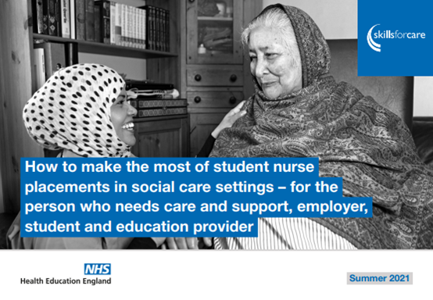
Understand the opportunities social care has to offer
This resource covers:
The context of social care and person-centered practice
Practice learning opportunities available across a wide range of settings.
Mapping of social care learning environments to the NMC Standards of Proficiency
Multi-disciplinary practice
How to make the most of student nurse placements in social care settings
Notes:
A further resource is ‘How to make the most of student placements in social care settings’
This guide was created in partnership by Skills for Care and Health Education England (HEE), it provides essential information about making the most of placements in social care for students, education providers and employers alike. Co-produced with those who are working and living within social care settings, the guide has been commissioned to support the system to understand the depth of nursing and nurse-led services within social care and the richness of learning that can be accessed by students should they take up a social care placement.
This guide covers
■ what social care is
■ the learning which is available to healthcare and nursing students
■ what a person who needs care and support wants nurses to know about them and the environment
■ how the standards of proficiency for registered nurses map to different settings

Slide 21
Fair Pay Agreement
Notes:
The employment rights bill sets out regulations to negotiate a fair pay agreement
In addition to the info shared on the slide, it is worth noting that the FPA will be the first ever agreement of its kind in the social care sector.

Slide 22

Why is the Fair Pay Agreement being introduced?
Fair Pay Agreements (FPAs) are a key part of the government’s new deal for working people. Make Work Pay outlined the government’s plan for “a New Deal for Social Care Workers, ensuring these workers are treated with dignity and respect and that they have a route to better conditions, training and progression. This will help us tackle the serious recruitment and retention crisis facing the sector, deliver higher standards for those receiving care and help us to tackle NHS waiting lists.”
The adult social care sector faces significant workforce challenges including challenges around recruiting and retaining staff.
Care professionals are essential to those who draw on care and support.
DHSC is introducing a FPAs so that care professionals are recognised and rewarded for the important work they do.
Care worker pay is amongst the lowest in the economy – at least 80% of jobs pay more than care worker median pay.

Slide 23
Process of agreeing content of the Fair Pay Agreement
Bill sets framework
Engagement and consultation
FPA implementation
FPA regulations made
Wide engagement with the ASC sector including Working Groups, Task and Finish Groups, teach-ins and public consultation.
Negotiated outcome is agreed and the FPA implemented.
The Bill includes broad clauses to enable the FPA process to be designed through consultation with the sector.
Following a programme of engagement, secondary regulations are drafted informed by evidence from public consultation.
Negotiating process
Negotiating body/processes are established and collective bargaining process begins.
We are here
Notes:
DHSC is currently in the “Engagement and consultation” stage of the process

Slide 24
WEBINAR RECORDING
What is happening with the Fair Pay Agreement for adult social care.
This webinar, delivered in partnership with the Department of Health and Social Care, introduced the FPA and provided details on what will be included. An overview of the Employment Rights Bill was provided, with links to the FPA shared. Key timings relating to the Passage of the Bill and consultation plans on the FPA were shared. Information on how the sector can get involved in the consultation were outlined.
Watch the recording here.

Slide 25
Any questions or thoughts

Slide 26
Oral Health Prevention & Education – Julia, Nicki & Rashmi

Slide 27





My Smile Matters
Main learning points for adultsocialcareprovidersand staff

Slide 28
Main points for maintaining oral health in care homes
•Assess people's oral health on admission to the care home Assessment templates already exist, or you adapt or develop your own to meet people's needs. The
NICE guideline suggests the Australian Institute of Health and Welfare Oral Health Assessment Tool.
•
Nominate a staff member to be an oral health champion where possible and give them the
appropriate training to cascade their knowledge.
Provide training for care staff in oral health.
Make oral health part of your everyday routine.
• •
Check that people have the right dental products and support them to brush twice daily or clean and maintain their dentures.
•
If a person experiences unexpected, significant weight loss, review the health of their mouth as a
possible cause.

Slide 29




Signs of a dental problem
Rubbing, pulling or putting fingers up to face and into their mouth
Putting objects in mouth and biting them
A swollen face, bleeding from the mouth or ulcers
Facial expressions – clenching teeth
Increased saliva Body language – huddled or rocking
Change in appetite, avoiding eating on one side or avoiding hard foods
Being more restless, moaning or shouting
Disturbed sleep
Leaving out a denture or refusal to have teeth brushed or to let carer near mouth.

Slide 30







Adapted toothbrushes
Foam hand grip
3-sided toothbrush
Plastic hand grip
Electric toothbrush
Pebble shaped easy grip handle
Oralieve 360⁰ toothbrush

Slide 31






Interdental cleaning
Floss or tape
Water flosser
Interdental brushes
Floss picks
Tuft toothbrush

Slide 32

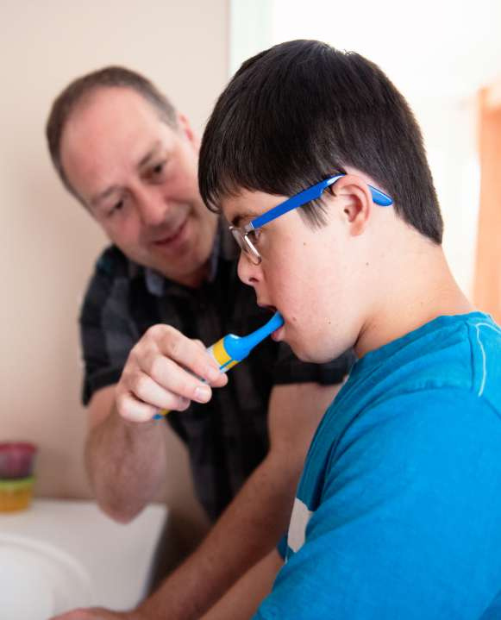

Tips for assisted brushing
Doesn’t have to be in the
May be easier for the person to sit on a comfortable
If person is normally in a wheelchair, then
bathroom
chair
keep them in it
Place a towel round their
shoulderstocatch
Agree to a stop signal if they need
Either stand behind or slightly to the side of the
drips
a break
chair
Have a routine method of brushing to prevent areas
A mouth chart will help to highlight areas brushed or
not
Use a twice a day toothbrushing
chart
beingmissed

Slide 33

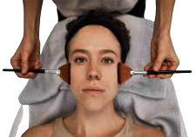





Tips to help toothbrushing

Slide 34

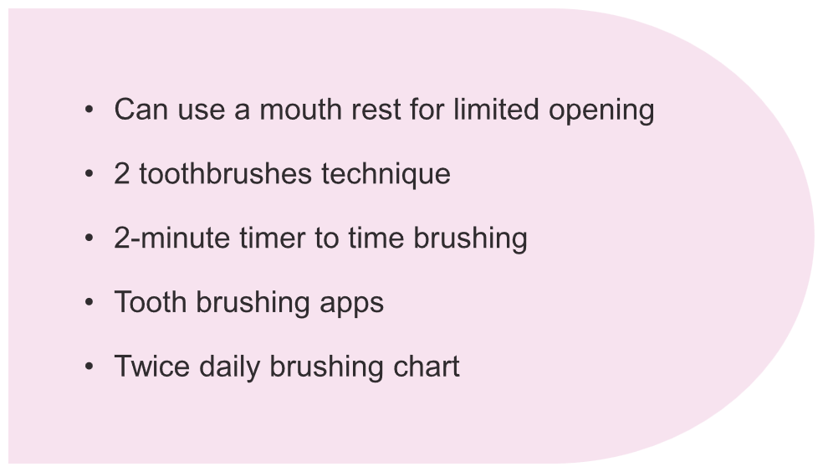







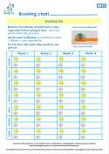

Tips to help toothbrushing

Slide 35
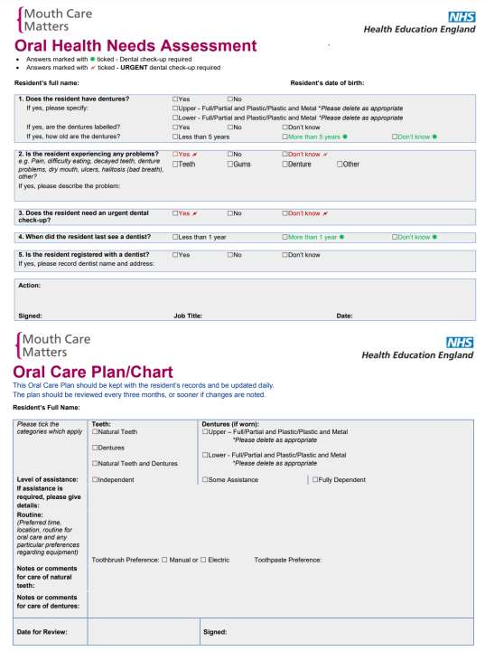



Oral care plan
Oral health needs assessment should be carried out on all new admissions. Followed with an oral care plan
Kept up to date
Details of their dentist
Any help needed with brushing
What kind of toothbrush and toothpaste they prefer
Natural teeth or dentures
Any loose teeth in the mouth

Slide 36
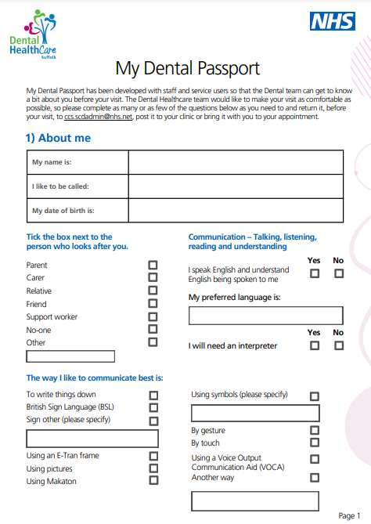


Dental passport
Reasonable adjustments How can we support you with your medical treatment? May need appointments at certain times of the day
Likes and dislikes
How do you prefer to communicate? How can we support you if you are feeling anxious or upset?
(you could write“play music”or“talktome”for example)
How doyou reactto thefollowingsoundsand things?
Drills (sound and smell) Rubber gloves, Anaesthetics
Quiet place to wait

Slide 37

Email the Oral Health Team: ccs.oralhealth.suffolk@nhs.net
Nicola.rice7@nhs.net
THANK YOU
Website:
www.dentalhealthcareeoe.nhs.uk
Facebook:
@ccsdentalhealthcare

Slide 38
Care Homes in Suffolk

Slide 39
Current and future situation – Suffolk (exc Waveney)
ICBs across the country are in the process of a restructure and from 1 April 2026, Suffolk and Norfolk ICB will formed. Suffolk and North East Essex will lose the Essex part, Norfolk and Waveney will gain the rest of Suffolk.
Patients who require a domiciliary visit can be referred to Cambridge Community Services via their online portal (link on next slide)
Patients who are able to attend a specialist setting can be referred via the same link but will be seen at premises in Bury St Edmunds or Ipswich.
The specialist settings are designed to make patients with additional needs feel comfortable. There are wheelchair tippers, wider corridors, longer appointment times and a quiet environment.
Staff are specially trained to work with people with additional needs eg dementia, learning disabilities and autism.
Patients can also be seen in the care home.
Historically, there was limited provision for these patients to be seen. We secured additional resource from 1st January 2025.
Once seen, patients are assessed using a BDA Case Mix Score. Previously the threshold for retention within the community service is 10. This was lowered to 7 from 1st January 2025. Patients below 7 will be referred to a High Street dental provider.
We have a number of High Street Dental providers across Suffolk and North East Essex who provide our Dental Priority Access and Stabilisation service. They will all be linked to individual care homes and have made reasonable adjustments for patients with dementia, autism or a learning disability. If you are unsure if your home is linked to a dental provider, please contact the SNEE dental team at dental@snee.nhs.uk

Slide 40
Waveney - Support for Care Homes now and in the future (Location- Lowestoft)
AIM: Expansion of Domiciliary services in Care homes and for Residents who are unable to access oral healthcare services in the primary care in Norfolk and Waveney.
We have currently 1 Community dental service in Waveney which runs from Whapload Road, Lowestoft.
The Community Dental Service (CDS) delivers oral health education and preventative care programs directly to care homes.
We are currently in the planning and scoping phase and are seeking your feedback to help us shape the service.
The project will be built on the following data:
Total Care Homes(NW): 588
Total Care Home Beds(NW): 11,291
We need your input on the following key areas:
What should this service look like?
What specific features and support should it include?
How can we best collaborate with you to make it successful?
NEXT STEPS- set up a working group to review the current service and scope for the future

Slide 41
Contacts
Suffolk and North East Essex Dental Team
dental@snee.nhs.uk
Suffolk referrals to Community Dental Services
portal.dentalhealthcareeoe.nhs.uk/dentalreferral/nongdpreferral
Norfolk and Waveney Dental Commissioning Team
nwicb.dentalnorfolkandwaveney@nhs.net
Community Dental Services
Norfolk & Waveney - Community Dental Services

Slide 42
Mark Tattum-Smith
Project Lead for Reverie
Suffolk County Council

Slide 43



Introducing Reverie:
VR as an accessible therapeutic
technology for people with dementia
Care Development East, Bungay
1st October, 2025
Mark Tattum-Smith
Project Lead for Reverie
Suffolk County Council

Slide 44

Hello …
Digital Practice Lead (Waveney)
Suffolk County Council
Worked within Adult Social Care in Waveney for 16 years
Registered Social Worker
Part of the Cassius Digital Care Team.
Project Lead for Reverie VR

Slide 45
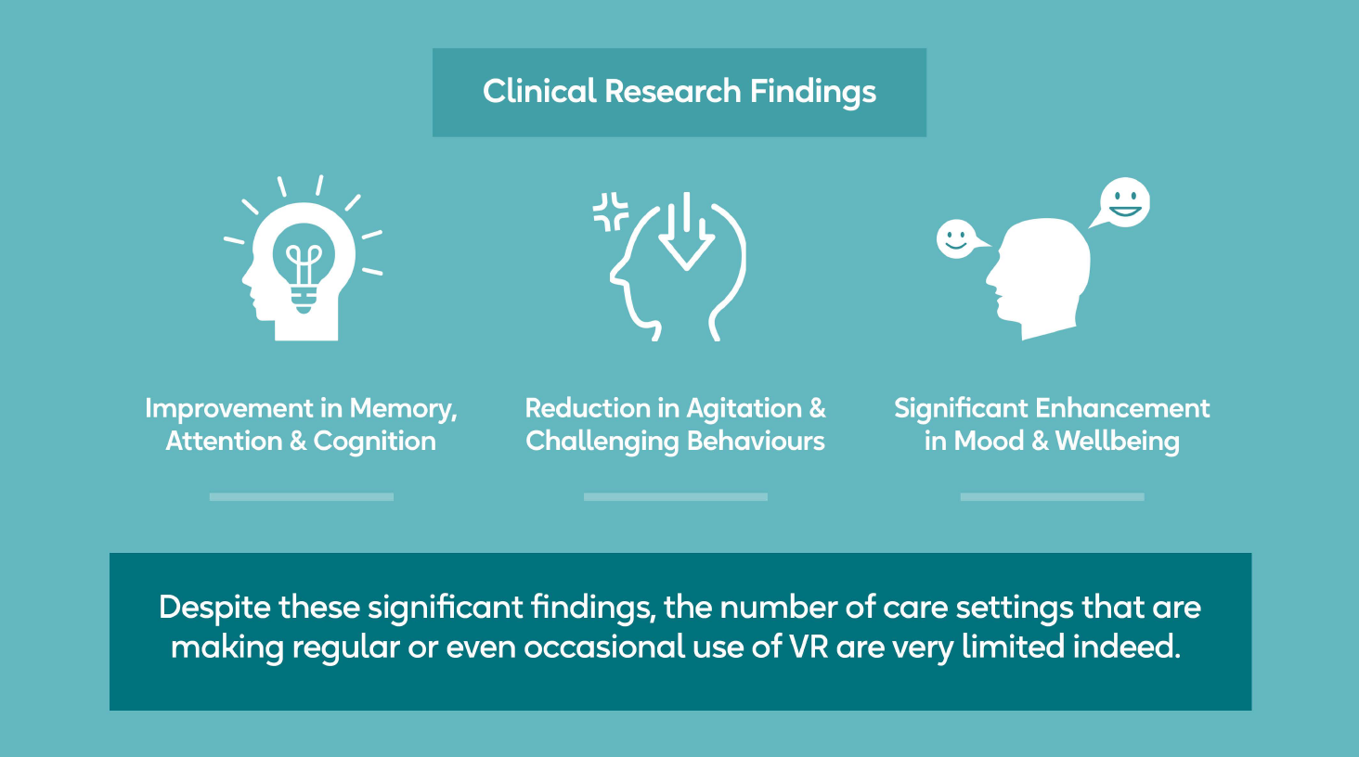

Slide 46
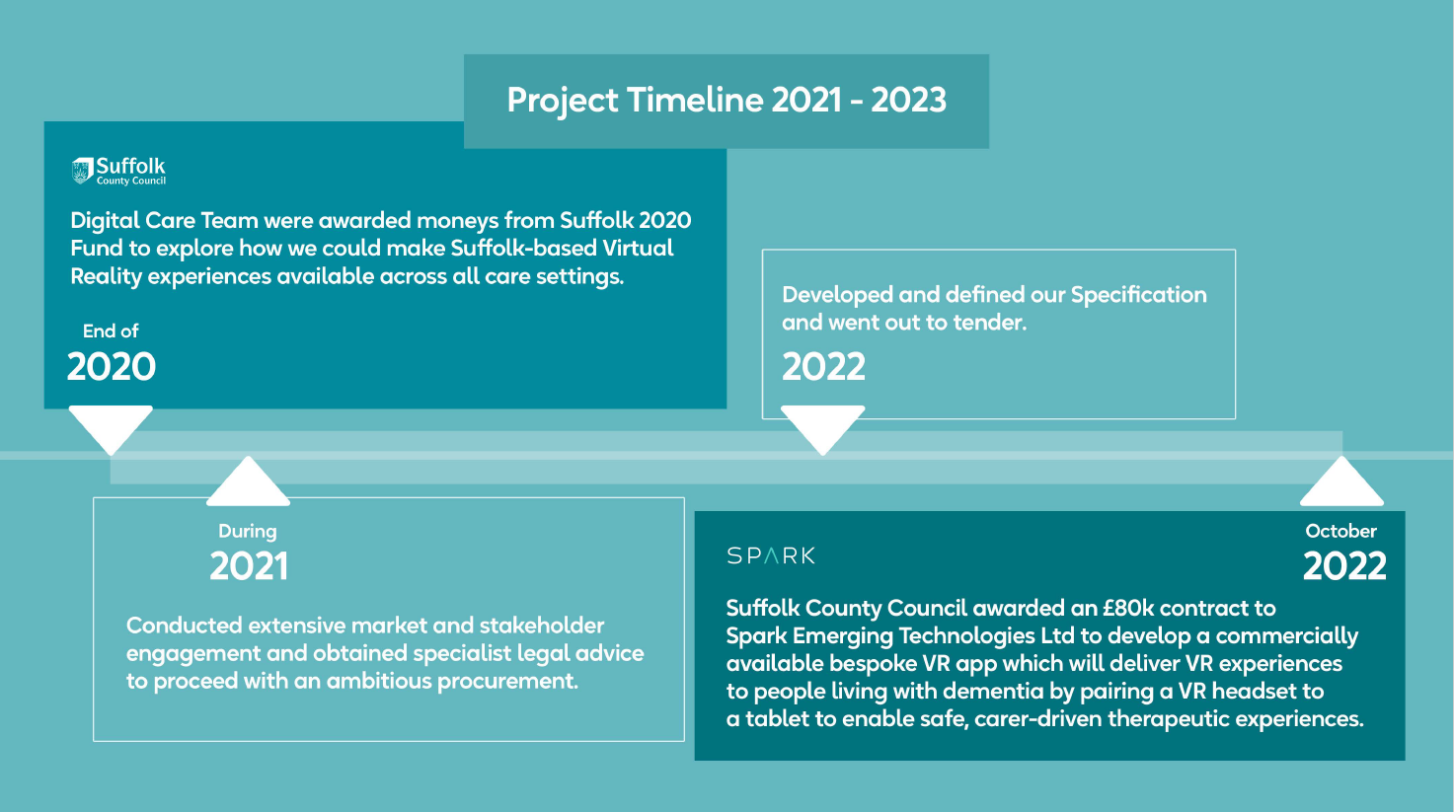

Slide 47

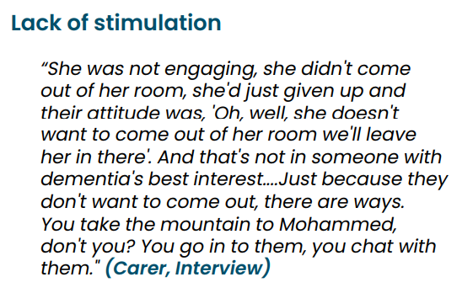
Healthwatch Suffolk’s Dementia Report 2023
Problem 1) Cognitive Stimulation

Slide 48
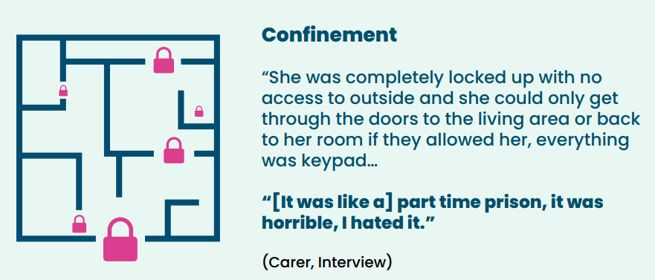
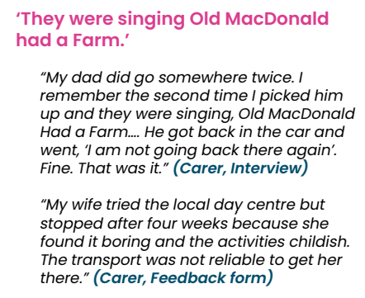
Healthwatch Suffolk’s Dementia Report 2023
Problem 2) Autonomy & Freedom
Problem 3) Personalisation

Slide 49
A carer’s view of VR
“You can’t get them to a forest walk every day, you can’t get them to a beach every day, you can’t get them to a cathedral every day and it’s as close to those environments that they can then get to regularly … so it’s… definitely beneficial for them because I mean [the PWD] wouldn’t have seen the lovely countryside today if it hadn’t of been virtual reality unfortunately … so it’s great. It stimulated him.”
Carer cited in (2021) Rose et. al. “Bringing the outside in: The feasibility of virtual reality with people with dementia in an inpatient psychiatric care setting”. Dementia, 20 (1), pp. 106-129

Slide 50


A summary of the contract
The VR app will link a laptop with a VR headset to enable carer-driven, supported VR experiences.
This means that the carer will be able to pause or stop the film if the user is becoming bored or in anyway distressed.
No dependency on Wi-Fi.
Once the build of the app and testing is complete, the app will be openly commercialised with Spark.
ROI - SCC have secured a significant discount on the cost of set-up and subscription which it will make available to all accredited care settings in Suffolk.
Spark will supply hardware and provide ongoing software support.
App will enable personalised VR experiences tailoured to individual interest and likes.

Slide 51


Slide 52
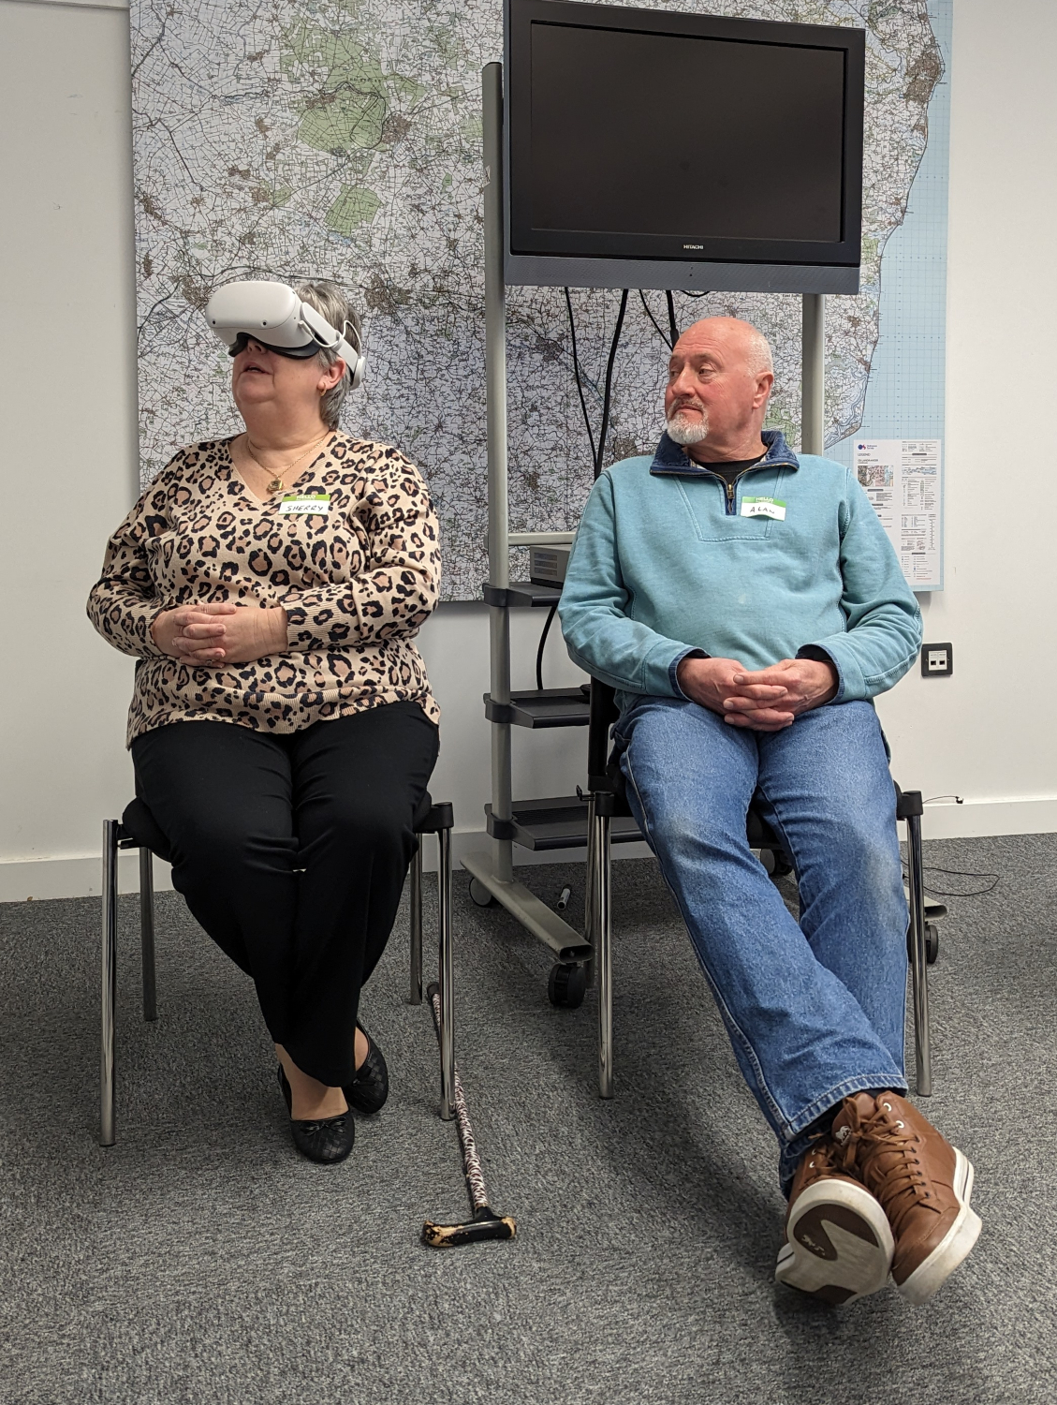
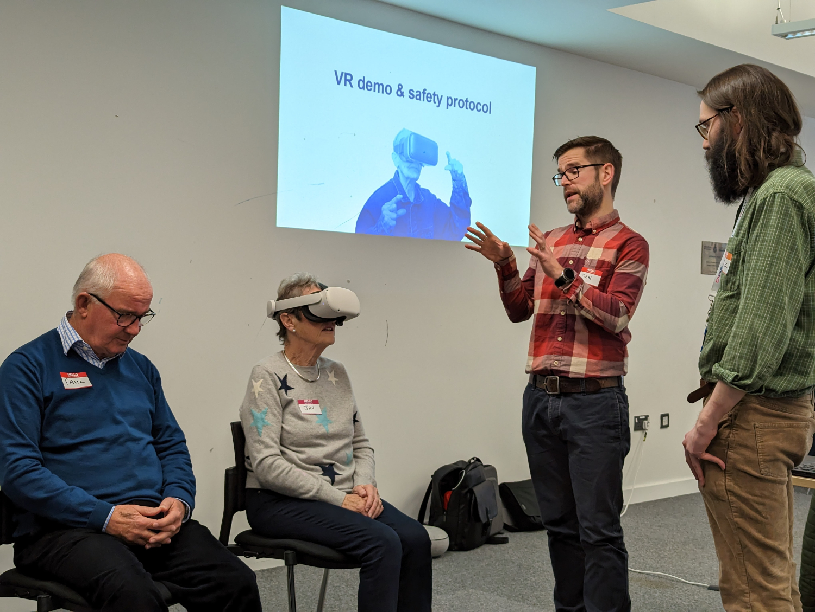
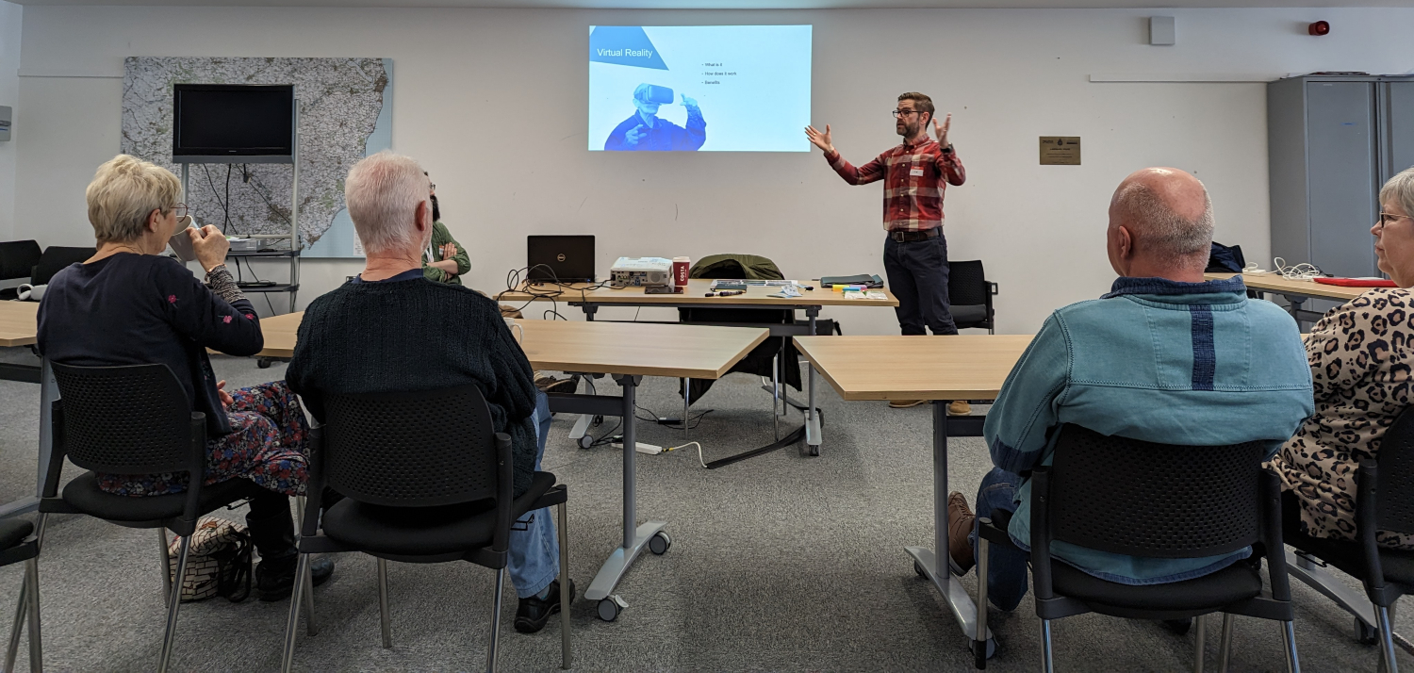
Synergy Workshop 1: March 2023

Slide 53
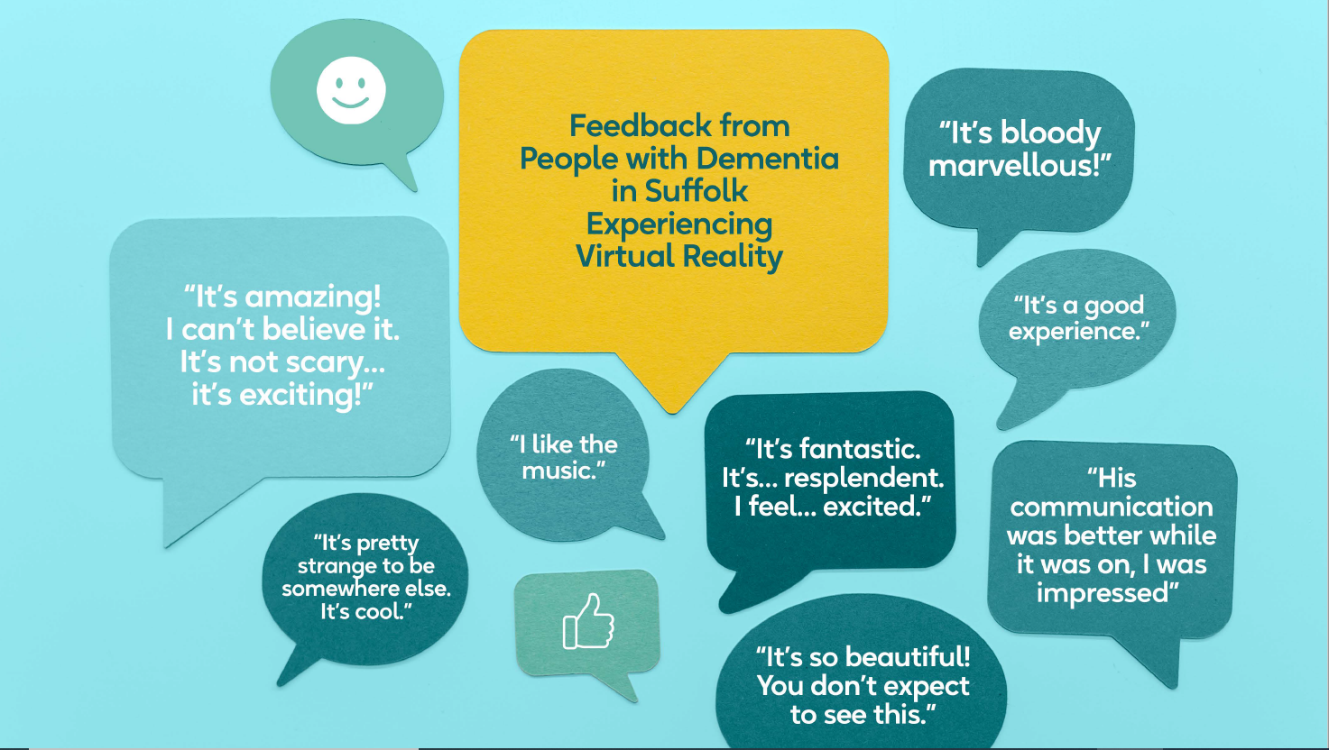

Slide 54
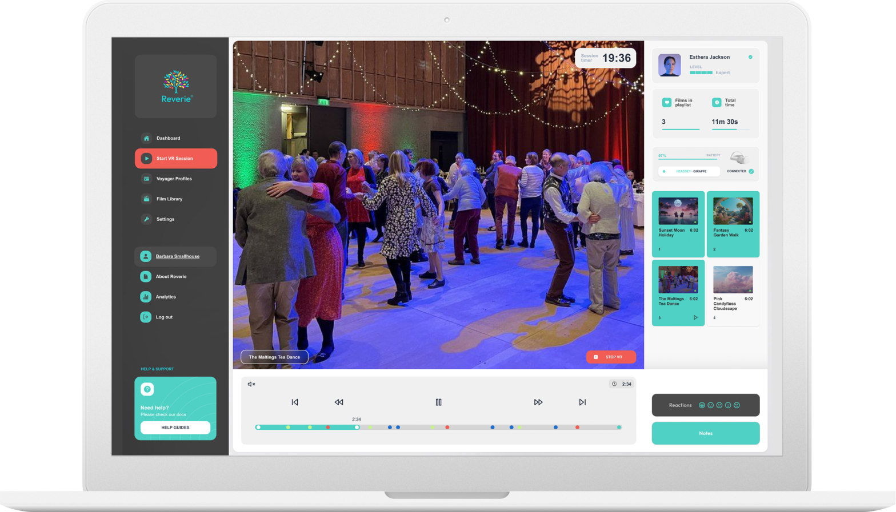
Development: 2023 - 2024
2023
# Co-production over Reverie Lobby & Branding
# Commencement of film capture – Southwold / Bury St Edmunds / Cycle ride from Thorpeness / Snape Maltings / Flatford Mill / Colchester Zoo
# Back-end work on the app to enable system to be Wi-Fi free;
# Planning of UI structure of the app;
2024
# Cyberessentials certification & DPIA sign-off
# External Website Build
# Co-production of Front-end development of app
# Hardware confirmation
# Trial in Care UK Care Home & Day Centre
# Collateral Resources
# Sign-off by SCC

Slide 55

How to get Reverie: 1/ Hardware – one-off cost 2/ Software – Monthly or annual payment for license
There is a substantial and exclusive discount available for ALL Suffolk care providers on both the hardware and software. Contact Reverie for details.

Slide 56
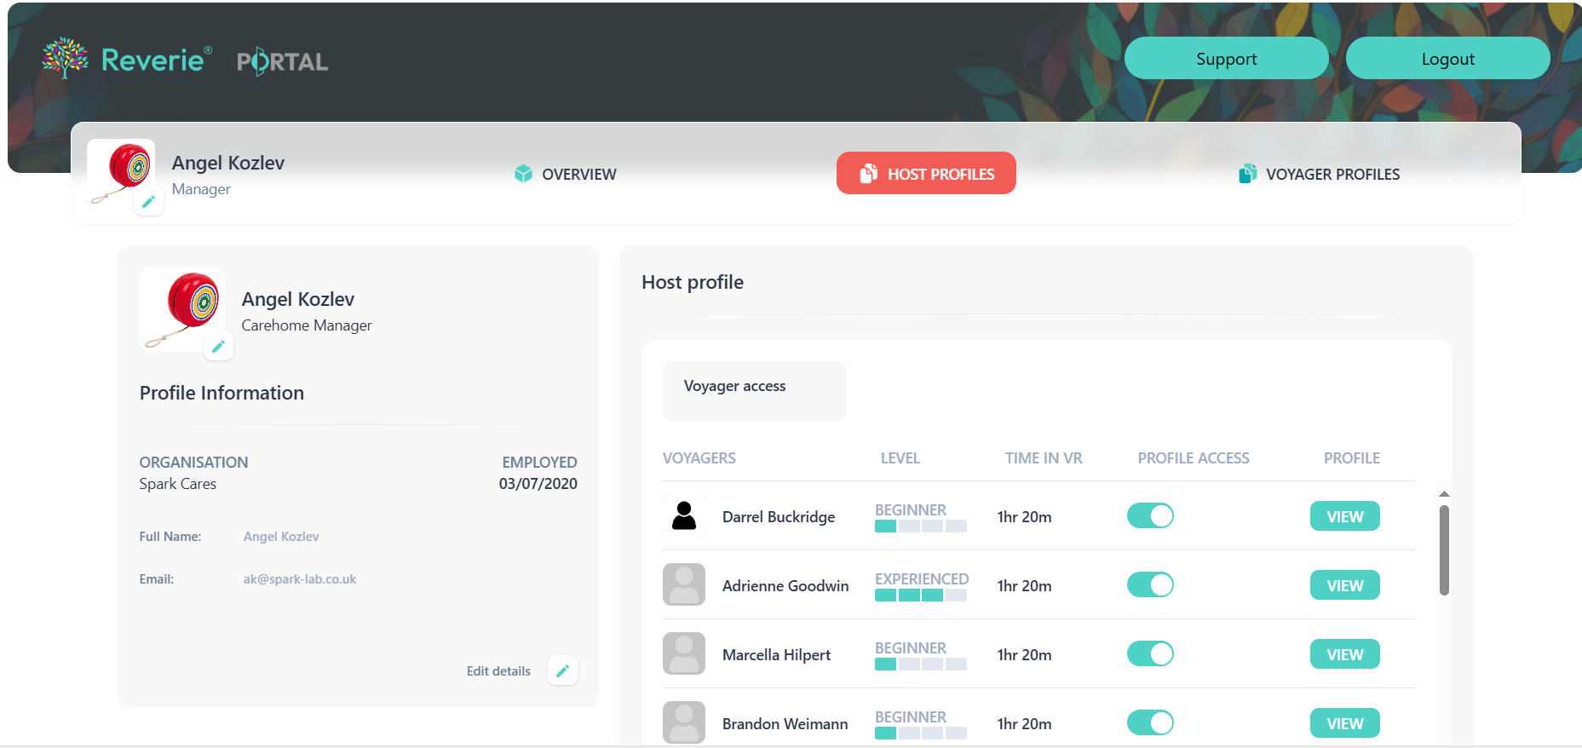

Slide 57
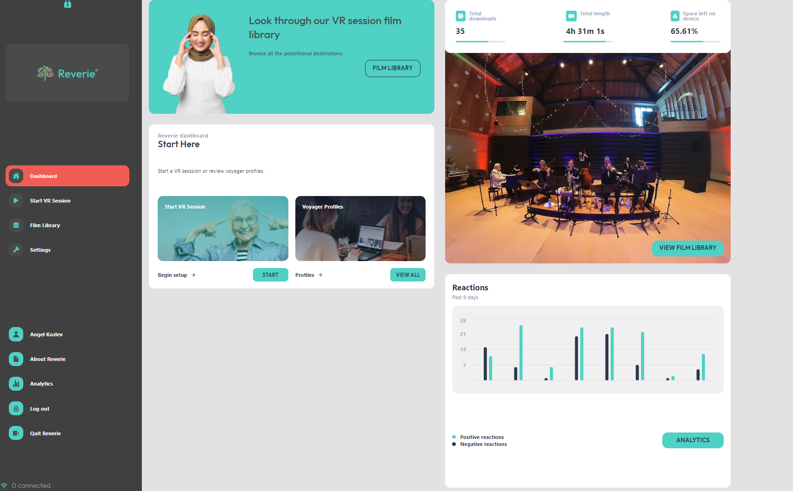

Slide 58
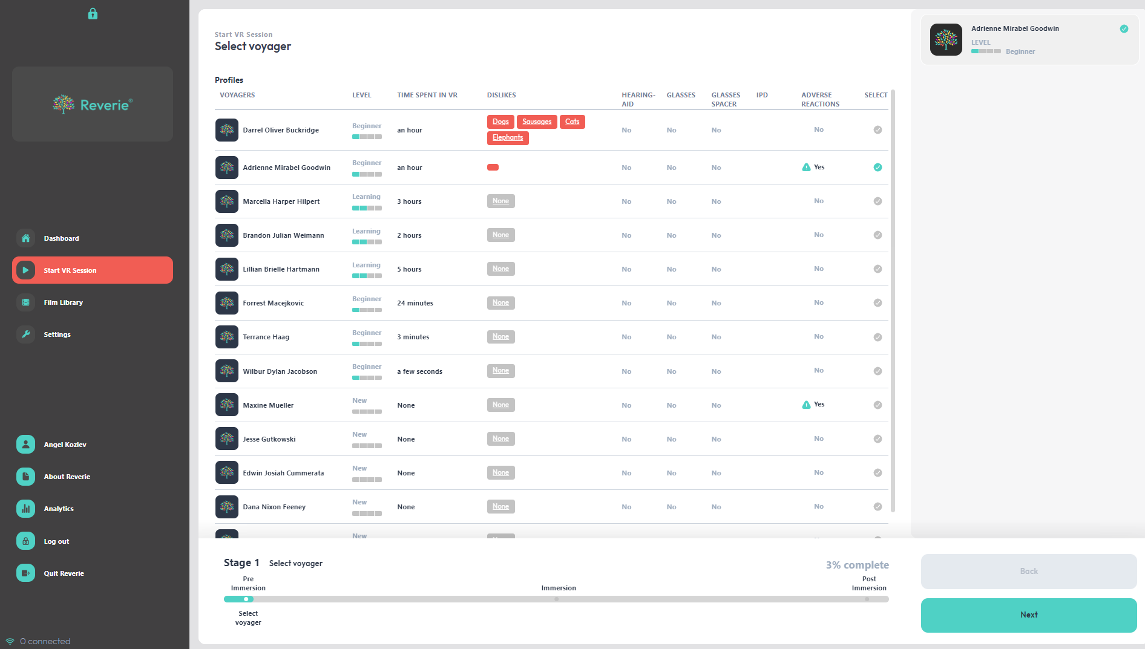

Slide 59
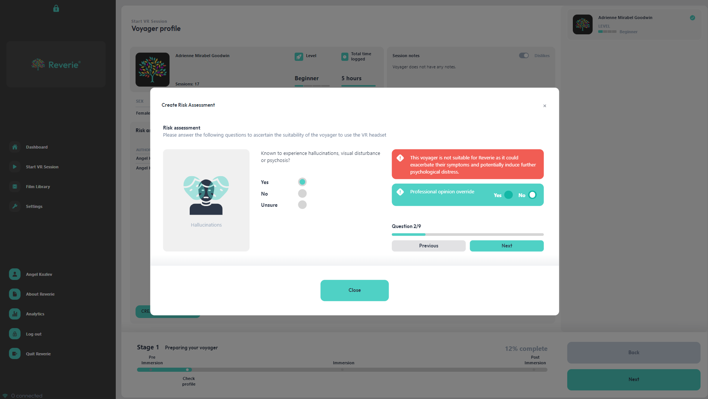

Slide 60
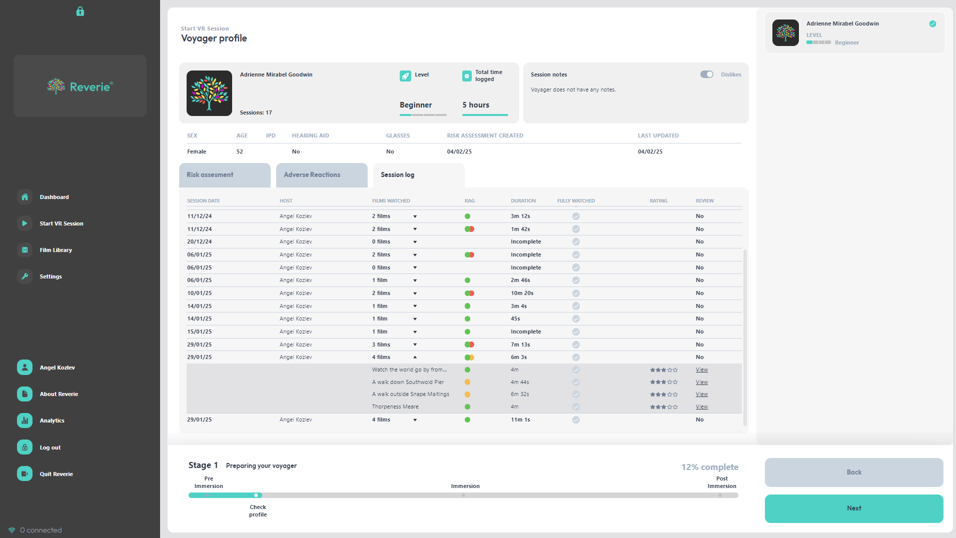

Slide 61
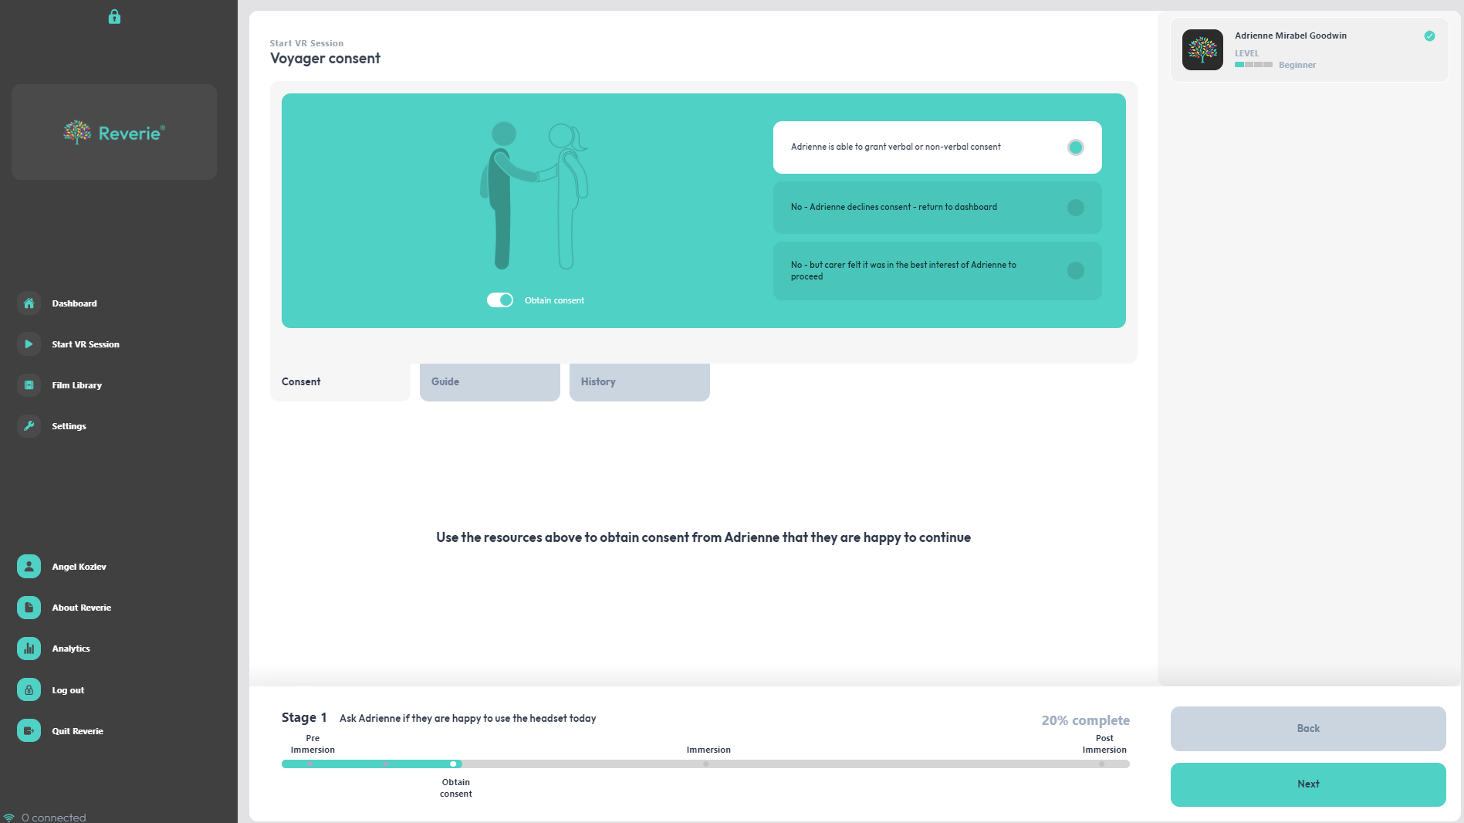

Slide 62
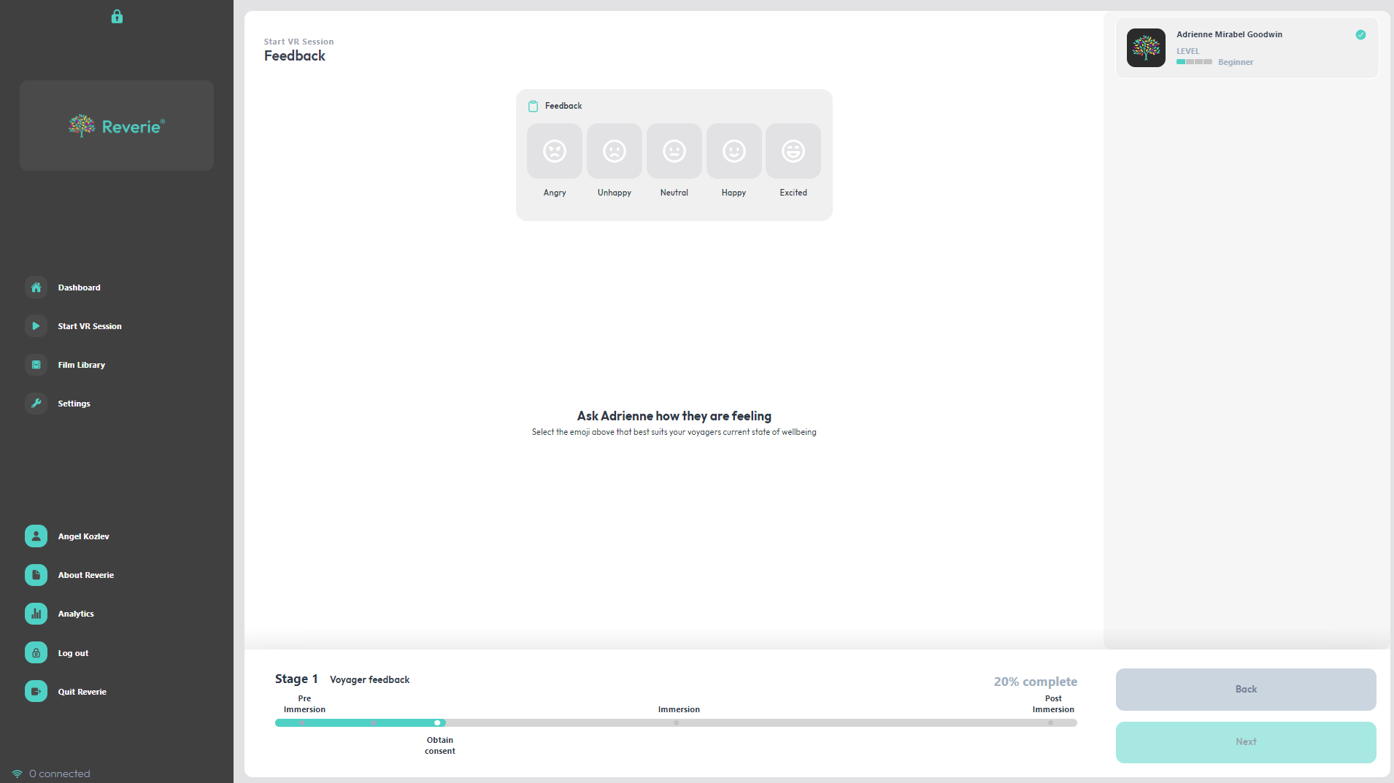

Slide 63
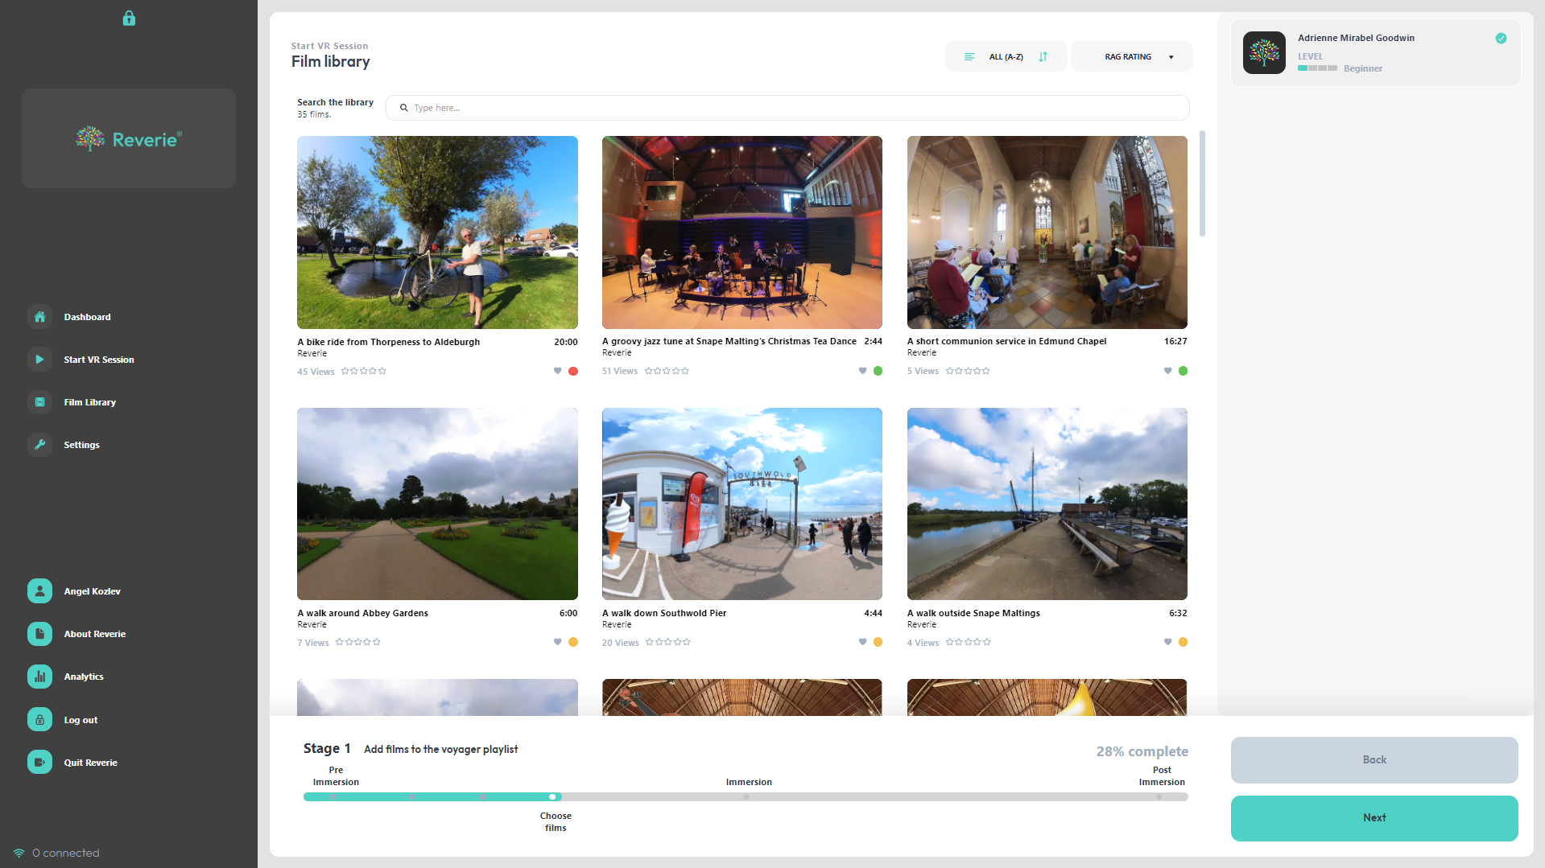

Slide 64
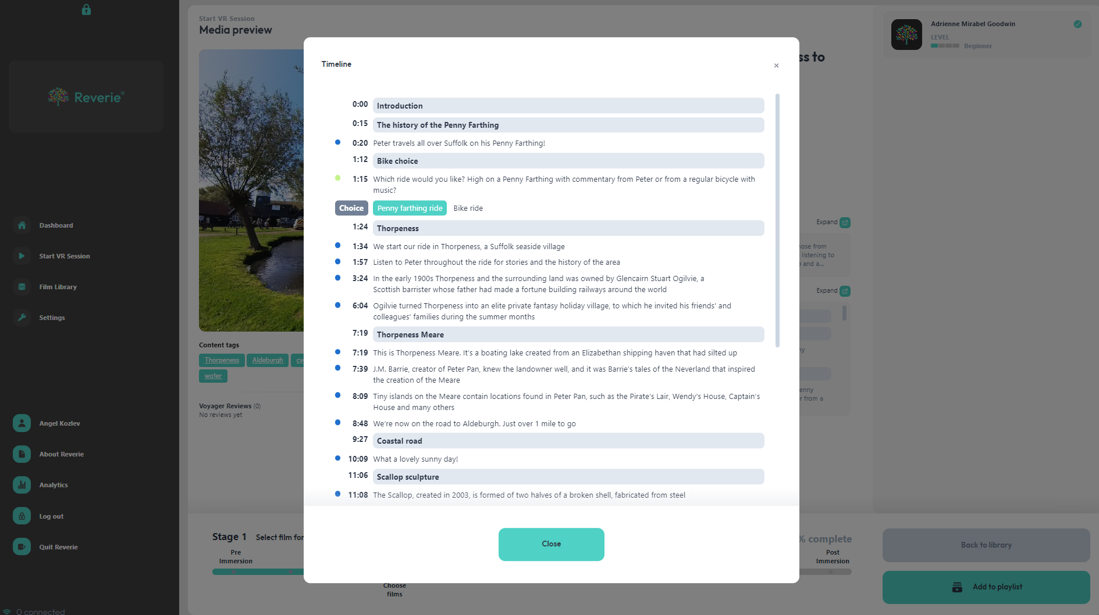

Slide 65
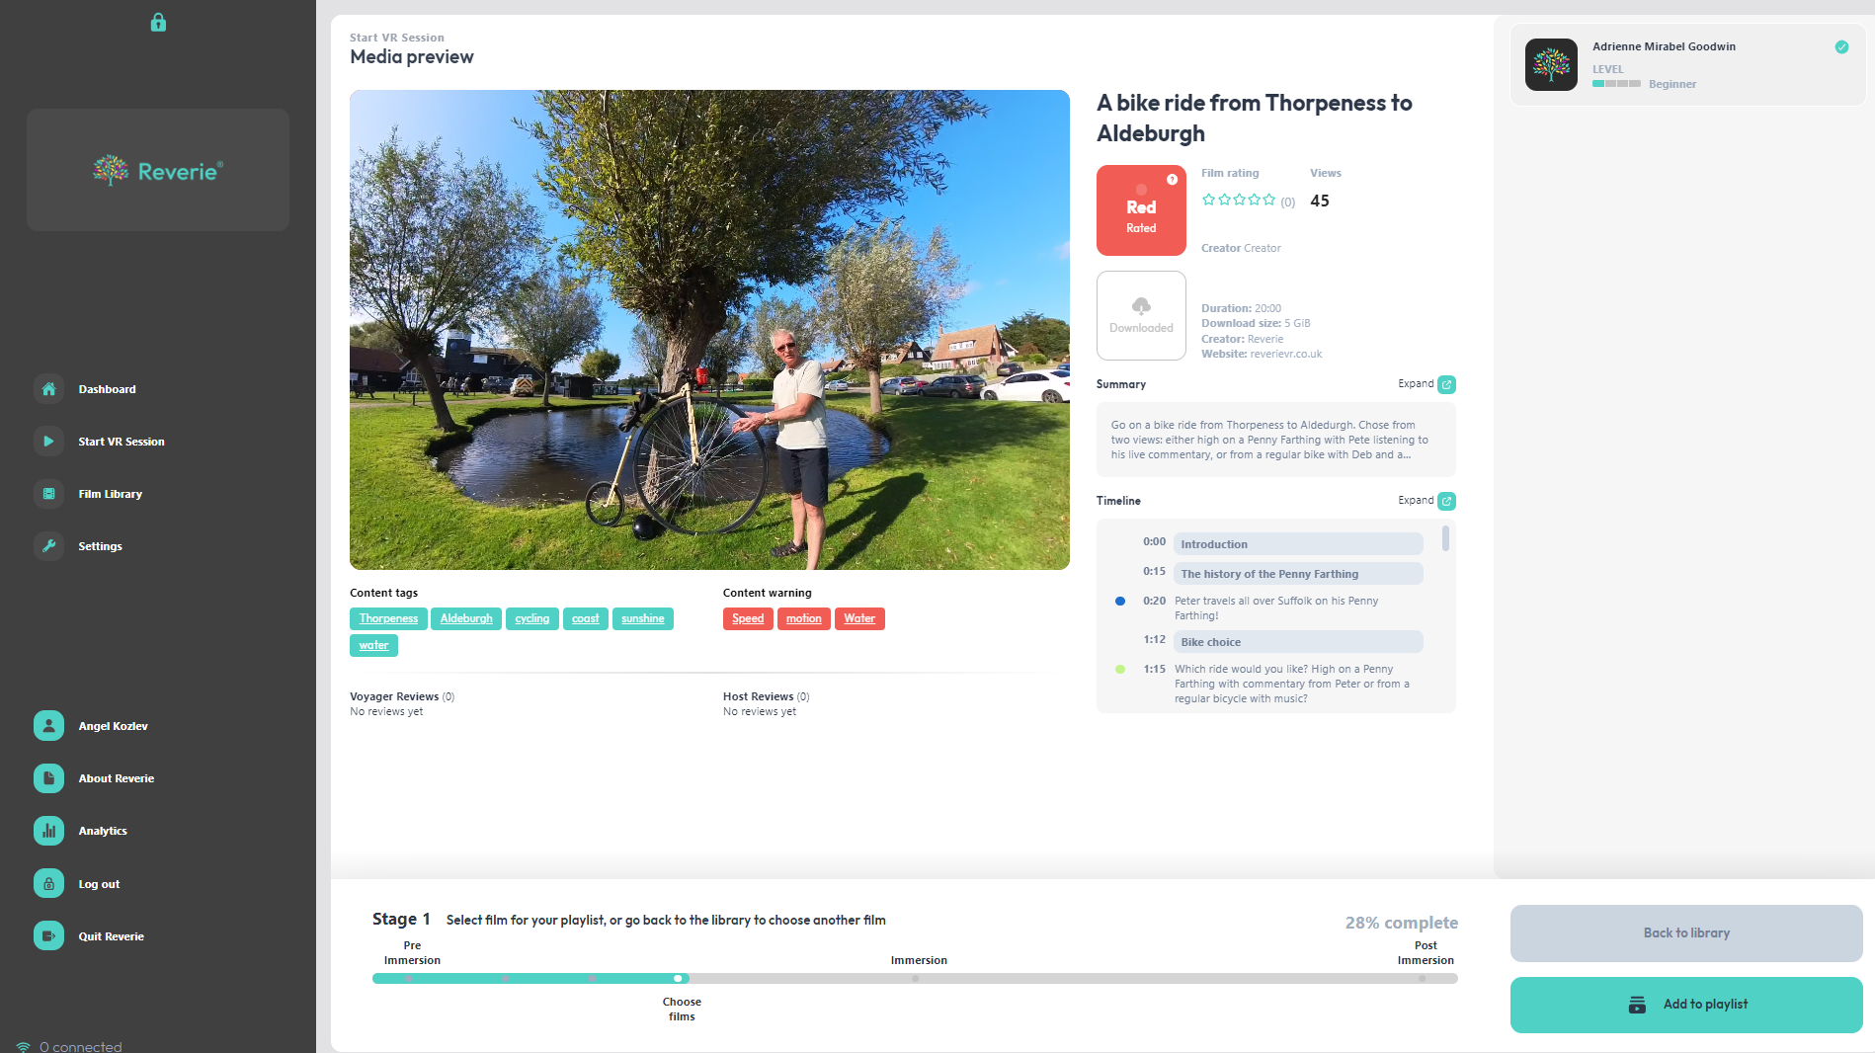

Slide 66
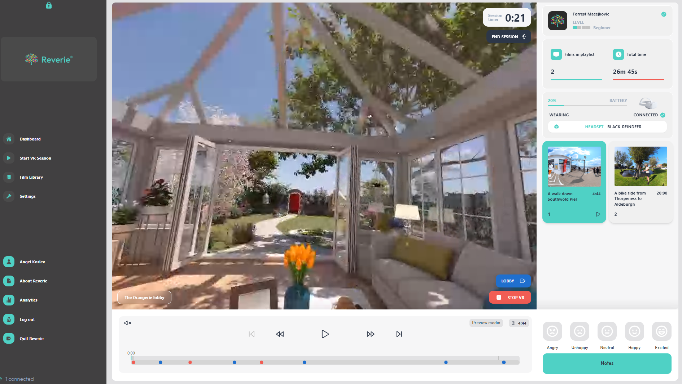

Slide 67
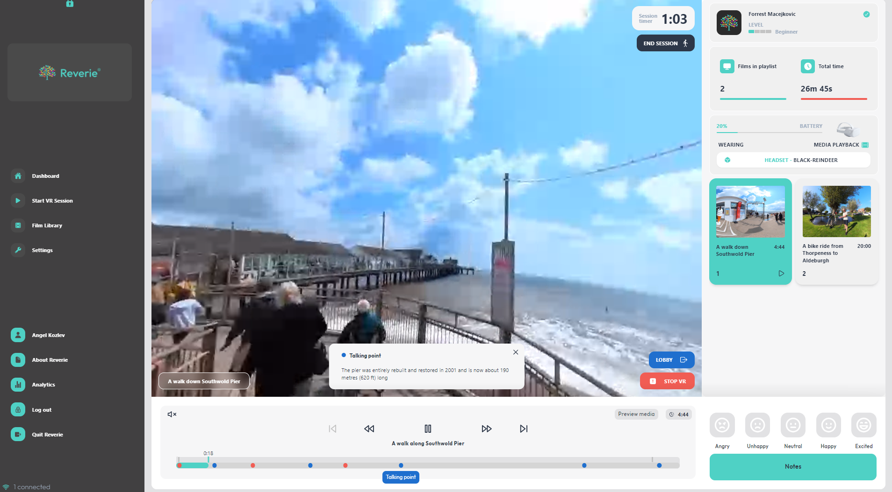

Slide 68
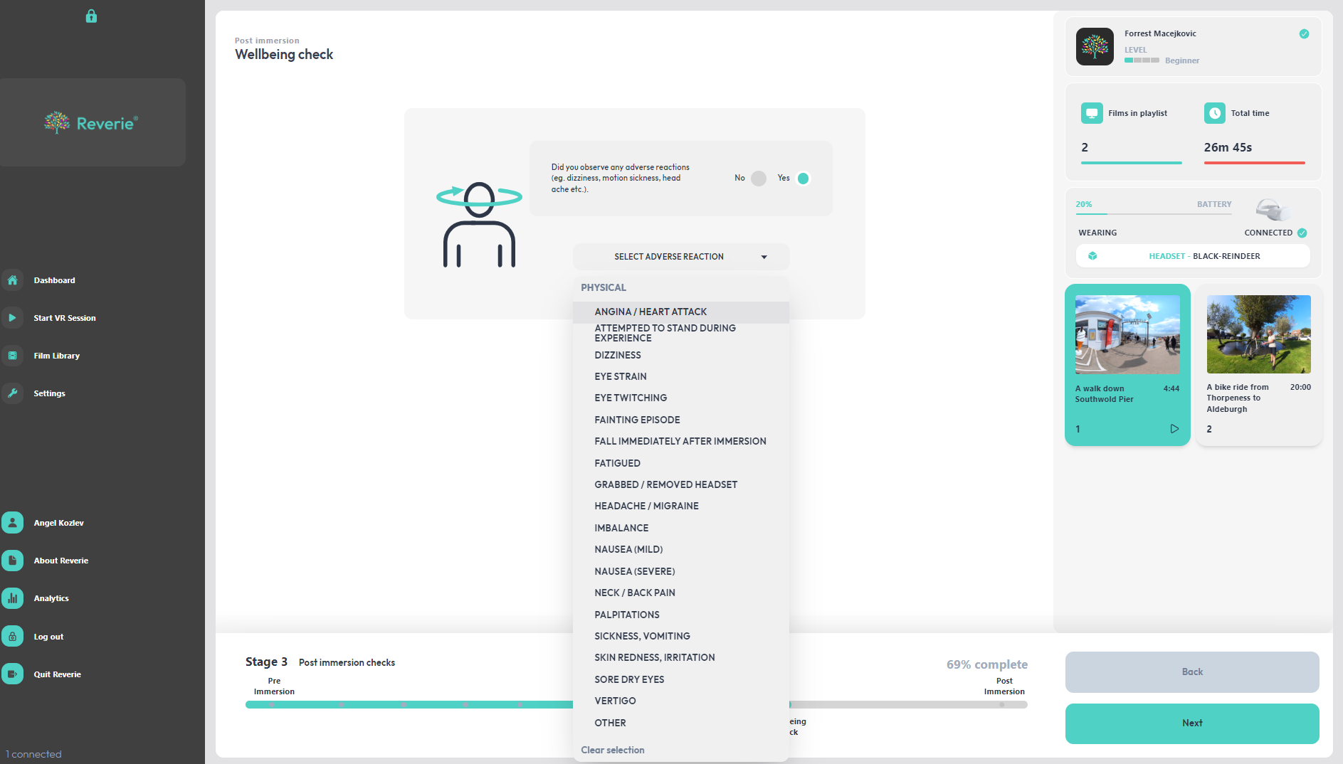

Slide 69
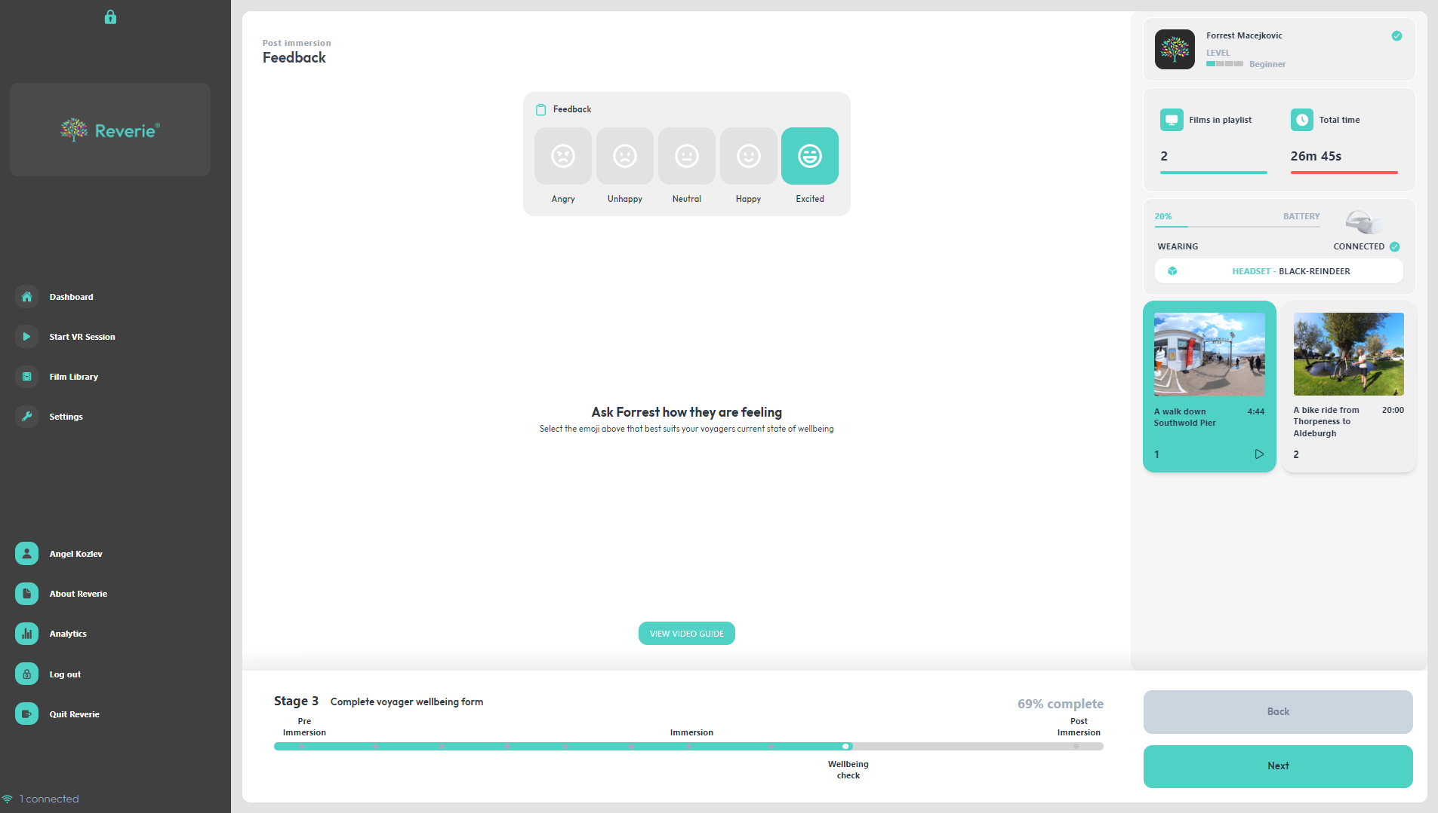

Slide 70
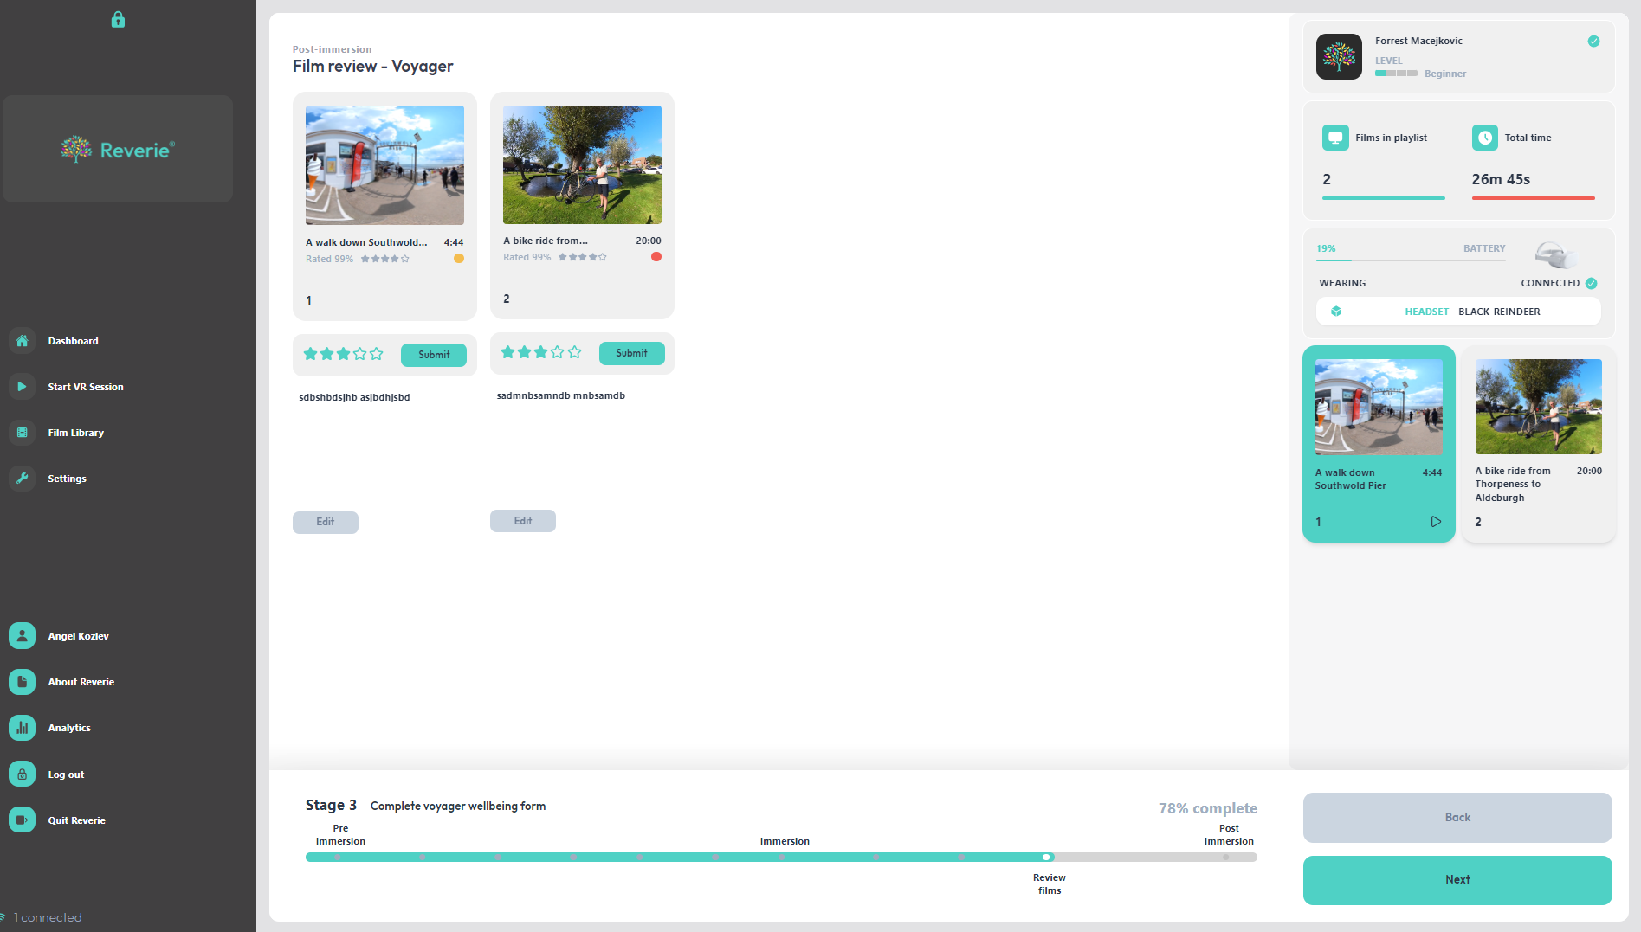

Slide 71
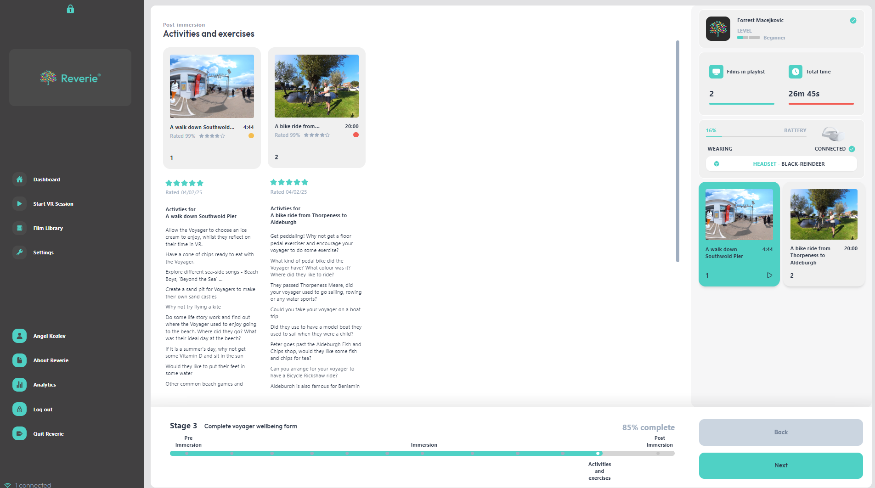

Slide 72

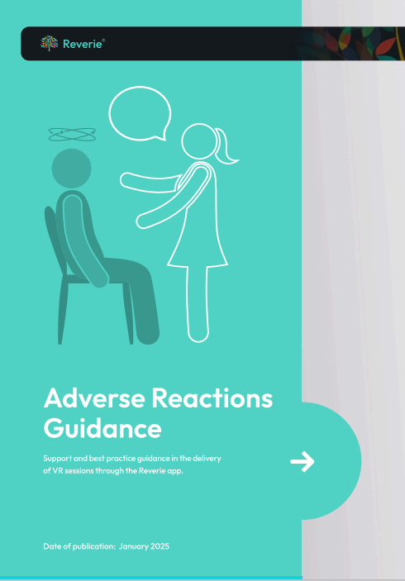
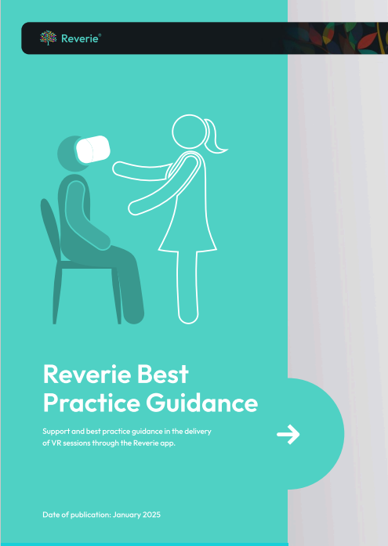

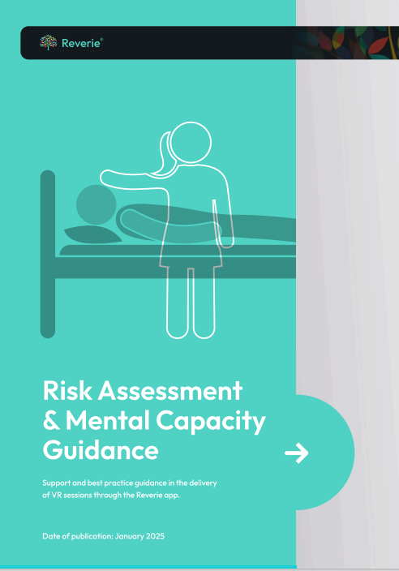
A range of guides have been written and are being uploaded to the app and portal platforms to ensure there is adequate support for the application.

Slide 73


The Website is now live! Please contact the Reverie team to get your exclusive and substantial discount on the cost of the hardware and the software!
www.reverievr/suffolk.co.uk

Slide 74
10 Minute break

Slide 75
Jenny Gallant
Learning Consultant

Slide 76
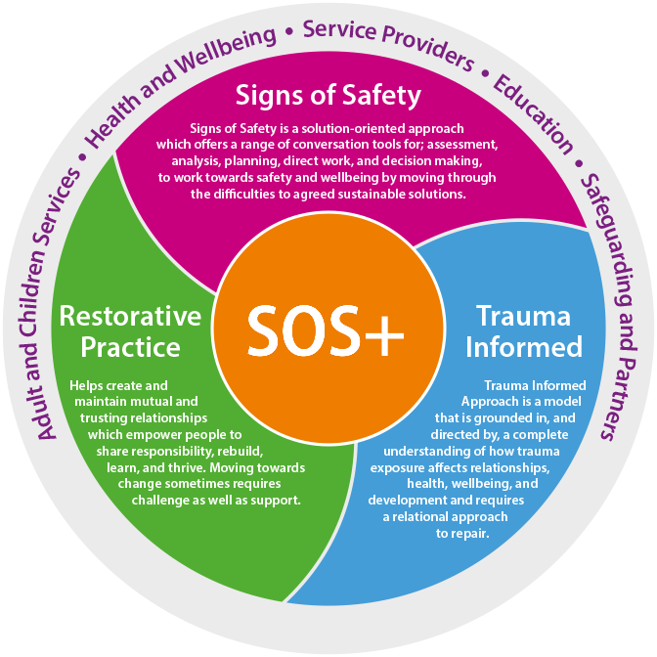
Welcome to SOS+

Slide 77


Notes:
On your table you will find a copy of the Take What you Need Tokens. These have been created by Dr Karen Triesman, who you may have already heard of. She is a trauma specialist who has created lots of amazing resources that we will use in the SOS+ learning programme.
These tokens can be used to help us think about what ourselves and other might need in order to feel supported and safe. You can use these tokens in a number of ways, but for the purposes of today we are going to use them to help identify what everybody needs in order to make this space a successful learning environment for everyone.
There is something really positive about starting the day by taking something you need and offering the same opportunity to others.
Take some time to think about what you need today, there may be things you can think of that aren’t on the screen.
We are going to use the Take What you Need Tokens to shape our AGREEMENT FOR SUCCESS. These are guidelines developed by everyone working together to identify what they need to feel safe in the learning environment to achieve their best.
Agreement for success align with restorative approaches to prevent relationship struggles from happening, and can be used a start of any conversation whether that conversation is with peers, colleagues or the people we are working with.
We’ve returned to face to face training, and this might come with some challenges. This is the space for us to try and iron some of those things out. For example, some of you might feel the need to get up and walk around. These are the types of things that we need to think about.
Table Activity: 20 mins total (10 mins to prepare – 10 mins to share)
As a group consider what you will agree to, to meet everyone's needs within the group and what you will agree to in order to meet the needs of others in the room. You may want to use some of the needs highlighted in the word cloud to shape your Agreement for Success.
Write your Agreement for Success on the paper
Feedback:
Choose two Agreements for Success to share with the room.

Slide 78


Notes:
When you go onto CPD there is a specific tile for Signs of Safety – if you click on that it will list all the courses

Slide 79
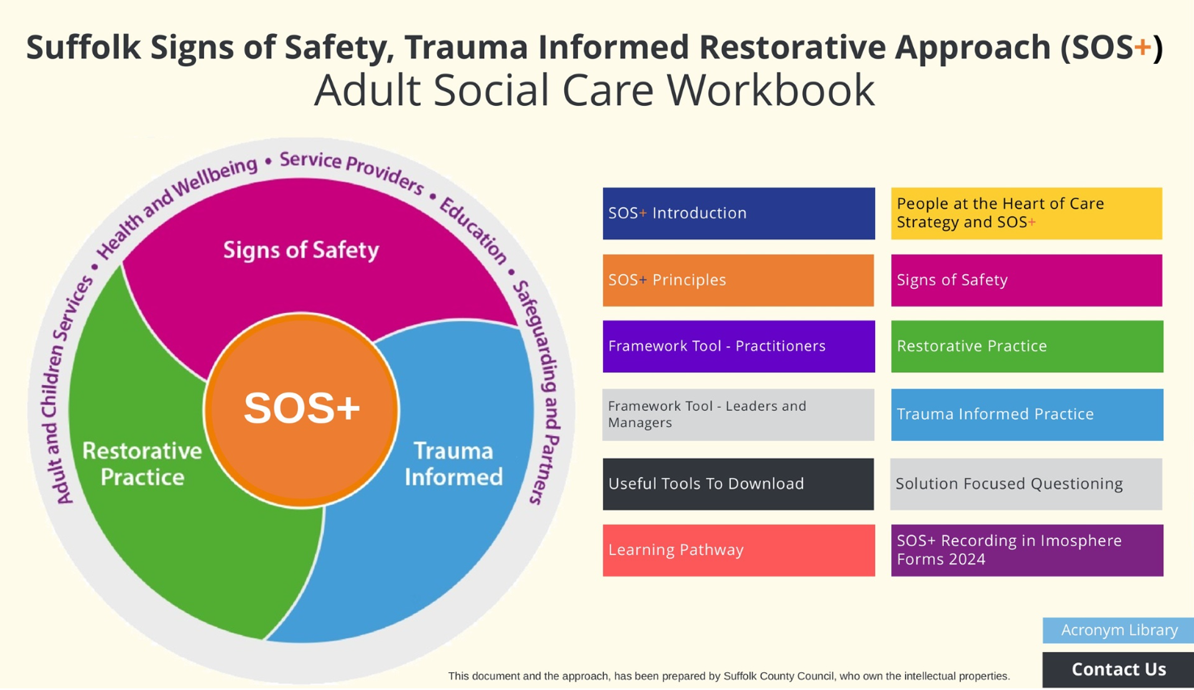
Notes:
LINK FOR WORK BOOK
https://view.pagetiger.com/Workforce-Development/signs-of-safety-acs
We have an electronic workbook that everyone will be able to access which gives details of the principles and the framework and gives lots of useful tools and useful questions to support a trauma informed, restorative solution-oriented approach.
.

Slide 80
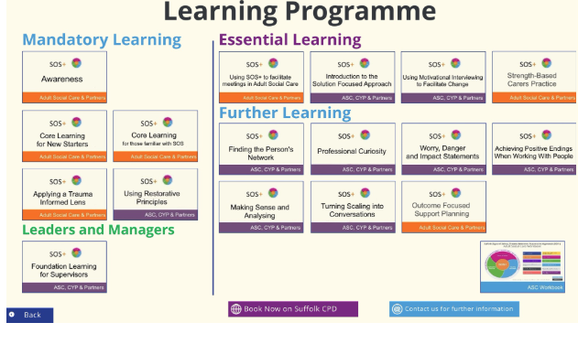
SOS+ Core Learning Offer on Suffolk CPD
Notes:
SoS+ Awareness
Suffolk Signs of Safety, Trauma Informed and Restorative approach (SOS+) is an integrated approach which brings together the key elements from Signs of Safety, Trauma Informed and Restorative practices. At the heart of our role as a county council is working with, individuals and communities, to keep them safe, health, well and cared for. We are committed to doing the best we can for the wellbeing of the people of Suffolk.
When booking your learning, be mindful that the sessions run for 3 hours. You will be required to attend the whole session.
Learning Outcome:
This workshop will provide an understanding of the three integrated practices of SOS+ and how they may support you in your role, this may be completing a referral or gathering information for an assessment.
SoS+ Core Learning for New Starters
Signs of Safety is a solution oriented, person-centred practice approach which supports people to have choice and control which is at the heart of our planning, commissioning, and delivery of social care support in Suffolk and supports the People at the Heart of Care Strategy. Our vision is to encourage people to live as independently as possible with access to support and activities from friends, family, and their local community. The Signs of Safety practice approach supports all conversations, assessments, analysis, planning, direct work, and decision making.
The enhanced practice approach (SOS+) brings together the key elements from Signs of Safety, Trauma Informed and Restorative practices.
This workshop forms part of an ESSENTIAL LEARNING PROGRAMME and is for everyone who works directly with people or uses Signs of Safety in their assessments, supervisions, and recordings. When booking your learning, be mindful that you are required to attend both days.
Learning Outcome:
This 2-day workshop programme will provide an understanding of the three integrated practices of Signs of Safety, Trauma Informed Practice and Restorative Practice. Understanding and applying the practice principles and the practice framework tool. We try to accommodate all learning styles, personalities, and abilities, with regular breaks and reflection time. We combine diverse activities to ensure input content is manageable and can be processed well. Our training is interactive and provides an opportunity for self-reflection and peer learning.
SoS+ Core Learning for those familiar with SoS
Signs of Safety is a solution oriented, person-centred practice approach which supports people to have choice and control which is at the heart of our planning, commissioning, and delivery of social care support in Suffolk and supports the People at the Heart of Care Strategy. Our vision is to encourage people to live as independently as possible with access to support and activities from friends, family, and their local community. The Signs of Safety practice approach supports all conversations, assessments, analysis, planning, direct work, and decision making.
The enhanced practice approach (SOS+) brings together the key elements from Signs of Safety, Trauma Informed and Restorative practices.
This workshop forms part of an ESSENTIAL LEARNING PROGRAMME and is for everyone who works directly with people or uses Signs of Safety in their assessments, supervisions, and recordings.
SoS+ Applying a Trauma Informed Lens
SOS+ is an integrated approach which brings together the key elements from Signs of Safety, Trauma Informed and Restorative practices. Trauma Informed Practice is a model that is grounded in and directed by a complete understanding of how trauma exposure affects people’s health, wellbeing, and development.
This workshop helps to acknowledge the skills needed to ensure people affected by trauma are recognised and responded to in a way that prevents re-traumatisation.
This workshop forms part of an ESSENTIAL LEARNING PROGRAMME and builds upon the learning from the SOS+ Core Workshops. When booking your learning, be mindful that you will be required to attend the whole session.
Learning Outcomes:
This workshop will promote an awareness and understanding of the impact that experiencing trauma may have on the people that we work with. This includes the people we support and their families, as well as staff and other colleagues.
It will also provide the opportunity to consider and reflect on our practices, attitudes and behaviours using a trauma informed lens and underpinned by relevant psychological thinking.
SoS+ Using Restorative Principles
Restorative practice describes a way of being which enables us to build and maintain healthy relationships. This includes a range of approaches to manage conflict and tensions in a way that repairs harm and mends relationships. Restorative practice focuses on a systemic and relational shift to create a secure and safe environment, to improve the emotional wellbeing of all. Restorative practice promotes a culture where people are pulled in, not pushed out, creating a greater sense of community, and encouraging a willingness to act in the right way for the right reasons.
This workshop forms part of an ESSENTIAL LEARNING PROGRAMME and builds upon the learning from the SOS+ Core Workshops. When booking your learning, be mindful that you will be required to attend the whole session.
Learning Outcomes:
To provide an overview of the core restorative mindset, principles, and model key practices, including the use of restorative language and questions.
Restorative practitioners believe:
Everyone has their own unique perspective on a situation or event, and needs an opportunity to express this, and feel heard
What people think at any moment influences how they feel which informs how they behave
Our actions and deeds impact on those around us. When a situation occurs those involved can help to find ways forward together
When our needs are met, we function at our best.
SoS+ Foundation Learning for Supervisors
The interactive workshop will provide an opportunity to reflect on your own experience of supervision and provide a theoretical base and range of practice tools to support your role as an aspiring supervisor or for those who already supervise. The two day programme will cover:
Your journey to becoming a practice supervisor
Functions of supervision
Promoting emotional resilience and having reflective discussion in supervision
Developing the skills of our supervisee
Leading and influencing others in your organisation
Promoting evidence informed practice
Reviewing your learning
*Please ensure you refrain from attending this learning session with your line manager or supervisee. The reflective space is to support your growth and development as a supervisor. You will explore your experience of supervision and this may be more challenging if you are in the session with your current or past supervisor.
Using SoS+ to Facilitate Meetings in Adult Social Care
This workshop is part of the SOS+ suite of learning and is for people who want to know more about how to apply SOS+ principles when facilitating meetings in Adult Social Care.
Learning Outcome:
To provide an overview of the application of the SOS+ core principles alongside a variety of tools to support facilitating meetings.
SoS+ Introduction to the Solution Focused Approach
Integral to SOS+ is applying a solution-oriented approach to facilitate change and move towards agreed solutions. This learning is part of the SOS+ suite of learning.
Solution Focused approaches are formed on the belief that the person holds the resources and hope for change.
This session introduces the Solution Focused Approach, identifying where the approach has come from and how it has developed and when and how the approach could be used.
During the session we will explore the principles that underpin the approach and experience using Solution focused questions and techniques.
SoS+ Using Motivational Interviewing to Facilitate Change
This workshop is part of the SOS+ suite of learning and is for people working in both ASC and CYPS who want to know more about how to apply the principles of the Cycle of Change and Motivational Interviewing techniques to their conversations and interventions.
Motivational interviewing is a collaborative, goal-oriented style of communication with particular attention to the language of change. It is designed to strengthen personal motivation for commitment to a specific goal by eliciting and exploring the persons own reasons for change within an atmosphere of acceptance and compassion. Motivational Interviewing: helping people change. Miller & Rollnick 2012. The approach is used to support the person to consider their readiness for change, including their motivation and confidence. Motivational Interviewing focuses discussion upon the gap between the life we are living and the life we want, how we are behaving and how we want to behave. Through exploring the persons own resistance and ambivalence towards change helps them identify how ready they are, and what might need to happen to get started.
SoS+ Strength-Based Carers Practice
This learning is part of the SOS+ suite of learning and is for people working in Adult Services who support Carers and/or complete Carers Assessments.
In this training program we explore how we adopt a strengths-based mindset. How we can support carers to build on their strengths and resources to feel more in control of their situation. Promoting independence by taking a holistic view of the carers needs, including their network and community resources.
SoS+ Finding the Person's Network
This interactive virtual workshop is for people who have completed their core Signs of Safety learning and want to expand their knowledge and application of how to identify and including people who are involved in the everyday lives of the adult or child to enhance planning.
The workshop programme will provide an opportunity to reflect on your own experience of practice and provide a theoretical base and range of practice tools to support your role.
The session will cover
Theoretical knowledge and research
A range of Advanced tools to identify important people
Skills to overcome the challenges
Techniques to support involvement with planning, building solutions and long-term success.
Close
SoS+ Professional Curiosity
This interactive virtual workshop is for people who have competed their core signs of safety learning and want to expand their knowledge and application of being professionally curious.
Fostering professional curiosity and challenge are a central aspect of working together to keep children, young people, and adults safe. This interactive session will explore what this means to you, how you remain curious at times when you’re faced with uncertainty, and how the application of the Signs of Safety principles underpin being curious.
SoS+ Worry, Danger Impact Statements...Statements of Unmet Need
This interactive virtual workshop is for people who have completed their core Signs of Safety learning and want to expand their knowledge and application of Danger/Worry/Impact Statements. The workshop programme will provide an opportunity to reflect on your own experience of practice and provide a theoretical base and range of practice tools to support your role.
The session will cover:
Exploring what worries are and what can influence our perception of them.
Describing what a Danger/Worry/ Impact Statement is.
Exploring what makes a good Danger/Worry/ Impact Statement.
Skills practice
SoS+ Achieving Positive Endings When Working With People
This interactive virtual workshop is for people who have completed their core SOS+ learning and want to expand their knowledge.
It will provide an opportunity to reflect on your own experience of practice and provide a theoretical base and range of practice tools to support your role.
Endings can be a difficult and emotive subject to explore, and we encourage self-reflection during the session. Please discuss with your manager in advance if you feel support may be required.
The session will cover:
Exploring what endings mean to us…
Exploring how we can support those we work with to have good enough endings?
Thinking about the difference good enough endings make…
Skills practice
SoS+ Making Sense and Analysing
This interactive virtual workshop is for people who have completed their core Signs of Safety learning and want to expand their knowledge and application of making sense of the information that is gathered when working with children, families, and adults through critical analysis.
The workshop programme will provide an opportunity to reflect on your own experience of practice and provide a theoretical base and range of practice tools to support your role.
The session will cover
Know when to stop gathering information and make sense of what you have
Evidence your starting points and find out if there is anything else you need to know
Understand how critical analysis can support planning and long-term success
Close
SoS+ Turning Scaling into Conversations
This interactive workshop is for people who have completed their core Signs of Safety Learning and want to expand their knowledge and application of scaling.
The workshop programme will provide an opportunity to reflect on your own experience of practice and provide a theoretical base and range of practice tools to support your role.
The session will cover:
Methodology of scaling
Developing scaling questions
How to use scaling in a meaningful way
Challenges of scaling & how to overcome the challenges
This interactive workshop is for people who have completed their SOS+ learning and want to refresh and expand their knowledge around outcomes and strength based planning in Adult Services.
In this training programmed we explore how we adapt a strengths-based mindset. Foster a Safety Oriented Approach by identifying and building on the strengths of the person and their network. How language is key to improving communication and how we consider what else other than the provision of care and support might assist the person in meeting the outcomes they want to achieve.
The session will cover:
What is an outcome based support plan in line with the Care Act 2014
The difference between Needs and Outcomes
How we can use Signs of Safety and Solution Focused questions to find out what a person wants to achieve (their outcomes)
What outcomes look like in a Care and Assessment plan.

Slide 81
Our direction of travel:
We launched SOS+ in January 2024. We developed and rolled out the SOS+ Awareness for Reablement Support Workers and providers in June 2024. Between June 2024 and August 2025 we have trained 169 delegates offering a session bi-monthly for that specific service.
Notes:
Went live with this enhanced training package in January 2024 and since then we have had 1,019 people attend training. We launched the Awareness sessions for Reablement Support Workers and Providers in April 2024 and we have run 5 sessions and trained 68 people.
We have the capacity to offer more sessions, these can be bespoke, face to face or virtual at a time that suits the needs of the delegates.

Slide 82
Some feedback from our Evaluations
Being more aware and giving people time to feel comfortable and confident.
This course lead me to a greater understanding of those in distress. I will apply this understanding by applying greater empathy.
Understanding how people may respond to different situations in different ways due to previous experiences that may affect their behaviour.
Really good experience. Felt part of the discussion and was really good to share information which expanded our knowledge.
I will be more obliged to listen and give time to every individual.
I found the course very interesting Jenny and Kara got the conversations going within in and out of the breakout rooms.
Didn’t like the breakout rooms.
It’s not always easy to build this type of relationship with our customers that invites their trust as much as we would like to. Unfortunately lack of time doesn’t always allow for this.
Thankyou I really enjoyed the course.

Slide 83

Possibility of a SOS+ forum for Providers
- Facilitated by SOS Team
Notes:
A platform (possibly Teams) that all providers can link into to see what SOS+ training is on offer?

Slide 84
SOS.Central@suffolk.gov.uk

Slide 85

Notes:
Please can I ask before you leave to click on the QR code with your phone and fill in the quick Evaluation form about todays learning.

Slide 86
Winter Care Planning –
Lisa Elmy

Slide 87

Winter Planning

Slide 88
Winter Planning – Introduction
Icebreaker Flamingo Challenge
Before testing yourself, make sure somebody is with you, that you’re in a clear area, and are wearing suitable footwear. If you feel unsteady or unwell at any time, stop the test.
Here are the rules:
Keep your eyes open and your hands on your hips
Stand on one leg without any other support
Time starts when your foot leaves the ground and stops when you put your foot back down (or take your hands off your hips)
See if you can maintain the pose for your age category.
18-39 = 43 seconds
40-49 = 40 seconds
50-59 = 37 seconds
60-69 = 30 seconds
70-79 = 19 seconds
Over 80 = 5 seconds
To raise awareness of the impact ageing has on strength, balancing and agility, we are asking people of all ages to see how long they can stand on one leg

Slide 89




Flamingo Challenge
Are you ready
for winter ?
Notes:
No additional funding.
Focus on performance recover plans, vaccinations, and patient experience. There is a Trust bed capacity plan and season variation meetings have started, but their focus is on UEC and Elective recovery rather than short term plans for winter.
But we all know that supporting people in their communities, in their own homes, looking at prevention is the biggest impact to demand in our hospitals and to improves care, quality of life, happiness's wellness connectivity is what we are all about.

Slide 90

Contingency Planning
Winter - Suffolk and North East Essex Vaccination Service
Warm and Well - Norfolk & Waveney Integrated Care System (ICS

Slide 91



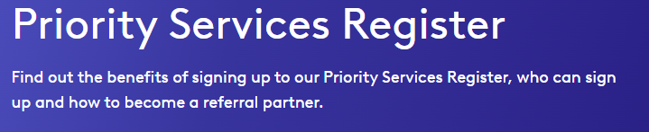
Weather Plans

Slide 92
Advance Care Planning
ReSPECT | Resuscitation Council UK
Treatment Escalation Plans
Importance of ReSPECT process Care Home Perspective
Importance of ReSPECT process Family Perspective

Slide 93
Feel Good in the Forest – from anywhere

Slide 94


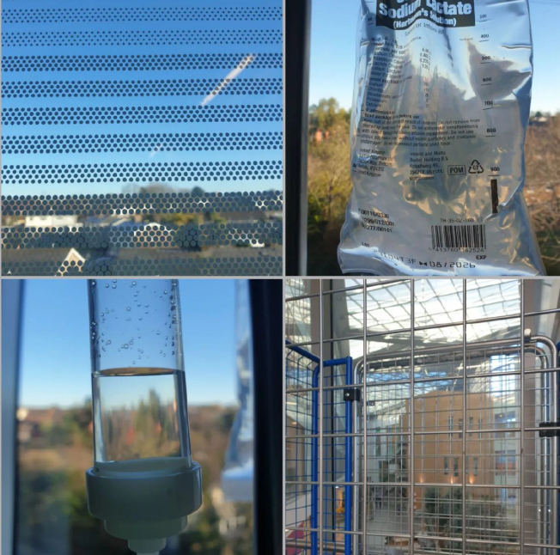

The idea…

Slide 95
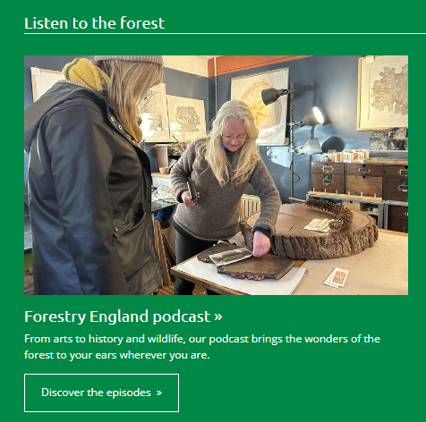


Bringing the forests to you
Virtual forests hub| Wellbeing| Forestry England

Slide 96
Resources for health professionals – one stop shop
Nature moments - quick tips for healthcare settings.pdf one document with some useful links to get people started.
more information or access to the virtual forests resources: Virtual forests hub| Wellbeing| Forestry England

Slide 97
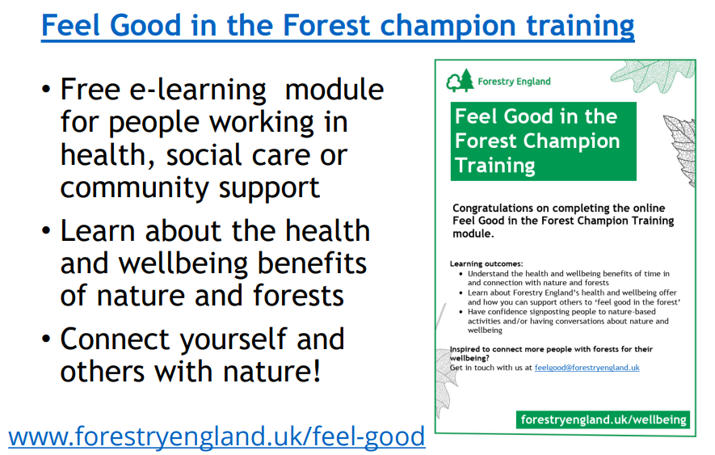
To find out more:
Resources Archive - NHS Forest
Feel Good in the Forest champion training
Quick tips email: Ellen.devine@forestryengland.uk
Nature moments - quick tips for healthcare settings.pdf

Slide 98
CDE
Funded Training Opportunities

Slide 99
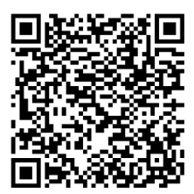


New Workshops We’re excited to announce four upcoming training workshops designed to support and strengthen skills in the care sector.
Open to all social care staff – limited spaces available, so book your place today!

Slide 100



Slide 101

Dying with Dignity: Navigating the End-of-Life Process
This free, in-person training (delivered by St Elizabeth Hospice) builds your skills and confidence in compassionate end-of-life and palliative care.
23rd & 30th October - Ipswich
5th & 12th November - Stowmarket
19th & 26th November - Kesgrave
3rd & 10th December - Bury St Edmunds
Must attend both days

Slide 102


Virtual Reality Buses
Autism Reality Experience
Inclusive Virtual Dementia Tour Training
Lowestoft: Friday 3rd October - 10am Lowestoft: Friday 3rd October - 1:30pm
Lowestoft: Friday 28th November - 10am Lowestoft: Friday 28th November - 1:30pm

Slide 103
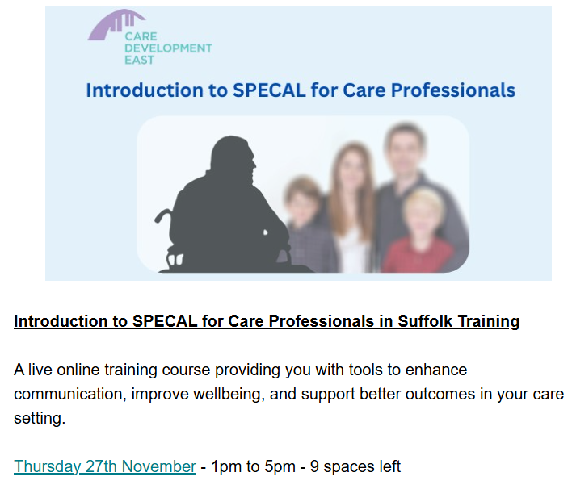

Slide 104
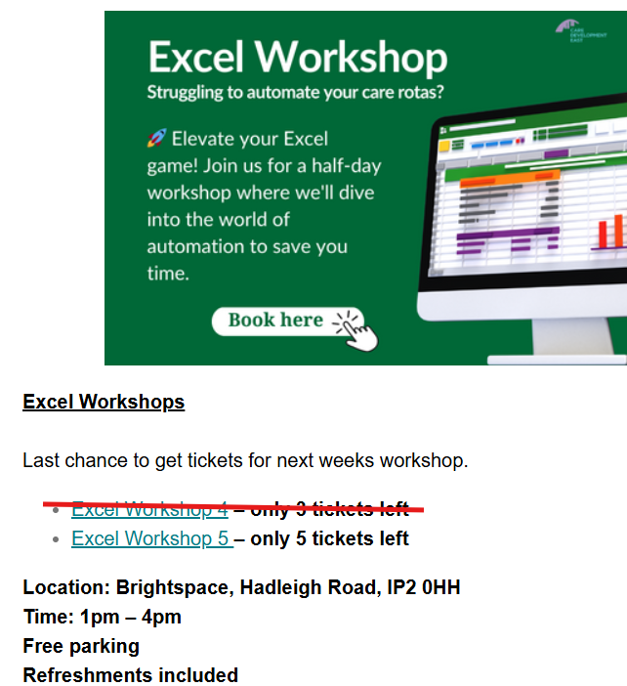

Slide 105

Thank you for listening and attending today
Please complete survey sheet on your table
21

