Slide 1
Agenda
1.30-2pm Networking
2-3.30pm Suffolk Care Awards Special
Please choose a seat

Slide 2
Welcome to our Suffolk Care Awards
Leaders In Care Special
11th June 2025

Slide 3
Welcome to our new CEO
Gemma Bloomfield

Slide 4
Nominations

Slide 5
Nomination Categories
Wellbeing at Work
Community Engagement
Innovation & Sustainability
Developing Young People
Team of the Year Large
End of Life
Inspirational Leadership
Team of the Year Small
(Organisation size of under 50
employees)
Empowering People Through
Person-Centred Approaches

Slide 6
Nominations Timeline
14ᵗʰ May 2025 – Nominations Open
22ⁿᵈ June 2025 – Nominations Close
W/C 23ʳᵈ June 2025 – SCC Vetting Checks
W/C 30ᵗʰ June 2025 – Judging Panels
W/C 7ᵗʰ July 2025 – Finalists notified
14ᵗʰ July 2025 – Tickets go live!

Slide 7
Nomination Criteria
Every award has their own criteria
Access via the CDE website under ‘Suffolk Care Awards 2025’ and clicking ‘Judging Criteria’
You MUST refer to the criteria when submitting your application.

Slide 8
Nomination FAQ’s
Access via the CDE website under Suffolk Care Awards and clicking ‘Award FAQ’s’
If unsure, email conferences@caredevelopmenteast.co.uk

Slide 9
Nomination’s Top Tips
Read all the categories carefully.
Pick the category that best fits your work.
Make sure you cover all in the criteria.
If it says ‘show innovation’ include how the idea was new.
If it asks for impact, demonstrate this.
Include clear relevant examples.
Keep it concise.
Avoid jargon or abbreviations.
Add individual’s feedback and photos.

Slide 10
BLOW YOUR OWN TRUMPET
SUFFOLK
CARE
AWARDS
2025

Slide 11
"By choosing to nominate, you’ve already made a powerful difference.
Whether you win or not, your compassion, dedication, and impact on others’ lives are what truly deserve to be celebrated."

Slide 12
Shortlisting

Slide 13
Shortlisting Process
All entries are redacted prior to shortlisting
Matched against the criteria
SCC will be completing additional checks this year in respect of significant quality or safeguarding concerns.
Minimum 3 entries sent to a judging panel

Slide 14
Judging Panel

Slide 15
Representatives from CDE, sponsor & area of expertise.
No conflict of interest
No one on the panel is employed by a company applying.
Judging guidelines
All entries redacted
All nominations compared to criteria
Top 3 selected

Slide 16
Any questions?
Have you applied?
If not, what’s stopping you?

Slide 17
Nomination Activity

Slide 18
Welcome to our special guest Joanna McCall

Slide 19
OUR HOST
KAYE ADAMS
SCOTTISH TELEVISION PRESENTER AND JOURNALIST

Slide 20
SUFFOLK
CARE
AWARDS
2025
Recognise excellence. Celebrate dedication.
Be part of something special.
TRINITY PARK
WWW.CAREDEVELOPMENTEAST.CO.UK

Slide 21
CDE
Funded Training Opportunities
Behaviour Management
Oliver McGowan
PBS Informed Training
19

Slide 22
Upcoming CDE Events

Slide 23
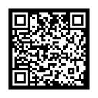
25th June 2025
Trinity Park,
Ipswich,
IP3 8UH
10:00am - 3:30pm
DEMENTIA
MARKETPLACE
Join us for an informative event intended for people living with dementia, their carers and families, providing information, advice and guidance to help people to live well with dementia in Suffolk.
FREE to attend
Over 40 stalls
Expert speakers
Refreshments and lunch available to purchase
Free parking
Quiet zone and activity space
Launch of VR Technology ‘Reverie’
BBC Radio Suffolk attending to do live report
Walk-ins welcome, registration encouraged -
www.eventbrite/caredevelopmenteast.co.uk
If you have any questions please contact info@caredevelopmenteast.co.uk

Slide 24
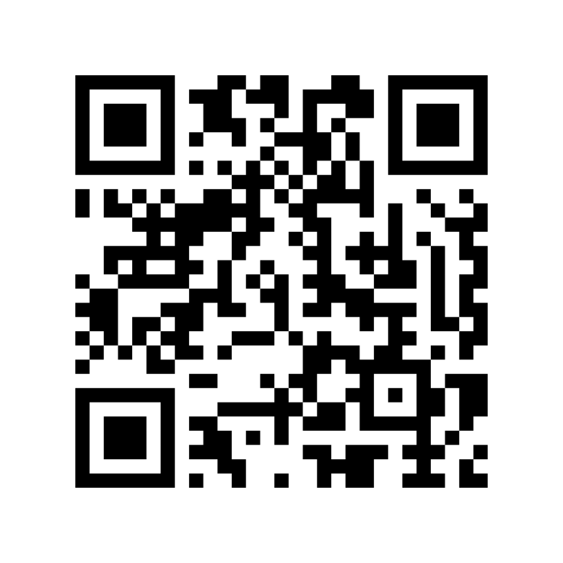
Thank you
Please scan the QR code to feedback on today’s meeting
21

