Slide 1

Welcome to our November Leaders in Care Network meeting

Slide 2


Suffolk Social Care Workforce Development Review
Michele James
Suffolk County Council, SDC Manager and Care Market Workforce Development Lead

Slide 3
Suffolk Social Care Workforce Development Review
Workforce development is a key area of support by the local authority to the adult care market
In December 2021, the government published People at the Heart of Care, which set out a 10-year vision for the adult social care workforce, within this is a focus on developing the care workforce
We are carrying out a review of the current workforce development offer in Suffolk, as well as considering the challenges, gaps and options available to shape a future offer

Slide 4
The challenges facing the care market
Based on predicted demographic changes there will be significant pressure on the adult care sector over the next few years
The demographic changes show an aging population within Suffolk which also links to increasingly complex and inter-related conditions, with growth in rates of dementia, and a longer life expectancy which will be associated with ongoing health issues.
The data also indicates a significant increase in care posts required and currently the predictions are that attracting candidates into these posts will be more difficult in the county, based on the falling number of people of working age in Suffolk plus perceptions of employment within the sector
This increased need for care staff, is against a background of recruitment and retention difficulties faced by the sector due to age profiles, pay levels, limited flexibility and poor image of social care as a career choice
In summary there are likely to be fewer people entering and remaining in employment in the care sector, in the future, while the demand for social care support services will increase.
Source: Skills for Care data at October 2023:
https://www.skillsforcare.org.uk/Adult-Social-Care-Workforce-Data/Workforce-intelligence/publications/local-information/My-local-area.aspx
SODA link: Suffolk Observatory – Population – Population Projections
Public health and Communities link: Suffolk_in_20_years_(2023) (healthysuffolk.org.uk)

Slide 5
What is being done to help address these challenges both nationally and locally
Nationally
Priorities to be addressed are highlighted in a national Workforce Strategy for the Adult Social Care Sector, launched by Skills for Care in July 2024.
The strategy identifies the adult social care workforce needs over the next 15 years and sets out recommendations for ensuring the sector has enough of the right people with the right skills.
International recruitment and encouragement into the care workforce has been successful in the numbers of international recruits entering the UK (11,500 international recruits were working in the Eastern Region’s workforce at June 2024). With approximately 640 within Suffolk. However, this cannot be a long term solution and brings its own challenges such as compliance with statutory requirements and the potential for exploitation of the care workers.
Locally
Norfolk and Suffolk County Councils have produced a Social Care and Health, Sector Skills Plan, in 2024, to identify the sector’s skills requirements.
Suffolk County Council is actively working with regional colleagues including being part of the ADASS regional workforce development group; has a strong individual contract management approach; is currently reviewing the workforce development support offer to the care market.

Slide 6
Suffolk Social Care Workforce Development Review
Outline of the current offer
SCC offer of support to care market | Care Development East (CDE) commissioned to deliver the offer
Range of funded (free) training programmes | via Complete Care Training Hub
Information, advice, guidance
Care Providers Managers forum
Recruitment fairs
Conference and events
KickStart initiative
Coaching and mentoring programme
Careers promotion via events in schools, colleges
Range of non-funded (charged for) training programmes

Slide 7
Feedback on care provider concerns on current workforce development and training offer
Providers are worried that they are experiencing longer hours, more complex care and greater medical needs
Joined up thinking needed about recruitment fairs – NHS, Skills for Care, SCC etc.
Younger recruits needing more support and having different expectations
Ability to access training and timings
Less duplication of the training available
Wider use of good models eg. Career cafes; use of more generic roles
Better profile of care – a campaign to promote roles and care sector image as a worthy career
The level of staff leaving the care sector
Variety of training, face to face, on teams or online
Providers value having clear career pathways and opportunities to progress
The potential impact of International Recruitment
Need for support to staff with health and wellbeing

Slide 8
Suffolk Social Care Workforce Development Review
Key Questions
1. What is useful to your organisation about the current offer?
www.menti.com / code = 5778 750
https://www.menti.com/aly2ej567ire
2. How can this offer be improved ?
www.menti.com / code = 3117 8637
https://www.menti.com/alxerbnemxdz

Slide 9
Suffolk Social Care Workforce Development Review
Thank you for helping to shape the future of workforce development support

Slide 11


Achieving Optimum Oral Health Care In Residential Settings
Essex Oral Heath Improvement Team
(©)Community Dental Services CIC, 2024

Slide 12
Who are Community Dental Services?
Community Dental Services has 7 clinics in Essex.
We provide a dental service for people with complex and additional needs (children and adults) including general anaesthetic & sedation clinics.
We provide a domiciliary service for bed bound patients.
We also have a clinic in Colchester with a tippy chair for wheelchairs.
Notes:
Community Dental Services has 7 clinics in Essex.
We provide a dental service for people with complex and additional needs (children and adults) including general anaesthetic & sedation clinics.
We provide a domiciliary service for bed bound patients.
We also have a clinic in Colchester with a tippy chair for wheelchairs
Referrals to our service need to come from a dentist, GP or other healthcare professional.
Referral criteria information and referral forms can be found on our website: https://communitydentalservices.co.uk/patient-information/referrals/essex/

Slide 13
CQC Smiling Matters Report 2019
Highlighted that awareness and implementation of NICE 2016 guidelines, should be a priority.
All care homes should have an Oral Health Policy (NICE 2016).
Oral Health Champion to be assigned.
Individual care plans & oral health assessment to be completed on admission.
Daily mouth care following ‘Delivering better oral health toolkit’ .
Supporting staff knowledge and skills by providing training
Notes:
The CQC Smiling Matters Report reviewed oral health in care home across England and highlighted that implementation of the NICE 2016 guidelines should be a priority and recommends that day to day oral hygiene to be of equal priority to other personal care tasks.
The report found that too many people living in care homes were not being supported with their oral health therefore staff needed better training.
Both the CQC report and NICE 2016 guidelines recommend that all care homes have an Oral Health Policy and assign an Oral Health Champion, ideally someone with interest in the subject.
The Oral Health Champion can be someone who has overall responsibility for oral health within the care setting - for example they can make sure all the oral health care plans are kept up to date, toothbrushes are changed regularly, staff are provided with oral health training and are following the Delivering Better Oral Health Tool Kit Guidelines (which we will talk a bit more about later). This is a document produced by Public Health England and provides oral health advice from birth – adulthood.
The NICE Guidelines set out what an oral health policy should contain and the importance of oral health assessments and individual care plans. Again we will talk about this in more detail on the next slides.

Slide 14
Statistics from the Oral Health Foundation.
74% of all adults have had a tooth extracted.
31% of adults have tooth decay.
66% of adults have visible plaque.
84% of adults have at least one or more fillings
8,337 new cases of mouth cancer each year
25% of adults don’t brush twice a day.

Slide 15
Care Teams Training
For professionals working in care of the elderly settings or caring for adults with additional needs.
Delivered via Teams or online toolkit.
2-hour delivery.
Certificate with CPD provided.
Training covers:
Why oral care is important
Update on CQC oral care guidelines/policy
Brushing/assisted brushing and supporting those who are resistant.
Diet
Visiting the dentist and barriers to care
Toothbrush aids & products
Conditions of the oral cavity including Mouth Cancer Awareness.
Seizures & trauma
Dental Neglect
Notes:
Condense notes

Slide 16

Lifelong Smile
Accreditation
6 Standards comprising of:
Oral Health Policy
Care Plans
Daily Oral Care Records
Raising Awareness - Staff
Raising Awareness - Residents
Raising Awareness – Families
We aim to work with the identified oral health champion

Slide 17

Role Of The Oral Health Champion
Responsible for oral health within the care setting.
Conduct initial oral health assessments on admission.
Create individual care plans.
Support Staff.
To be aware of and follow the ‘Delivering Better Oral Health Toolkit, 2021’.
Training can be provided by CDS
Oral Health Team.
Notes:
The role of the Oral Health champion is an important one with several key roles.
They have overall responsibility for the oral health of the residents in the setting this is achieved by:-
Establishing and conducting an initial Oral health assessment which identifies the needs of a resident.
The OHC will support staff, by promoting the keys oral health messages and ensuring they are following the Delivering Better Oral Health Toolkit, a Toolkit for Prevention.
The Essex Oral Health Team can provide training for your Oral Health Champion so they can carry out the role with confidence.
We also provide support group sessions for any OHC trained by us.

Slide 18


Mouth Cancer
Mouth cancer can occur in a number of places. Three signs and symptoms not to ignore & to be reported to your dentist are:
Any mouth ulcers present for over 10 days
Red and white patches in the mouth.
Unusual lumps or swellings in the mouth or head and neck area.
Early detection is so important!
Notes:
Mouth cancer can strike in a number of places, including the lips, tongue, gums, tonsils and cheeks. Three signs and symptoms not to ignore & to be reported to your dentist are:
Mouth ulcers present for over 10 days
Red and white patches in the mouth.
Unusual lumps or swellings in the mouth or head and neck area.
Early detection is crucial for survival, therefore it’s extremely important that we all know what to look out for. The key message here is “If in doubt, get checked out”.
We should all be having regular dental check ups every 6 months which should include an oral cancer screen. Mouth cancer can affect anyone.
People with dentures or no teeth can still get mouth cancer and therefore still need to have regular oral cancer screens and check ups by a dentist every 6 months.
More information on mouth cancer can be found on the NHS website at https://www.nhs.uk/conditions/mouth-cancer/ or on the Oral Health Foundation website at https://www.dentalhealth.org/mouthcancer
More information on mouth ulcers can also be found on the Oral Health Foundation website at https://www.dentalhealth.org/mouth-ulcers
For more information on how to check for mouth cancer there is an excellent section on the Oral Health Foundation website: https://www.dentalhealth.org/mouthaware
If you find anything unusual in any of these areas, or are unsure of anything, see a dentist or doctor as soon as possible.
If spotted early the chances of cure are good. Don’t hesitate to get checked.
A more detailed summary of signs and symptoms to look out for includes:
1. Any lumps, bumps, swellings, tenderness on face or neck
2. Any sores, lumps, changes in colour or texture on lips
3. Any red, white or dark patches in the cheeks or any lumps tenderness or ulcers
4. Lumps or ulcers on the roof of the mouth or change of colour
5. Any changes in colour or texture of the tongue, any lumps, swellings, or ulcers. Check top, sides and underside of the tongue.
6. Any changes in colour of the floor of the mouth, and any lumps, swellings or ulcers.

Slide 19

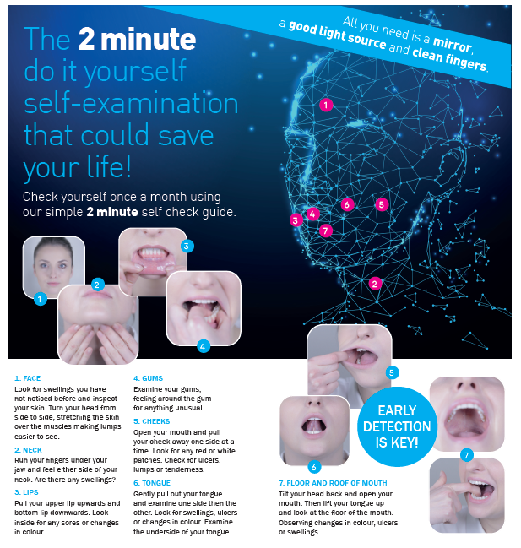
How To Carry Out a Self-Examination
Notes:
The Mouth Cancer Foundation have produced this 2 minute, do it yourself guide, on how to carry out a self-examination which you could download and display within your settings. There is also a very good video available on the Mouth Cancer Foundation website. https://www.mouthcancerfoundation.org/self-examination/ (copy & paste this link into your URL to view)

Slide 20

Resources
Useful link –
https://communitydentalservices.co.uk/oral-health/

Slide 21
Useful Resource
The Department of Health document Delivering Better Oral Health provides guidelines for all ages on oral care and is a really useful reference:
https://www.gov.uk/government/publications/delivering-better-oral-health-an-evidence-based-toolkit-for-prevention
Evidence based guidelines
Includes fluoride recommendations for all ages
Eatwell Guide
Notes:
The Department of Health document we mentioned at the beginning of the presentation called Delivering Better Oral Health provides guidelines for all ages (birth- old age) on oral care and is a really useful resource.
It includes evidence- based guidelines, fluoride recommendations for all ages and information on the Eatwell Guide and much more.

Slide 22

Any Questions?

Slide 23

Contact
Community Dental Services
Oral Health Enquiries
Oral Health Improvement Team:-
ohimp.essex@cds-cic.nhs.uk
Referral Enquiries
Contact the referral team:-
cds.essexreferrals@nhs.net
www.communitydentalservices.co.uk

Slide 24
Care Homes in Suffolk

Slide 25
Current and future situation
Patients who require a domiciliary visit can be referred to Cambridge Community Services via their online portal portal.dentalhealthcareeoe.nhs.uk/dentalreferral/nongdpreferral
Patients who can attend a specialist setting can be referred via the same link but will be seen at premises in Bury St Edmunds or Ipswich.
The specialist settings are designed to make patients with additional needs feel comfortable. There are wheelchair tippers, wider corridors, longer appointment times and a quiet environment.
Staff are specially trained to work with people with additional needs eg dementia, learning disabilities and autism.
Currently there is limited provision for these patients to be seen. We have secured additional resource from 1st January 2025.
Once seen, patients are assessed using a BDA Case Mix Score. Currently the threshold for retention within the community service is 10. This will be lowered to 7 from 1st January 2025. Patients below 7 will be referred to a High Street dental provider.
We are also looking at training for care homes to support residents with their oral health and hygiene. If you have not already done so, please complete the short survey to help us understand what would work best for you. QR code on next slide.
We hope to come back in the new year with Cambridge Community Services and Community Dental Services to see how we can best support our SNEE care homes residents.

Slide 26

Contacts
Suffolk and North East Essex Dental Team dental@snee.nhs.uk
Suffolk referrals to Community Dental Services portal.dentalhealthcareeoe.nhs.uk/dentalreferral/nongdpreferral
SNEE Care Homes questionnaire

Slide 28
Skills for Care
The Adult Social Care Workforce in Suffolk and the
National Workforce Strategy for Adult Social Care
Emma White
Locality Manager
November 2024
Notes:
Introduction
Good afternoon everyone I am Emma White, Locality Manager at Skills for Care.
Thank you to Christian for inviting me along today to talk him about two of the biggest pieces of work we undertake at Skills for Care, one of which is the workforce strategy for adult social care which we launched in July and the other is The state of adult social care workforce data which we produce every year in October and which provides a picture of the size and structure, the shape of adult social care nationally, regionally and locally and also across our health footprints.
Now I know that data isn't everybody's bag but I can assure you that data is really important and it's always behind the scenes in relation to all decisions for our sector. So decisions made by government for example reform and funding and also around things like the care service which is going to be obviously be looked at and we of course work closely with The Department of Health and Social care to help support providers and embed the decisions and initiatives made by Govt.
Our data is used extensively by local authorities who a lot of you contract with, so they know the size and demographics of the workforce for workforce planning and local funding, training and other initiatives. We know for example that a lot of managers are in their 50s and are going to leave at the same time and we also have quite big shortfalls for example with nursing. So all these decision makers use this data so the more accurate and the more data we have the better, and of course our health systems also use our data as we work in a more integrated way and start to become involved in the New Model of Care and local workforce plans.
And data is important for you as care providers or as owners of care services because the market changes such a lot. So if we think about the last four years we've had COVID and obviously we know we have had severe recruitment and retention issues and we've gone from not having enough care capacity in some areas too much capacity for example in domiciliary and we know that there's been a real struggle to recruit domestically so internationally a lot of recruits have been brought into adult social care. This has had its positives and its challenges but because of the changes to the visa requirements we are starting to see that international recruitment as we would expect, is starting to waver and to go down so, we need to have a look and see what we can do to support recruitment domestically but also ensure really importantly that we retain staff. As I said before the data that we collect and hold feeds directly into our workforce strategy and has really helped inform us on the big issues we need to tackle and transform in the sector.

Slide 29
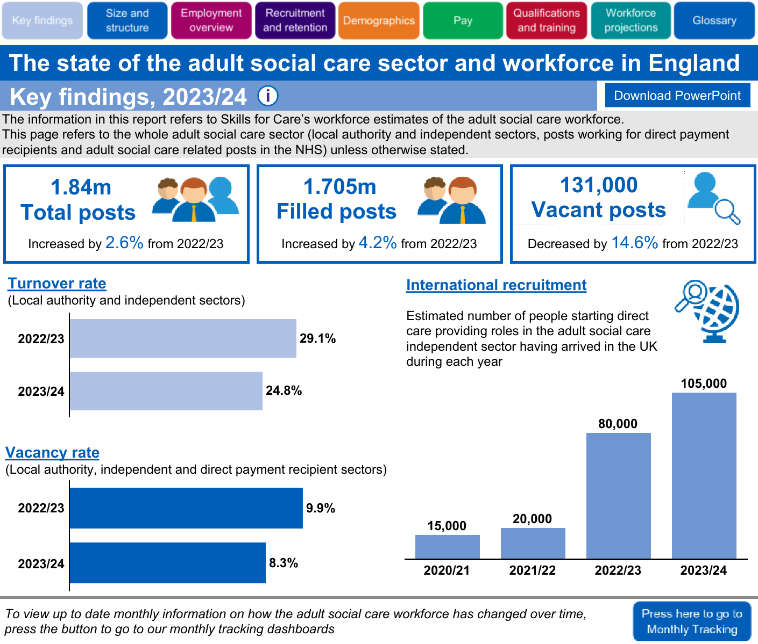
Notes:
So to start with I just want to briefly set the scene in terms of what the sector looks like nationally and regionally for 23-24 and these figures are from data received by care providers through the ASCWDS up to March 2024 and LAs up to Sept 23.
So here we have the national figures and a direct comparison with 22/23. As you can see, we have had some small increases in the amount of posts in the sector and which stands at1.84m total posts, we have 1.7m filled posts and 1.59 people working in ASC filling those posts, which is more than the NHS.

Slide 30


Eastern Data
Size and structure 23/24
1,900 organisations
4,400 care-providing locations
197,000 total posts
Employment overview
90% have permanent contracts
59% work full-time hours
20% on zero-hours contracts
Notes:
Lets now briefly look at some Eastern data
​
To understand the scale of the sector and the workforce in the Eastern region:​
​
1900 organisations​
​
4400 care-providing locations​
​
197,000 total posts ​
To break that down a little - There were 12,900 filled posts in local authorities, 146,000 in the independent sector, 13,000 filled posts working for direct payment recipients and 11,000 social care related posts in the NHS.
From this point, the figures in this presentation refer to the 158,000 filled posts in local authorities and the independent sector in the region.​
​
​
And an overview of employment:​
​
90% have permanent contracts – compared to 88% national​
​
59% worked full-time hours – compared to 55% national​
​
20% on zero-hours contracts – compared to 21% national

Slide 31
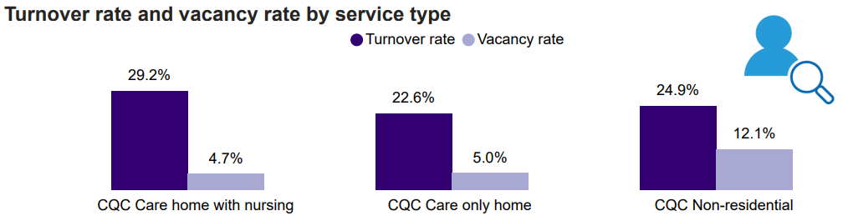
Eastern Data
Recruitment & Retention 23/24
14,000 vacant posts with a regional 8.1% vacancy rate
Turnover rate is 23.9%
58% of starters were recruited from within the adult social care sector
Notes:
So looking at key recruitment and retention stats...​
​
14,000 vacant posts – a decrease by -14.6% from 22/23​
​
8.1% vacancy rate, which is the same as the current national figure and is down from 9.9% for the previous years regional figure​
​
Turnover rate was 23.9% (or 35,000 leavers)​
58% of starters were recruited from within the adult social care sector (compared to 59% nationally)

Slide 32
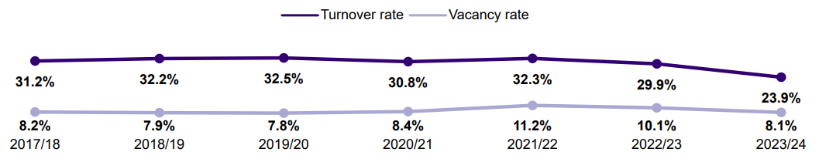
Turnover and Vacancy rates over time;
What we are seeing
Notes:
What is this latest data telling us?
After peaking during 2021/22, we have seen both the turnover rate and the vacancy rates drop at a national, regional and a local level.
While we can all see this as a positive, we also all recognise that attracting people to work in the social care sector and to then retain them remains an ongoing challenge.
It’s also worth noting that during 23/24, we have seen an increase in domestically grown talent moving to other sectors. It is possible the gap left by this movement of the workforce has been somewhat filled by the increase in internationally recruited staff. During 23/24, we saw 12,500 internationally recruited staff come to work in the social care sector in the Eastern region.

Slide 33
Local Authorities in Eastern Region
Regional Vacancy rate: 8.1% Regional turnover rate: 23.9%
 | Workforce | Vacancy rate | Vacant Posts | Turnover Rate | Number of Leavers
Bedford Borough Council | 4,600 | 9.8% | 500 | 23.5% | 1,100
Cambridgeshire County Council | 14,000 | 7.9% | 1,200 | 23.7% | 3,300
Central Bedfordshire Council | 4,400 | 6.7% | 325 | 21.7% | 950
Essex County Council | 31,000 | 10.1% | 3,500 | 24.2% | 7,600
Hertfordshire County Council | 4,900 | 4.5% | 225 | 20.2% | 1000
Luton Borough Council | 4,000 | 11.3% | 500 | 31.7% | 1,300
Milton Keynes City Council | 7,500 | 7.4% | 600 | 31.2% | 2,300
Norfolk County Council | 23,000 | 7.7% | 1,900 | 24.5% | 5,600
Peterborough City Council | 6,400 | 6.3% | 425 | 34.4% | 2,200
Southend-on-Sea City Council | 4,900 | 9.5% | 500 | 19.1% | 950
Suffolk County Council | 20,000 | 7.6% | 1,600 | 24.5% | 4,800
Thurrock Council | 3,000 | 8.4% | 275 | 23.2% | 700
Notes:
Continuing to look at vacancy rates and turnover, this slides breaks the data down into local authority areas focusing just on LA and IND employees
Now please don’t view this as a comparison table; there are a significant number of factors that can impact on a local authorities figures. We have local authorities based in urban, rural and coastal areas. We have some affluent areas in the region and we have areas which experience higher levels of poverty and we also have a range of different transport infrastructures across the region, all of which can impact on attracting people to work in the sector and also retaining them.
What these figures do is provide us with a view of the comparative size of each local authorities workforce and their own vacancy and turnover rates in terms of real numbers
Given the vital role that the social care sector plays in peoples lives, it is key that systems recognise the challenges in their own area and I feel sight of the actual figures helps sharpen our focus on the challenges ahead.
Reducing turnover in the sector is key to sustainability in the social care sector. The insight that Skills for Care gathers from across the entire sector tells us there are a number of reasons why people stay in the sector and why people leave and it isn’t just about pay, although that is a factor for some. Other factors include workplace culture, communication, leadership and management and also opportunities for CPD. Well-being support and flexible working were also referenced.

Slide 34
Integrated Care Systems
Regional Vacancy rate: 8.1% Regional turnover rate: 23.9%
 | Workforce | Vacancy Rate | Vacant Posts | Turnover Rate | Number of Leavers
Bedfordshire, Luton & Milton Keynes | 23,000 | 8.6% | 1,900 | 27.5% | 5,700
Cambridgeshire & Peterborough | 22,000 | 7.4% | 1,600 | 27.0% | 5,500
Hertfordshire & West Essex | 38,000 | 6.5% | 2,500 | 20.9% | 7,300
Mid & South Essex | 27,000 | 11.1% | 3,000 | 23.0% | 5,500
Suffolk & North-East Essex | 29,000 | 7.6% | 2,200 | 25.0% | 6,600
Norfolk & Waveney | 28,000 | 7.6% | 2,100 | 24.4% | 6,300
Notes:
I thought it would also be helpful to share the data from an ICS perspective.
We know how important the interdependencies between the health and care systems and the role that integrated workforce planning can have in relation to supporting people to remain living in their home in the community, to support the prevention agenda and to decrease pressure on health systems through the provision of high quality social care services.
The data that we are viewing truly highlights the importance of systems collaborating to identify and deliver integrated workforce solutions. As SfC regional lead, I am working with some of our health and care system WF leads on areas of collaboration and integration such as new roles, new skills, DHA and integrated workforce planning.

Slide 35
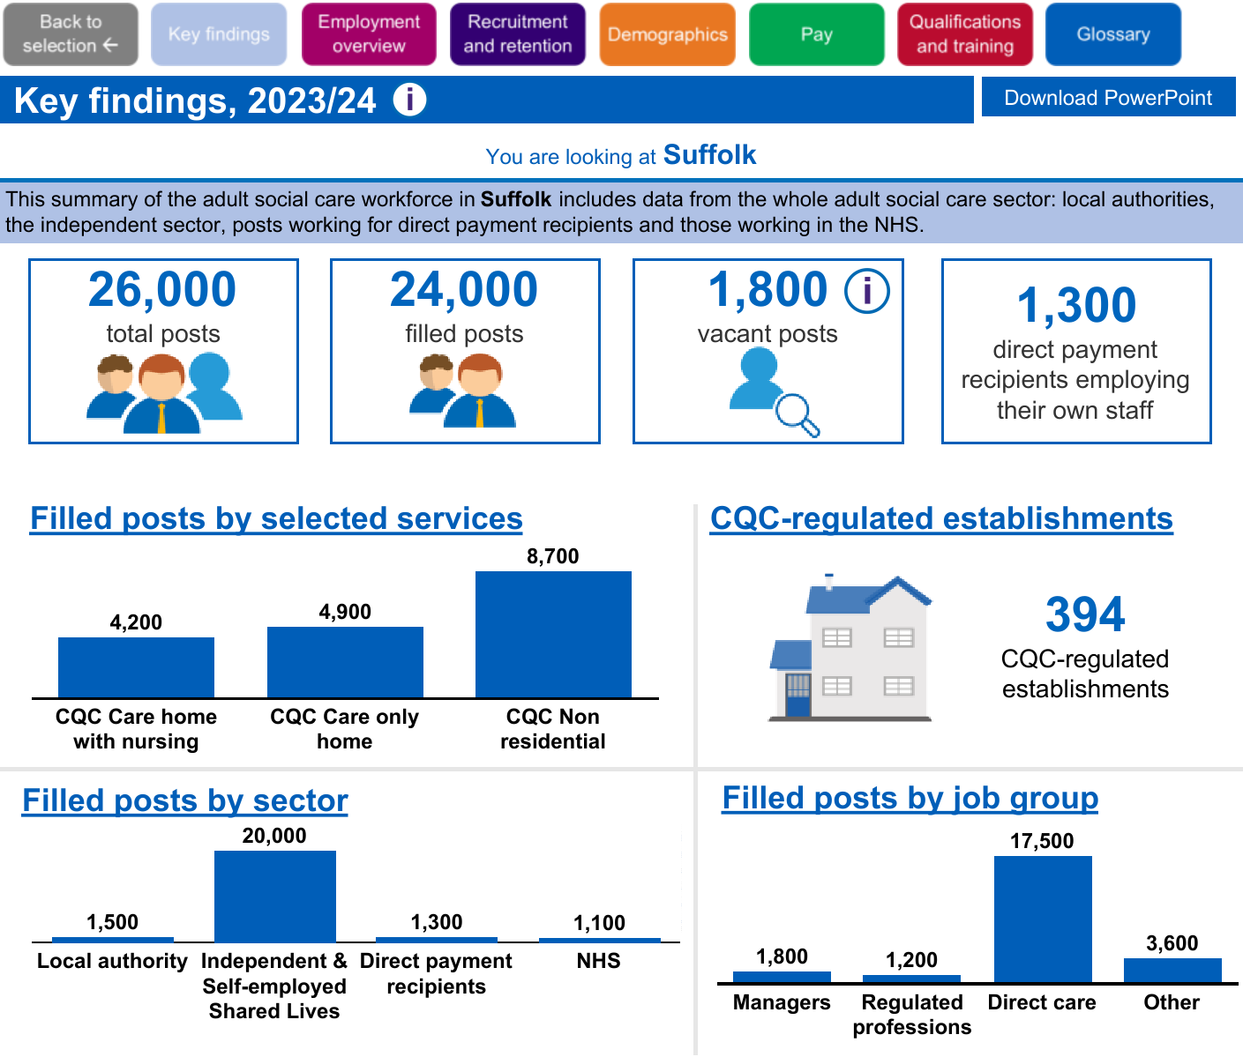
Notes:
So if we look at Suffolk data we can get an idea of the make up of the whole sector inc LA staff and DP/NHS.

Slide 36
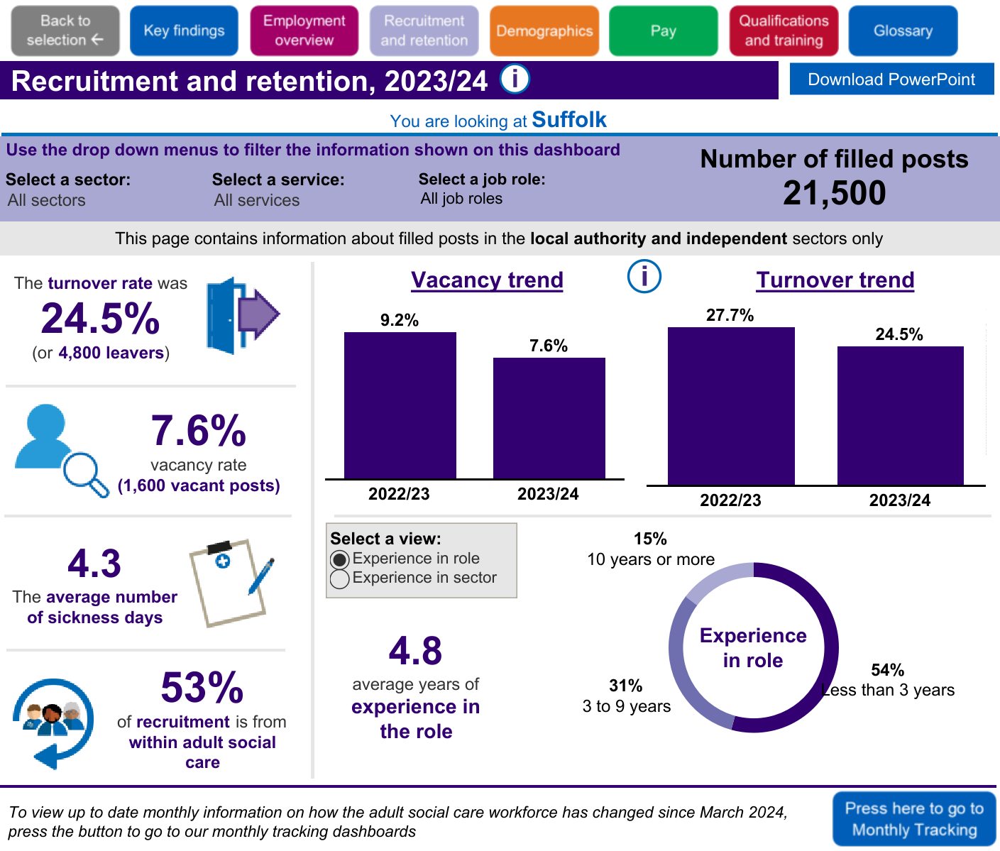
Notes:
This slide breaks down the date further to just LA/IND sector

Slide 37
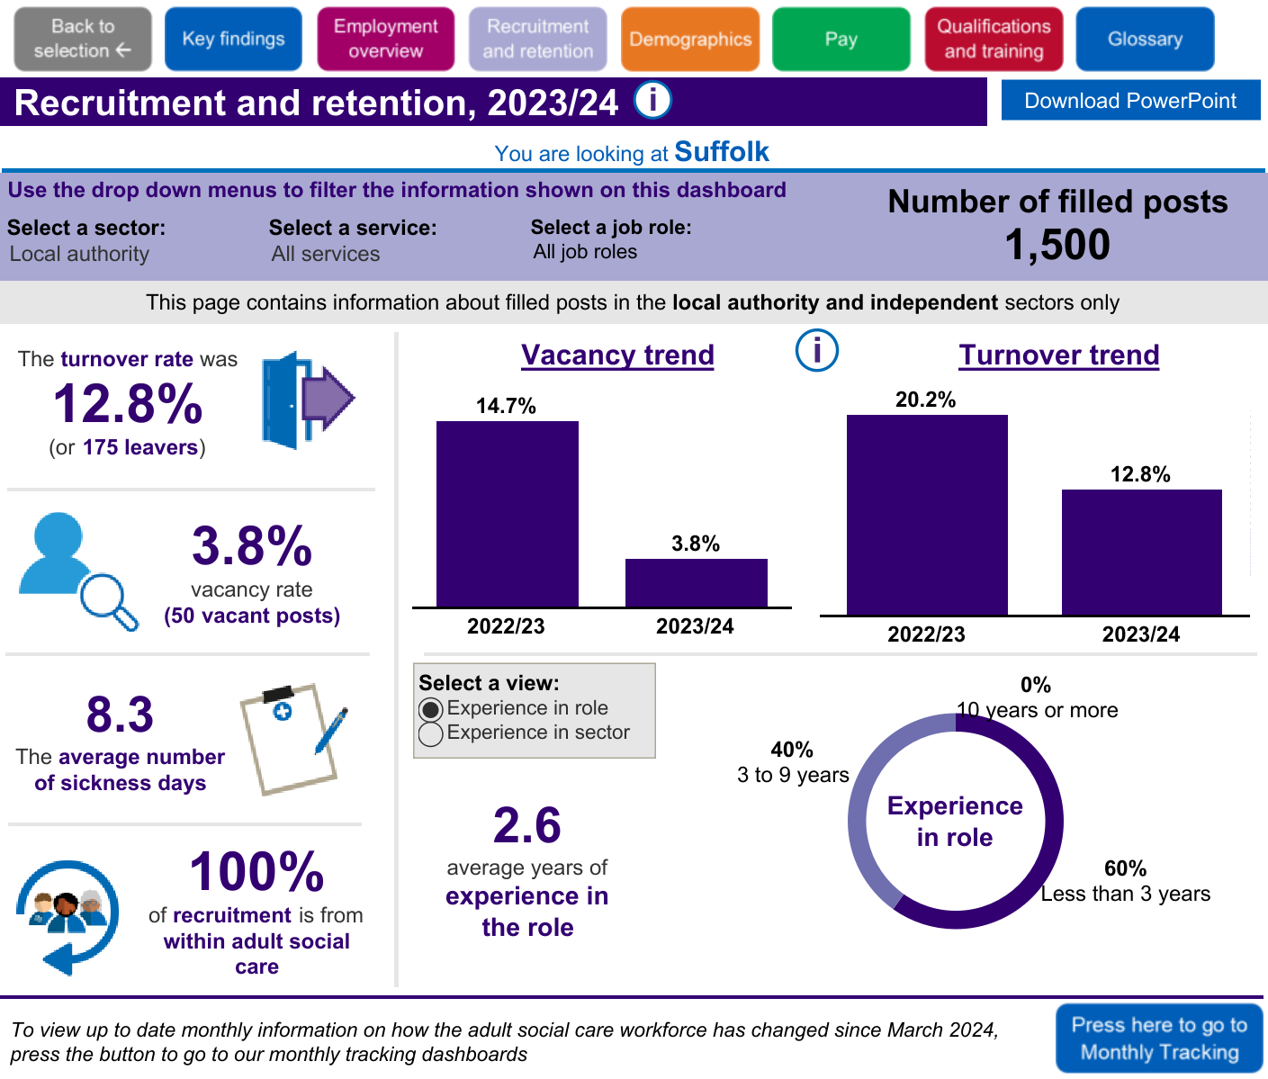
Notes:
Here we look at data just for the LA ASC workforce and we can see that the vacancy and turnover rates have dropped quite significantly.

Slide 38

Notes:
Here we have the IND sector and can see that with all of the data that although lower than last year is still fairly high although sitting just below the national average.

Slide 39
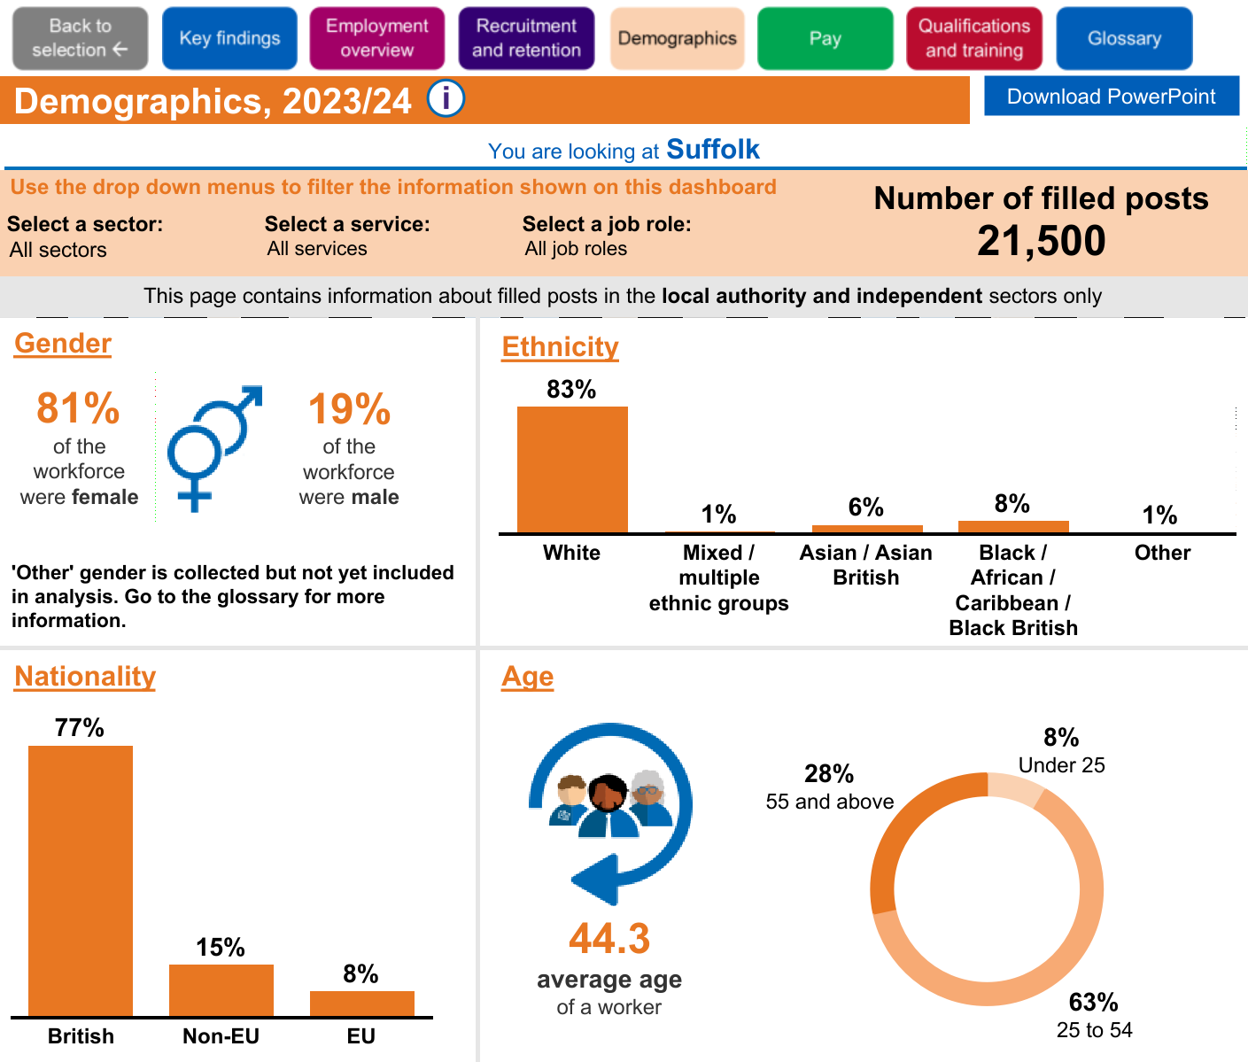
Notes:
Now if we look at demograhics I am sure some of these figures will come as no surprise with the majority of our workforce being white and female.

Slide 40
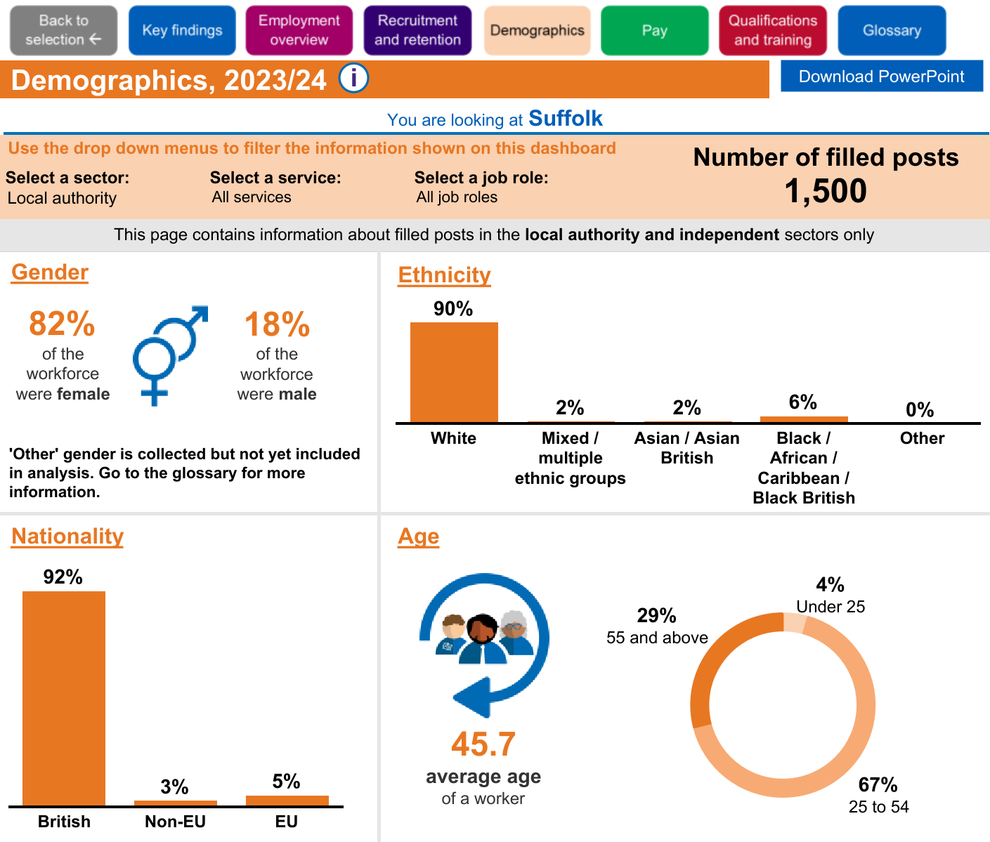
Notes:
For LA Suffolk it is pretty similar.

Slide 41

Notes:
And for the ind sector,again not much change from across the board

Slide 42
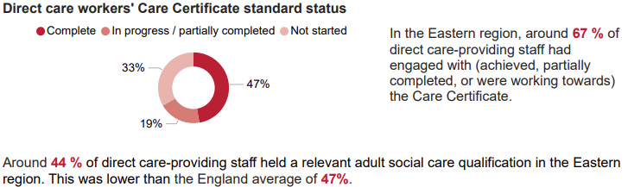
Learning & Development in Eastern
Notes:
One of the factors I mentioned when discussing retention was the value of CPD for the workforce so this was one other area I wanted to focus on.
In the Eastern region, around 67 % of direct care-providing staff had engaged with (achieved, partially completed, or were working towards) the Care Certificate with 47% having completed it.
Around 44 % of direct care-providing staff held a relevant adult social care qualification in the Eastern region. This was lower than the England average of 47%.
We can see from the visuals that only 25% of the workforce are qualified up to level 2.
The launch of the CWP and the level 2 care Certificate is part of a wider drive to support the professionalisation of the social care workforce and it was good to hear Martin speak about this social care reform work earlier.
I was planning to do a section on social care reform but as Martin has already covered this, I will just say that I feel this slide visually highlights the importance of promoting the new level 2 Care Certificate, the LDSS which could be used to access funding for the Care cert level 2 and the CWP to systems and social care providers across the region. We at SfC are promoting these through our numerous networks in the region as we recognise the value of a skilled and well-trained workforce.
It would be great to see LA’s and systems working to deliver these reform items to support workforce development and sustainability in our region.

Slide 43


A Workforce Strategy for
adult social care in England
Notes:
So that is the data nationally, regionally and in Suffolk and as I said before we really need this data to help us look at specific areas of the workforce strategy and ensure we can use a baseline picture of what our sector looks like.
So for those of you who haven’t heard of the development of the ASC workforce strategy, for the first time ever, the adult social care sector has come together, led by Skills for Care, to develop the Workforce Strategy it needs to work alongside the NHS long term workforce plan. Adult social care needs a workforce strategy as a focus to ensure we have enough of the right people with the right skills to provide the best possible care and support for the people who draw on it.
Social care is important for all of us. It is important to the 10 million people it impacts (including those who draw on paid and unpaid care, the workforce and unpaid carers) and it is important for the effective functioning of the NHS.
This Workforce Strategy, even if implemented in full, needs to be accompanied by transformation in social care. This means more and better prevention which social care is at the heart of, more of a focus on transforming social care through new models, science and technology.

Slide 44


Attract and retain
Recommendation Government to lead joined-up and consistent action on pay, terms and conditions
Recommendation Strategic, cross-government action on a 10-year attraction plan for social care
Recommendation A focus on retention with a People Promise for social care and action on ethical international recruitment
Recommendation Implement the Social Care Workforce Race Equality Standard (SC-WRES).
Notes:
The strategy is a big document which you can find on our website but broadly broken down in to to 3 keys areas, which again, align with the NHS long term workforce plan. And they are attract and retain, train and transform.
We have of course worked with the sector and all key stakeholders including the government, local authorities, health DHSC and CQC to develop the strategy and will continue to work with these key organisations to take forward and deliver on the strategy.
Attract and retain
Joined-up, consistent action on pay. Central government (lead) with local government, unions and employers. (2024)
Consider the modelling in this Strategy in the Fair Cost of Care exercise. (2025, ongoing). Central Government, DHSC and Local Government. We have modelled and costed three options for improving pay in the Areas of focus, recommendations and commitments section.
A transition plan to increase domestic recruitment and reduce international recruitment. Government departments/bodies and the sector. (Ongoing)
Continued funding to support ethical international recruitment. Department of Health and Social Care (DHSC). (Ongoing)
Review the application of ethical recruitment. DHSC and Home Office. (By March 2025)
Regulator encouraging recruitment and retention plans. Commitment – Care Quality Commission (CQC).
A 10-year attraction plan focusing on men, younger people and people with technical skills. Cross-sector partnership, sponsored by Department for Work and Pensions (DWP) and DHSC. (By summer 2025)
Support for individual employers. The Local Government Association (LGA). (Start 2024)
A national programme to attract graduates and career changers. DHSC. (From 2025)
Attract more social workers and occupational therapists with a clearer pathway and financial support for students. DHSC; DfE; Social Work England (SWE); the British Association of Social Workers (BASW); the Royal College of Occupational Therapists (RCOT) and Skills for Care.
Attract more registered nurses and nursing associates to working in social care and offer them attractive career pathways to retain them. DHSC; Council of Deans of Health; Universities; ICSs. (From 2025)
A People Promise for Social Care. Skills for Care, commissioned by DHSC. (Scoping 2025, launch 2026)
Scope retention pilots in five ICS areas. DHSC; Skills for Care and stakeholders. (2026/27)
Regulator support for workforce wellbeing and equality, diversity and inclusion. CQC.
Create Workforce Strategy employer champions. Commitment - Skills for Care and provider representatives.
Retain more internationally educated registered nurses working in social care through pathways, support and regulation. Nursing and Midwifery Council (NMC); CQC; DHSC.
Implement the Social Care Workforce Race Equality Standard (SC-WRES). Skills for Care and partners (commitment); DHSC; Department of Levelling Up, Housing and Communities (DLUHC); Department for Education (DfE), CQC. (From 2024)
Improve wellbeing through guidance, training, NHS Health Checks, regulation and awareness-raising. Sector and health organisations (2024, 2025, ongoing); DHSC (2025); CQC (From 2025)
By implementing these recommendations with clear ownership, we can create a more attractive and supportive environment for social care staff, ultimately leading to a stronger and more diverse workforce.

Slide 45

Train
Recommendation Invest in high-quality development - including new skills and overhauling apprenticeships - with a 3-year funding commitment
Recommendation New skills and roles and Level 3 competence for direct care staff and robust support for the RPW and Registered Managers
Recommendation A leadership development roadmap for social care managers – with potential requirements for higher qualifications
Commitment Skills for Care and CQC will streamline mandatory training requirements
Notes:
Train
Regulator to signpost to what good looks like in learning development. Commitment - CQC and Skills for Care. (2024, ongoing)
Expand Skills through the Care Workforce Pathway: DHSC and Skills for Care. (Starting 2024)
Continue funding to support delegated health tasks: DHSC with the sector. (From 2024)
Continue funding for new skills: DHSC. (Annual)
Develop Leaders through a framework for Directors of Adult Social Services (commitment - Skills for Care and Association of Directors of Adult Social Services (ADASS) and partners) and continue investment in the leadership programme for regulated professionals (DHSC). (2025)
Streamline and communicate mandatory training requirements. Commitment - Skills for Care and CQC. (2025)
Continue the Care Certificate and support uptake. DHSC. (From 2024)
Ensure level three competence for direct care staff. DHSC and Skills for Care. (2025, ongoing)
Overhaul social care Apprenticeships: Expert partners, commissioned by DfE. (2025)
Ensure high-quality training in functional skills, digital, data and technology and AI. Skills for Care, CQC, Care Provider Alliance (CPA) (commitment, 2024); Association of Colleges (AoC), Association of Employment and Learning Providers (AELP) (2025).
A three-year funding plan for training: DHSC. (From 2024)
Invest in training and developing social workers. DHSC/DfE with sector partners and local authorities. (2025)
Invest in training and developing occupational therapists. DHSC with sector partners, local authorities.
Invest in training and developing registered nurses working in social care. DHSC; sector partners; Council of the Deans of Health (CoDH); National Institute for Health and Care Research (NICE); NMC; CQC. (From 2025)
Develop managers through support, education and potential registration. DHSC; Skills for Care; CQC. (From 2025)
By investing in getting development and training right, we can give people working in social care the skills, knowledge and development they need to come into social care and to stay in social care, delivering exceptional care and support in a rapidly evolving environment.

Slide 46
Transform
Recommendation A legislative basis for the Workforce Strategy – and a central body for implementation
Recommendation Support for lCS workforce planning that promotes a “one workforce” approach and analyses future needs
Commitment Gather evidence on the impacts and potential models of a workforce registration scheme
Recommendation Attract workers to social care in coastal and rural areas
Notes:
Rec 1 – A legislative basis for the workforce body and a central body for implementation
There is no requirement for a workforce strategy in social care, unlike in the NHS where the Health and Care Act requires the Secretary of State to publish how the health service is meeting the needs of the workforce every five years.
We feel there should be a legislative requirement to have a workforce strategy and regular workforce planning for adult social care because this will need sustained, joined up, consistent effort over a number of years.
We suggest that the DHSC, NHS England and Skills for Care align workforce planning in social care to the drivers and assumptions in any NHS workforce plan.
The role of government departments in setting the direction of this strategy will be central.
However, it would be hard for government to lead its development and implementation given the design of central government, overlaid with the dispersed and diverse nature of the adult social care workforce. We suggest that, to effectively address the workforce challenges, social care needs a central body with a legislative mandate to not only develop a unified strategy upon direction by government, but also, crucially, drive its implementation across the diverse landscape.
This expert body would have the autonomy and credibility in social care to develop an adult social care Workforce Strategy, aligned with government priorities.
It would be instrumental in bringing focus, expertise, trust, agility, credibility and neutrality. It would ensure the Strategy translates into tangible action, tackling the critical issues facing the social care workforce.
Without this central co-ordination and leadership, it leaves the sector with a fragmented approach, not least because there are so many different bodies with an impact on the workforce including three government departments, 153 local authorities, 18,000 employers, 42 integrated care systems, at least three regulators, one workforce body, 10 national employer representative bodies, more than 50 local representative bodies and many organisations representing people with lived experience and carers
Support ICS workforce planning (2025 scoping, ongoing): Skills for Care, local government, NHS Employers and partners should collaborate to support ICSs in
developing workforce strategies, which should:
o Have strong national, regional, and local leadership
o Promote a ‘one workforce’ approach with equal partnership and investment in health and social care
o Analyse demographics and future needs and the local labour market
o Focus on aligning terms and conditions, training and wellbeing support for both sectors
o Establish a social care academy and shared technology approaches
o Support recruitment from new demographics and builds shared career pathways between health and social care
o Increase direct contact across the two systems through joint training, placements, and secondments.
Registration
While there might be potential additional benefits to regulating a profession, the legislation states that we regulate a profession in England for public protection purposes. As a steering group we have talked about registration of the care workforce. This has been a debate over years in social care and, as has been the case previously, there is not one common view.
There were broadly three views in the steering group:
1. Registration is key to the public recognising the sector as the professionals that they are, important for public safety and for development of people working in social care.
2. There is not enough evidence to show the impact of registration on the workforce in other countries and, given the scale of the workforce, the cost-benefit argument is not clear enough yet.
3. Registration would undermine steps towards personalisation and detract from the person-centred approach essential in social care, prioritising compliance over individualised support.
Read committment

Slide 47
National Workforce Strategy for Adult Social Care
Desire & Commitment from partners across the region: Our regional group is aligning to the strategy themes and we will be actively looking to map local and regional activity against the recommendations
A regional launch event: Attendees at a recent regional launch event felt this group could be used as a foundation to implement parts of the strategy in our region
ADASS East and Local Authorities: ADASS East are committed to supporting the strategy and its implementation. Local Authorities are looking to the strategy to support their strategic approach to integrated workforce planning and one will activity map their workforce strategy against the national strategy
Notes:
Desire & Commitment from partners across the region: Our regional group is aligning to the strategy themes and we will be actively looking to map local and regional activity against the recommendations. This group includes membership of SfC, ADASS East, PiCH, a social care employer, an expert by experience and a large number of the LA’s and ICBs in the Eastern region.

Slide 48
What is already happening in the Eastern region?
Integrated Care Systems: Two ICSs in our region are actively looking to draw upon the strategy to support their strategic approach to integrated workforce planning and two more have requested to meet Skills for Care
Integrated Care Systems: The BLMK ICS has launched a survey to ASC employers to help map workforce gaps and workforce development activity against the national strategy. The same ICS is working with their LAs and universities and looking to align their education and recruitment activity with their social care system partners
Delegated health care in our region – increasing due to access of specialist training from hospitals and integrated working between health and social care
Notes:
Go through slide
Delegated healthcare in our region example: We have recently identified a case study where a domiciliary care provider has enabled their staff to undertake complex health care tasks and this has enabled them to continue to support a lady with complex health & care needs to live at home with her husband. This has only been possible because the provider has linked with a specialist team at a hospital and has been able to access specialist training for her workforce.

Slide 49
How Skills for Care can support you
Guidance, information and resources
Care Workforce Pathway
Level 2
Care Certificate
LDSS
ASC WDS
Leaders &
Managers
Workplace Culture Toolkit
Workforce Intelligence
Digital Transformation
Developing Your Workforce
Workforce Planning
Workforce Transformation
Integration
& DHA
Direct engagement
Notes:
So I hope you have found this useful, because whatever happens, you as social care providers and those who draw care and support are at the heart of all decisions and developments going forward to help make the improvements needed in our sector and I always think it is better to be part of transformation than on the edge of it.
And you require any more information or require any support for you services in general please do let me know, and I have included here some of the areas of support that is available and my contact details.

Slide 50

Emma White
Locality Manager
Cambridgeshire, Peterborough and Suffolk
If there is anything I can do to support, or you require any more information just let me know.
emma.white@skillsforcare.org.uk
Tel 07800 868637

Slide 51
Thank you
Any questions?

Slide 53
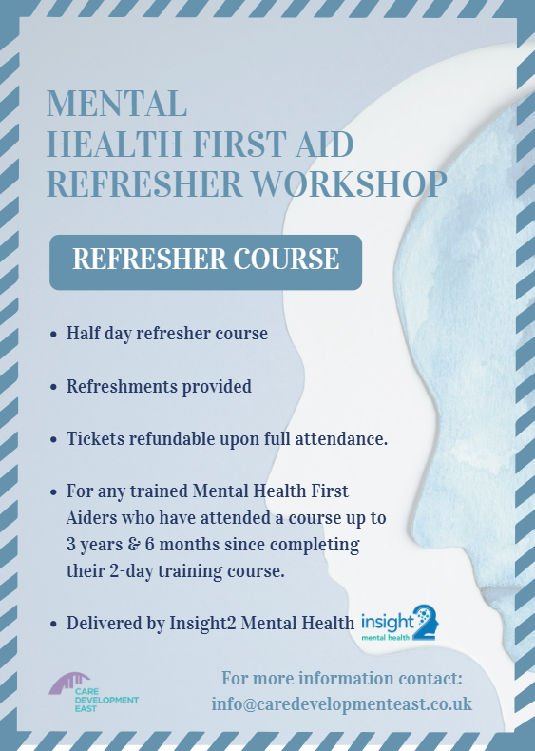

Only one date scheduled for the year!
12/12/2024
IP-City Centre
If your certificate becomes more than six months out of date, you will need to re-complete the full MHFA course, so this is a fantastic opportunity to ensure your certificate stays valid.

Slide 54

6 spaces available on our last session of the year!

Slide 55
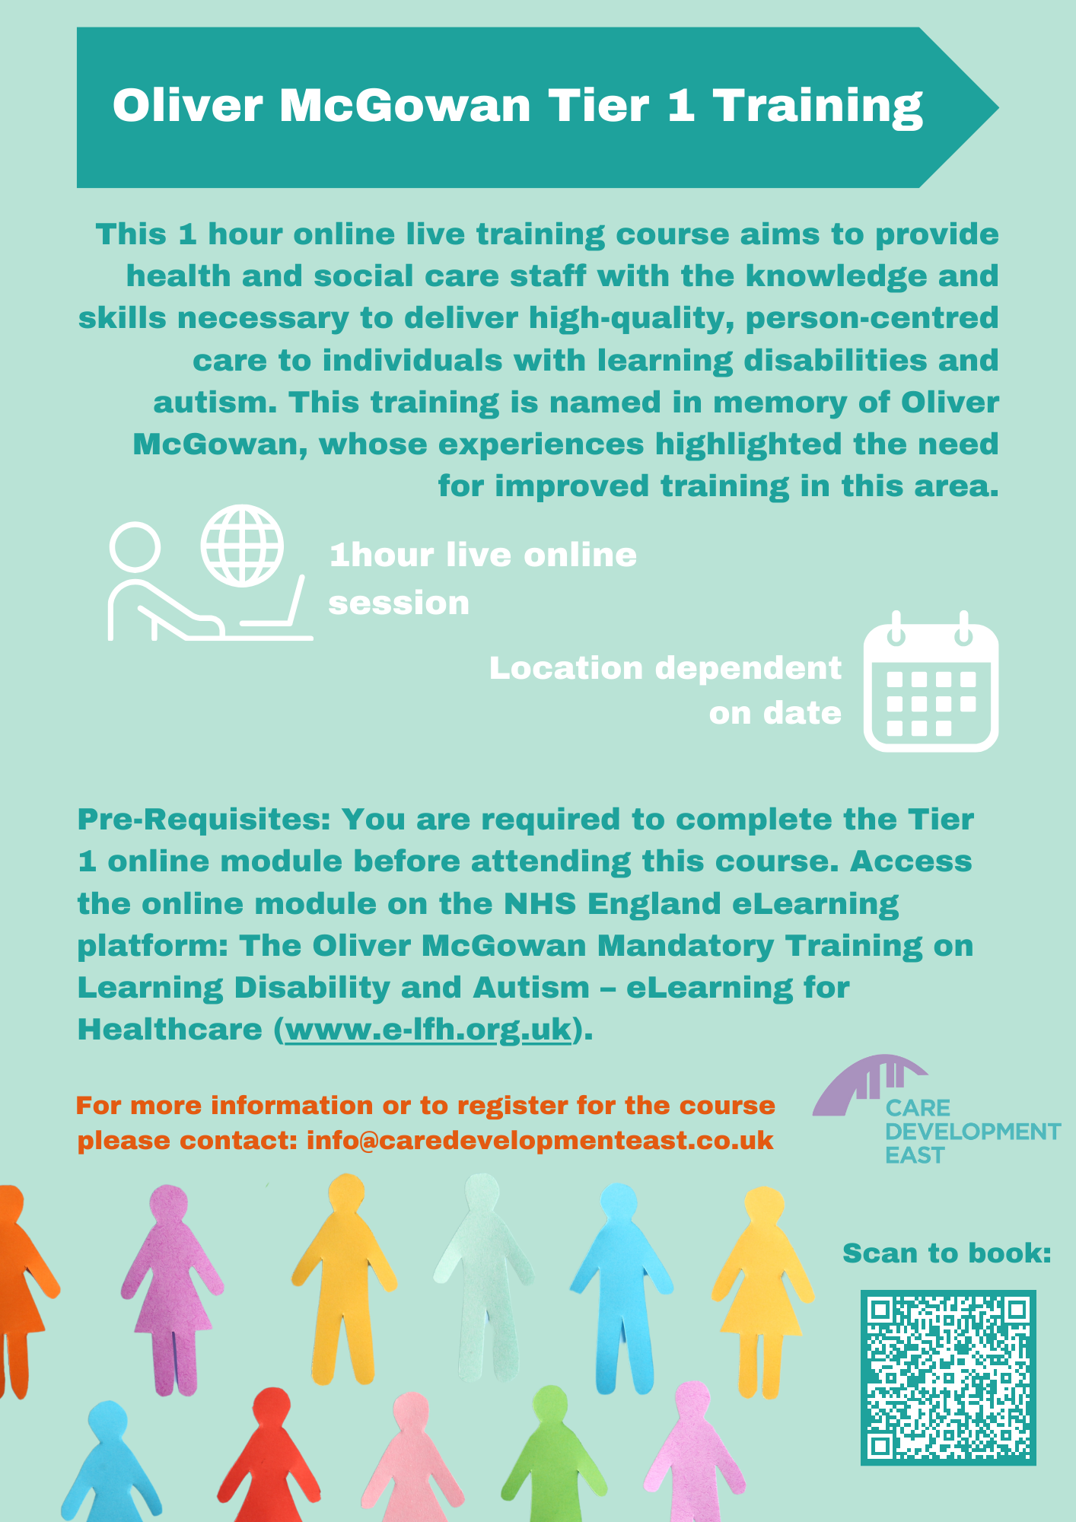
Tier 1 is suitable for your admin and support staff – only one session left and unlikely to be offered in 2025!

Slide 56


View the full brochure online here:

Slide 57
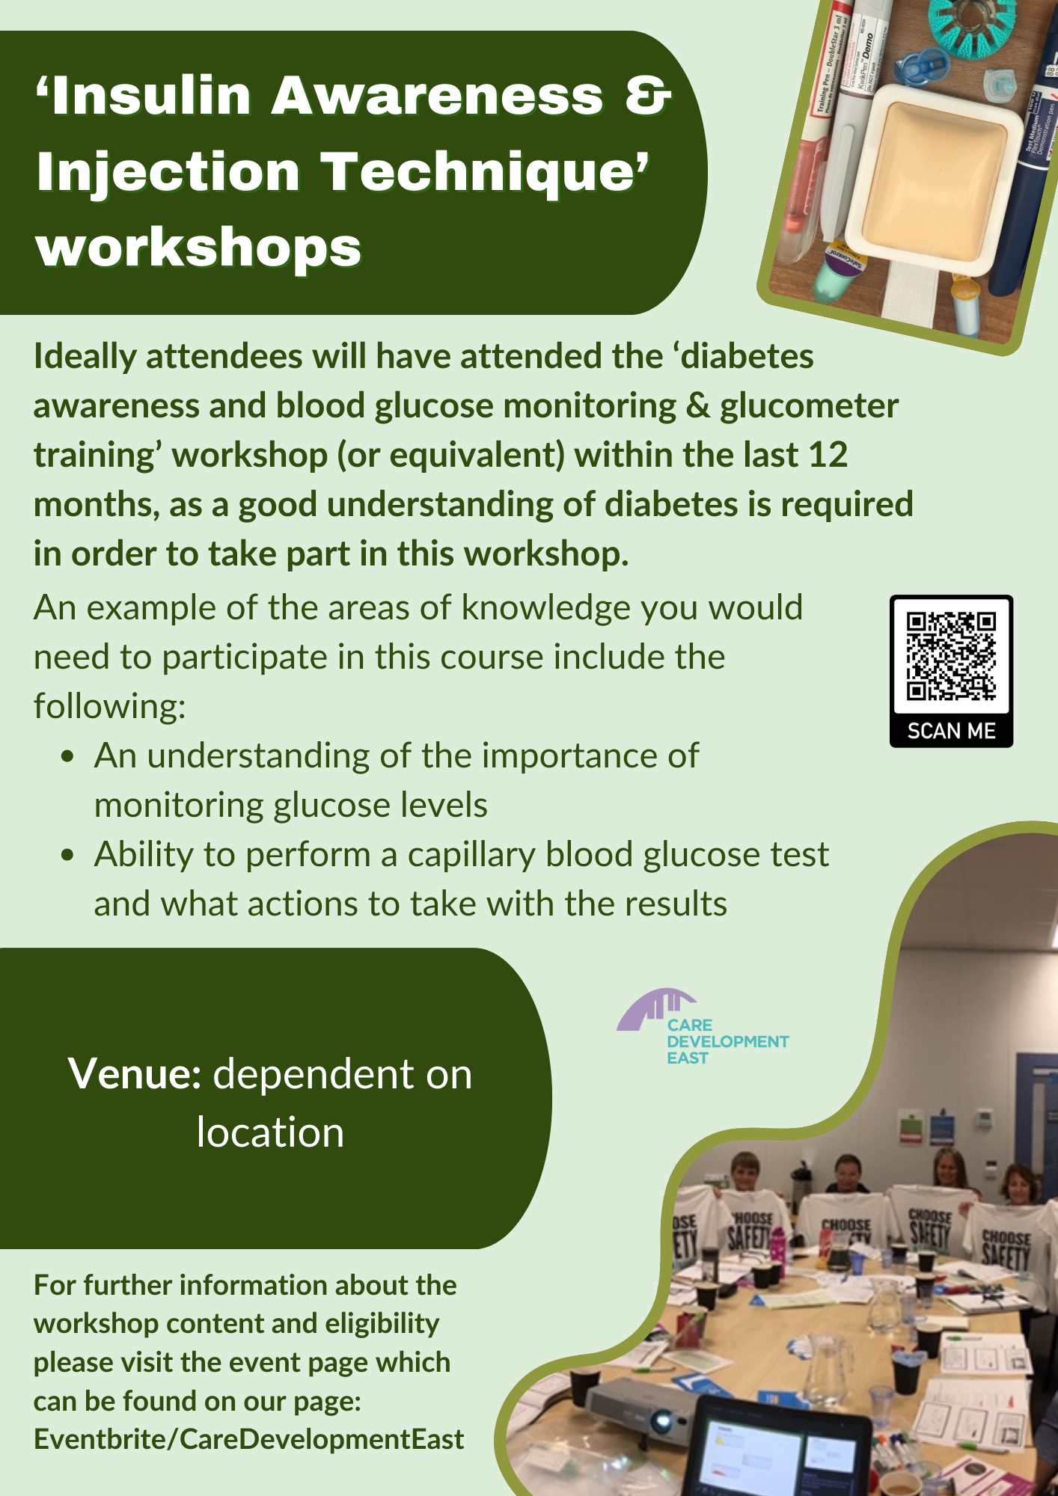
Suitable for those that have attended our ‘Diabetes Awareness’ workshop and are looking for more in-depth Insulin training.

Slide 58
The Future of Care event
Due to the popularity of the first event in Ipswich, there is now another date scheduled for Bury St Edmunds

Slide 59

Please scan the below QR code to give feedback on today’s session:

