Slide 1
WELCOME

Slide 2
SUSTAINABILITY & THE IMPACT OF CLEANING PRODUCTS
PAUL RIVETT

Slide 3
WHAT IS SUSTAINABILITY
?

Slide 4
How sustainable do you think you are?

Slide 5
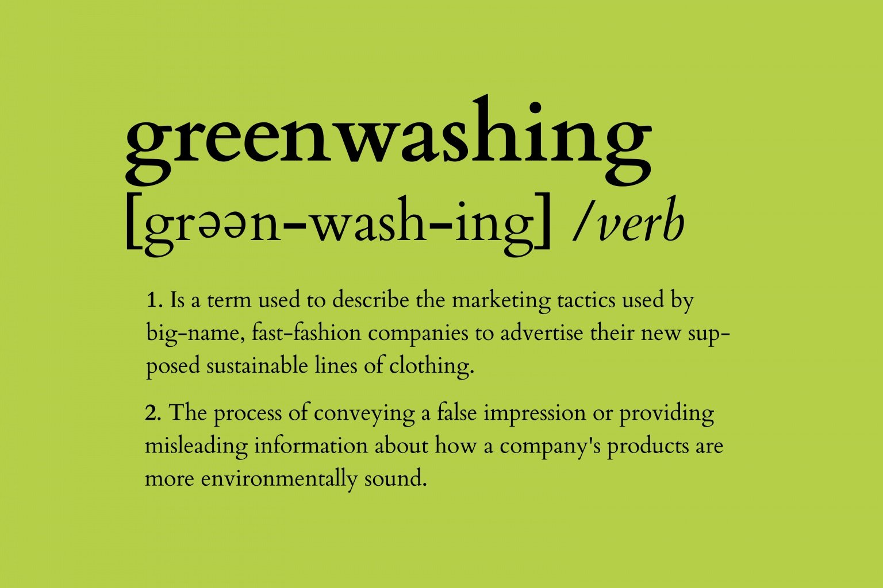
SUSTAINABILITY WITHIN CLEANING & HYGIENE
?

Slide 6
SUSTAINABILITY factors to avoid greenwashing
The Product
How is it produced/manufactured
Where is it produced/manufactured
Packaging
Certificates and accreditations
?

Slide 7
Why is cleaning important?

Slide 8
Impact of cleaning products
Regular exposure to cleaning products significantly affects lung function, research has suggested
US research has found that chemicals in everyday household products are now a key contributor to city air pollution, rivalling some vehicle emissions
A 20-year study of 6235 woman showed that cleaning with products that contained dangerous chemicals as little as once a week, was as damaging over time to their respiratory health as smoking 20 cigarettes a day
?

Slide 9
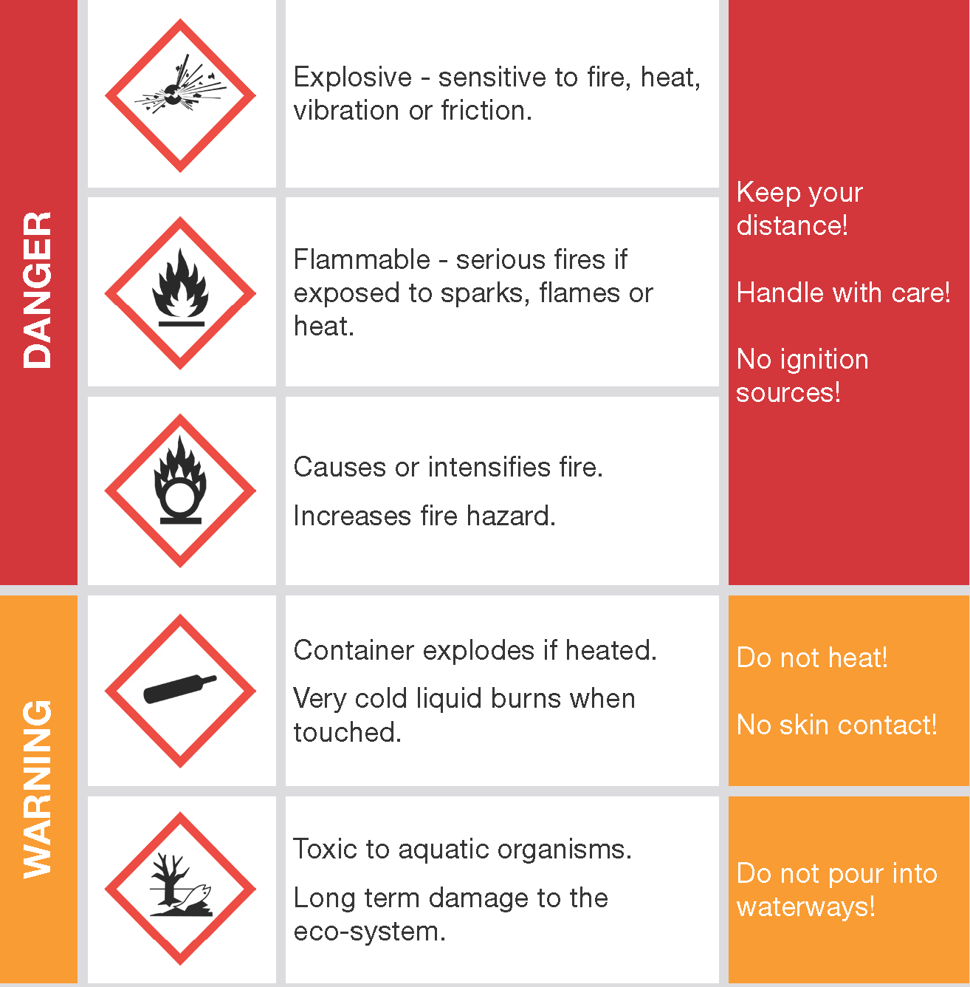
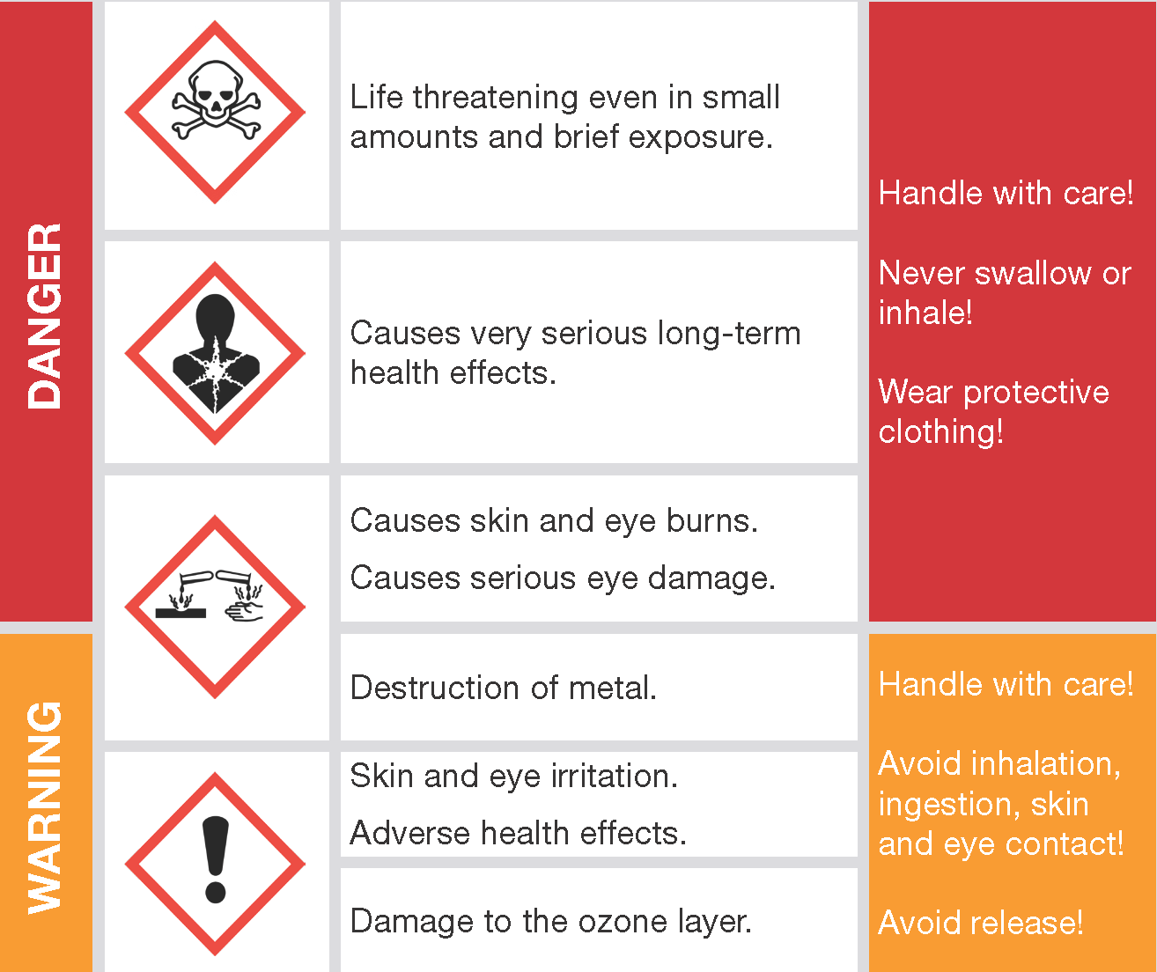
Can WE AVOID SEEING THESE ON OUR PRODUCTS

Slide 10
Delphis eco
The Product
The Product
?

Slide 11
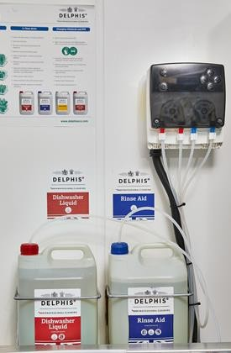
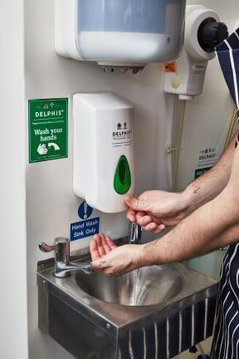
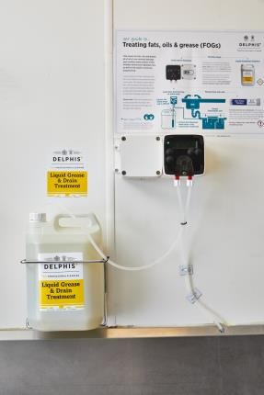
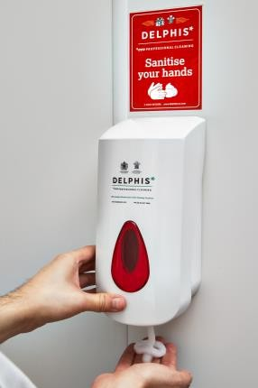
S TAT E OF T H e A RT C H E M I C A L D I S P E N S I N G S Y S T E M S

Slide 12
D R I V E N B Y P R OT E C T I N G T H E P L A N E T

Slide 13
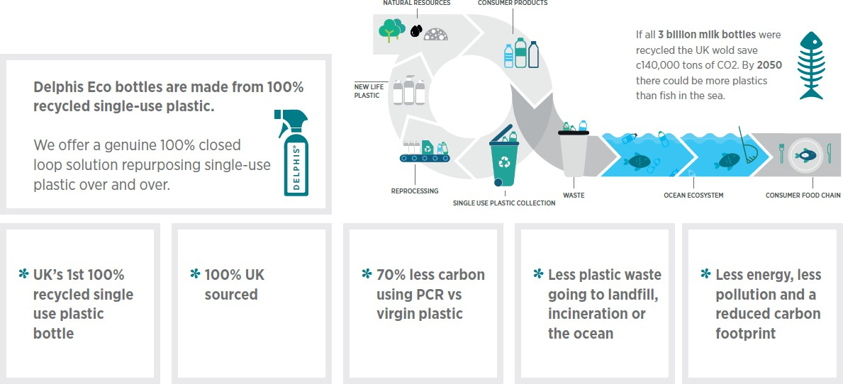
P A C K A G I N G I N N O V A T I O N
G I V I N G S I N G L E - U S E P L A S T I C A 2 ^{ND} L I F E

Slide 14
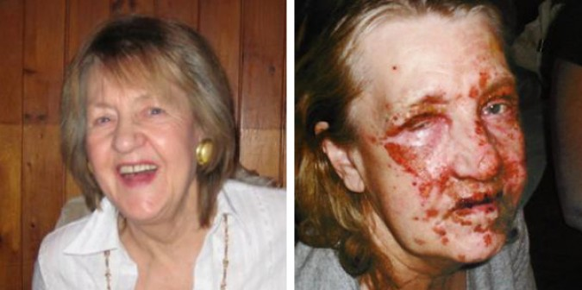

Slide 15
How newline can assist
?

Slide 16
Thank You For YOUR TIME

Slide 18
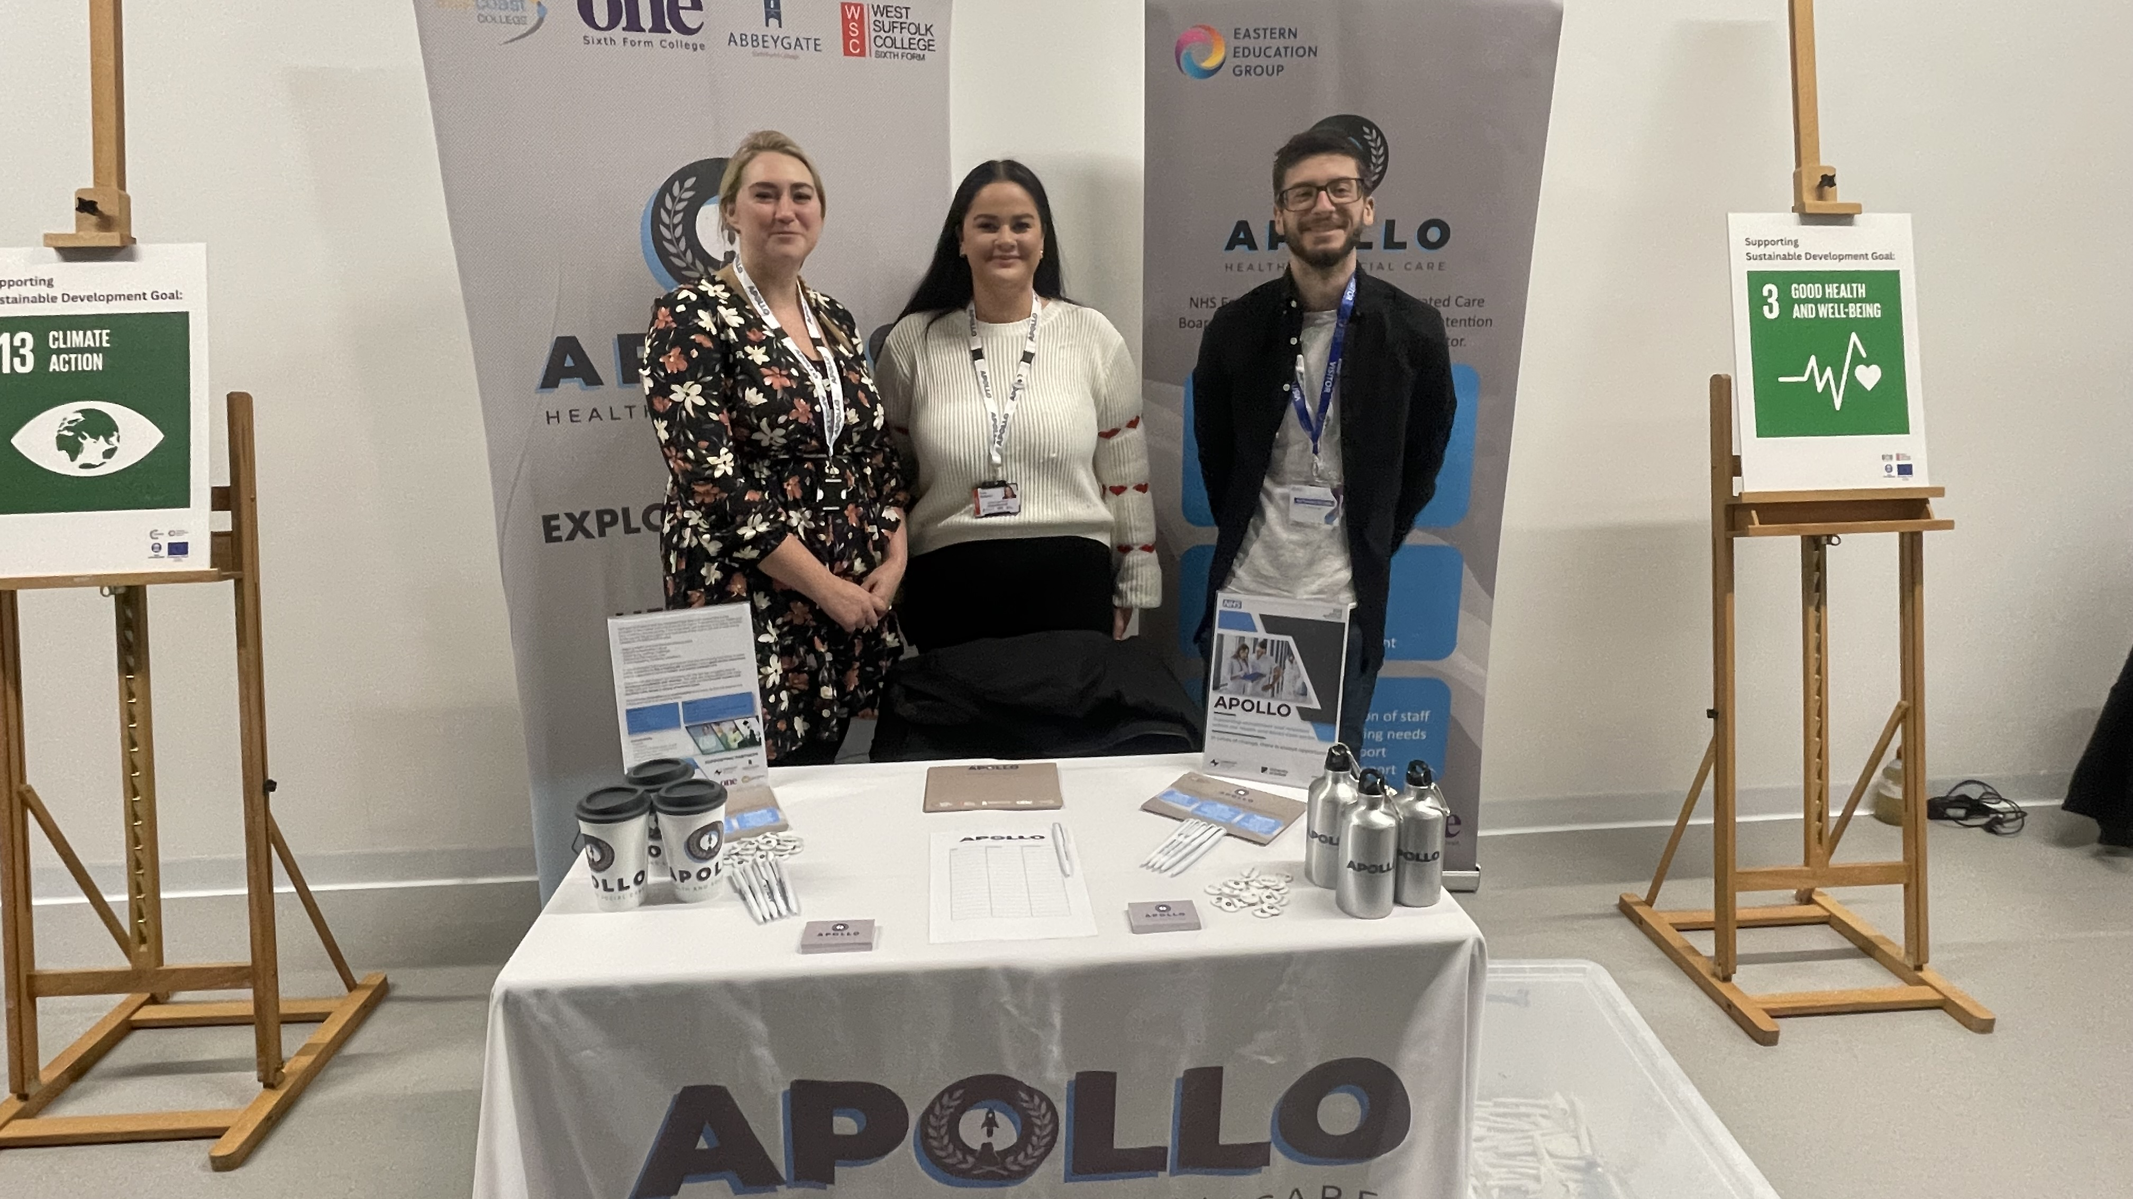
Who are we?
Felicity Deuchars – Project Lead
Emily McMahon – Inspire Lead
Jack Bundy – Project Direct delivery coordinator

Slide 19
What is Apollo?
NHS East of England and Integrated Care Board, pilot project aimed to strengthen the
health and care workforce in coastal and rural areas in Suffolk and Norfolk.
Innovation and sustainability is at the heart
Make health and care the best place to work
Improve leadership culture
Tackle staffing challenges
Ensure the community and those in need will receive holistic and person-centred care
Support providers with workforce recruitment and retention
Supportive of front-line ancillary roles across a variety of contract types.
Aims to recruit and support broader roles within the Health and Social Care sector (Admin, Physiotherapy, Hospitality).

Slide 20
Where are we operating?

Slide 21
What do we do for the community?
Work Readiness- CV Masterclasses and Interview Skills
Go out to the wider community enrol the public on to Apollo across Suffolk
and Norfolk
Run free ‘Introduction to Care’ courses
Operate DWP Swaps
Enrol learners on to Free Level 2 Qualifications (Dementia/Mental Health/Autism Awareness)
1:1 Mentoring and job coaching
Match participants with jobs
Offer travel subsidiary to attend courses and shadow shifts
Attend Careers Fairs in Schools
Arrange Class Talks
Signpost students to NHS Cadets and other local junior care academies

Slide 22
What do we do for Providers?
Offer free DBS for new starters
Offer training to upskill existing staff to meet evolving needs
The Level 2 Diplomas (NVQ style) provides core and optional units to support mandatory and organisation needs. Knowledge and skills are developed, and competency assessments prove ability.
Support you with recruitment
Match our participants with your job vacancies
Enrol your staff on to our Level 1 knowledge based care certificate and introduction to care courses
Management Support
Regional Funding Support
Support with retaining talent

Slide 23
Our courses
NHS Standard Care Certificate
Level 2 Understanding Mental Health
Level 2 Understand the context of Supporting Individuals with Learning Difficulties
Adult First Aid
Understanding Dementia
IT skills

Slide 24
Apollo Socials
Website- www.apollocareproject.co.uk
Facebook- www.facebook.com/apollowsc
Instagram- @apollo.wsc
LinkedIn

Slide 25
Any Questions?

Slide 26
Thank you for listening

Slide 27
Upcoming and new workshops

Slide 28
New CQC Health check Service for Social Care Providers
How it works:
We offer a contribution of up to £1000 towards the cost of a mock inspection conducted by a CDE or SCA approved provider. Simply complete the application form below and we will provide you with details of these providers.
Alternatively, you can opt to use an online toolkit to support your preparation. This service is provided by Quiq Solutions and recommended by Suffolk Care Association. Simply state your preference on the application form below.
Once you have had your inspection by one of the approved providers, simply send us a copy of the receipted invoice and we will arrange payment of the contribution via BACS.
Should you require any further details regarding the service, please dont hesitate to contact us via
info@caredevelopmenteast.co.uk

Slide 29
NEW TRAINING WORKSHOP
This training will be delivered by Lime Skills

Slide 31
Sign up to our newsletter to stay updated on our workshops

