Slide 1
Welcome to our March
Leaders in Care Network

Slide 2
Introducing today's speakers
Jamie Stewart, Transformation Manager Practice and Culture.
Mark Tattum-Smith, Digital Care Advisor (North), Reverie VR Project Lead
Lisa Elmy - Transformation Project Manager

Slide 3
Jamie Stewart
Transformation Manager, Practice and Culture
Suffolk County Council
Notes:
Will be speaking about Digital Ambition and Social Care Innovations.

Slide 4
Introduction to Digital Ambition
Goal: Enabling citizens and providers to access online tools and resources, empowering them to self-serve like never before.
Approach: Reducing administrative burdens, improving accessibility, and enhancing transparency for citizens and providers.

Slide 5
Overview of work underway:
AI Voice-to-Text Transcription
Objective: Reduce recording burdens for assessments and interactions, allowing staff to focus on care delivery.
Benefits: Faster documentation, improved accuracy, and streamlined processes.
Current Use Cases: Assessments, telephone calls, note-taking.

Slide 6
Supported Self-Assessment for Adults and Carers
Purpose: Empower citizens and carers to start and contribute to their assessments at their convenience.
Impact: Increases autonomy, enhances engagement, and supports person-centered planning.

Slide 7
Verified Accounts for Limited Record Access
Features: Allow adults, carers, and legal representatives to view key parts of their social care record.
Benefits: Enables them to update key information, track assessments, reviews, and support plans.

Slide 8
Digital Provider Informed Reviews:
Overview: Providers can contribute directly to a review or reassessment via the social care portal.
Benefits: Enhances provider involvement, improves accuracy of records, and supports efficient care planning.

Slide 9
Online Financial Assessment
Purpose: Provide early indication of assessed charges.
Benefits: Greater transparency for individuals, facilitating informed decision-making
and financial planning.

Slide 10
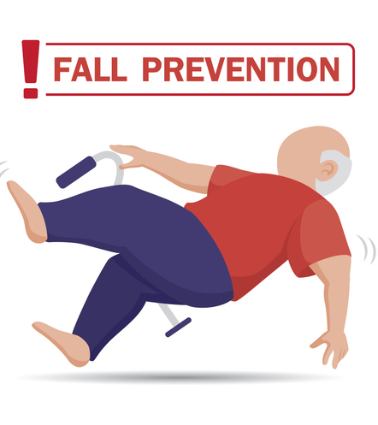
Innovative Falls Prevention and Management
CASSIUS Service and Falls Pilot:
As part of the Digitising Social Care programme, funding has been made available to explore and trial falls technology
We are piloting, installing Nobi smart lamps across a select number of care homes in West and East Suffolk to detect and prevent falls
Goal: Support falls prevention and risk management.
Outcomes: Improved safety and enhanced resident wellbeing.

Slide 11
Digital Social Care Records Integration
Vision: Collaborate across health and social care sectors to move toward online recording.
Provider Role: Encouraging providers to adopt digital records to streamline information sharing.
Part of the national Digitising Social Care programme ran by NHSE
Aim of the programme is to enable and support as many care providers as possible to move from paper recording to digital recording
Funding is available to CQC registered care providers to help towards the cost of implementing a Digital Social Care Record system
We have supplied funding to approx. 60 care providers, covering about 95 CQC locations
Already received some very positive case studies and working on benefits realisation

Slide 12
Questions?
What do you need from us to get involved?
How would you like to receive information in the future?
Is there anything else we can do to keep you updated?

Slide 13
Mark Tattum-Smith
Digital Care Advisor (North), Reverie VR Project Lead
Suffolk County Council
(Presentation in PDF format on different link on our website)
Notes:
Will be speaking about the Reverie VR Project for Social Care.

Slide 14
Lisa Elmy
Transformation Project Manager
Suffolk and North Essex ICB
Notes:
Speaking about ‘Age Well Social Care Support’

Slide 15
Age Well Social Care Support
Lisa Elmy-SNEEICB-IES Alliance Transformation
Notes:
Introductions
I am here 111 care homes line SBARD advance care planning further support

Slide 16
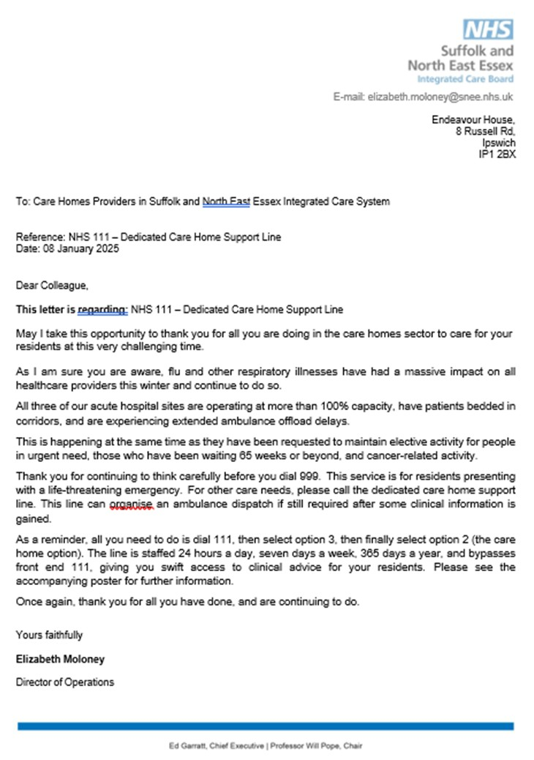
111 Care Homes Line
For non life-threatening emergencies
111 is here to help 24/7/365
The line bypasses front end 111
Get a call back within a one or two hour period.
Notes:
111 care homes line call 111 during the recorded info press 3 you will then be offered a care homes option front end 111 is bypassed so its important that you know an ambulance is not required at this point. (discuss)

Slide 17
SBARD Tool
SBARD is a structured method for communicating critical information that requires immediate attention and action
Five steps:
Situation
Background
Assessment
Recommendation
Decision
Notes:
SBARD is generally used to ensure that there is a standard approach in giving information to avoided misinterpretation of information by another professional.
You may be familiar with using this or already confident talking to another professional without the need of SBARD.
However, it’s a useful format to ensure all information is to hand and to proved evidence for your decisions and the reason for the use of the 111 route

Slide 18
The ReSPECT process when used as a part of an advanced care planning process for those in your care is a useful to support to the nature of interaction with Urgent Care services.
ReSPECT resources | Resuscitation Council UK
Notes:
Respect sure we are familiar with this process
further support hospices
clinical care plan for future treatment also can replace DNACPR
TEP advance escalation plan

Slide 19
Any Questions and Useful links
Bing Videos Telling Someone you are worried (SBARD)
Layout 1 SBAR communication Tool
Advance care planning and ReSpect –hospices: In Your Community - St Elizabeth Hospice How We Help - Compassionate Companion
For Copies of the 111 care homes line poster and letter email: carehomes@snee.nhs.uk
Dying is not as bad as you think Kathryn Mannix BBC ideas Bing Videos

Slide 20
CDE
Funded Training Opportunities
Mental Health First Aider
Oliver McGowan
Excel

Slide 21
Tuesday 25th March 1.30pm – IP City Centre
Tuesday 29th April 1.30pm – IP City Centre
Monday 10th March 9.30am – Active Business Centre, Bury St Edmunds

Slide 22
Tuesday 15th & 22nd April at 9.30am
Tuesday 13th & 20th May at 9.30am
Venue TBA
Monday 24th March 10.00am – Active Business Centre, Bury St Edmunds

Slide 23
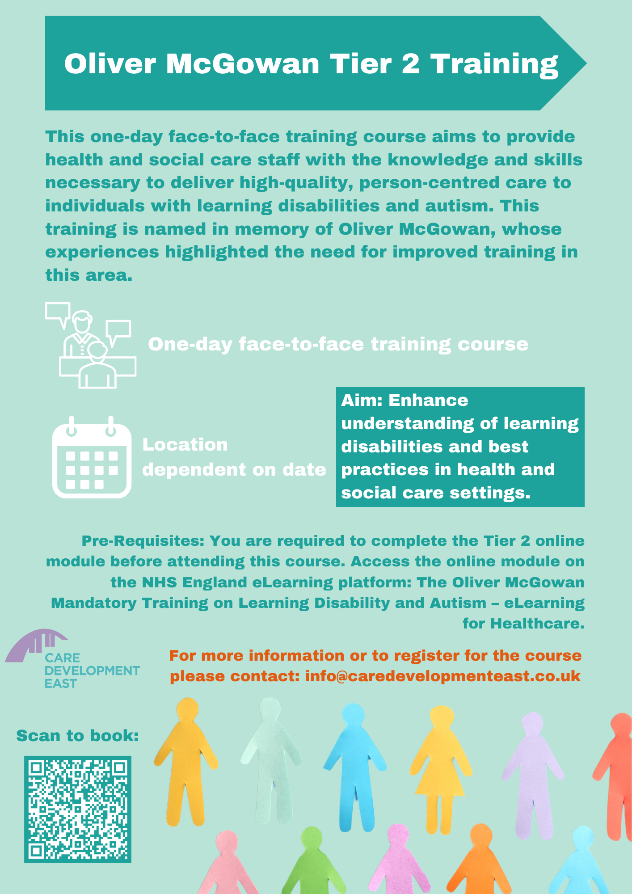
April – SOLD OUT
Wednesday 7th May, at 9.30am
St Andrews Castle,
Civil Ceremonies
6 Spaces left!
Notes:
If you have any questions or queries on space, please speak to Kelly.

Slide 24
Wellbeing Workforce Training for Managers – Your Interest?
🟢 Would you be interested in Wellbeing Workforce Training for managers? 🟢 How relevant do you find the following topics for your organisation?
Key Training Areas: ✅ Understanding the law and your legal responsibilities ✅ Spotting early signs of health and wellbeing issues in your organisation ✅ Implementing health and wellbeing best practices at work ✅ Managing staff absences and improving retention ✅ Developing support networks and promoting awareness ✅ Encouraging employees to address their own wellbeing
Let’s talk about it!

Slide 25
Upcoming CDE Events

Slide 26
Dementia Marketplace
Wednesday 25th June 2025
Suffolk Care Awards 2025
Thursdays 18th September 2025
Notes:
Dementia Marketplace – tickets coming soon

Slide 27
CARE AWARDS HOST
REVEAL
KAYE ADAMS
Notes:
Our celebrity Host for this year’s awards is Kaye Adams. You are all the first to know! Kaye Adams is a Scottish television presenter and journalist, renowned for her versatile broadcasting career. Kaye hosts the weekday morning show on BBC Radio Scotland from 9 am to 12 noon.
In 2022, she participated in the 20th series of BBC One's Strictly Come Dancing and has also been a host on the ITV talk show, Loose Women between 1999 and 2006. Kaye is also a co-patron of ‘Kindred’, a Scottish charity supporting families of young people with disabilities and mental health issues. We look forward to welcoming Kaye to Host our 2025 Suffolk Care Awards, it will be a night you do not want to miss!

Slide 28
SAVE THE DATES
Upcoming
Leaders in Care meetings

Slide 29
Thank you
Please scan the QR code to feedback on today’s meeting

